Slide 1
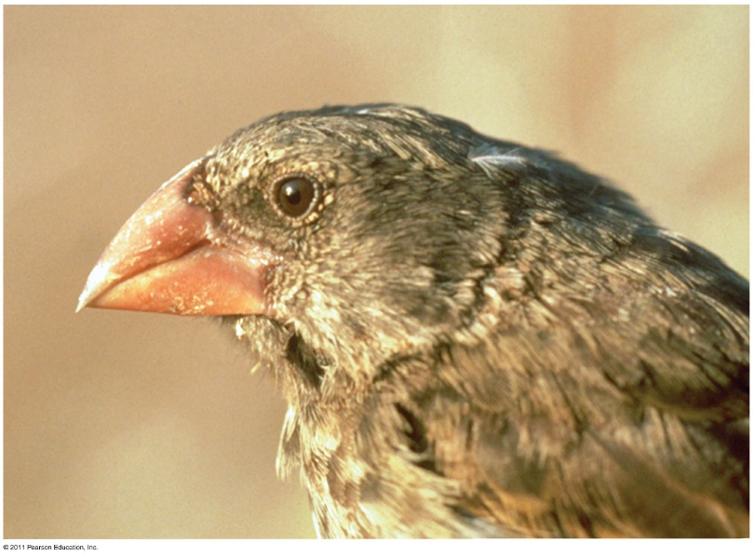
The Evolution of Populations
Chapter 23

Slide 2
What you must know:
How mutation and sexual reproduction each produce genetic variation.
The conditions for Hardy-Weinberg equilibrium.
How to use the Hardy-Weinburg equation to calculate allelic frequencies and to test whether a population is evolving.

Slide 3
Population genetics: study of how populations change genetically over time
Population: group of individuals that live in the same area and interbreed, producing fertile offspring

Slide 4
Gene pool: all of the alleles for all genes in all the members of the population
Diploid species: 2 alleles for a gene (homozygous/heterozygous)
Fixed allele: all members of a population only have 1 allele for a particular trait
The more fixed alleles a population has, the LOWER the species’ diversity

Slide 5
Hardy-Weinberg Principle
Hardy-Weinberg Principle: The allele and genotype frequencies of a population will remain constant from generation to generation
…UNLESS they are acted upon by forces other than Mendelian segregation and recombination of alleles
Equilibrium = allele and genotype frequencies remain constant

Slide 6
The Hardy-Weinberg Theorem
The Hardy-Weinberg theorem describes a population that is not evolving (this is rarely the case)
Can be used to measure whether the observed genotype frequencies in a population differ from the frequencies predicted by the equation (is the population changing?).

Slide 7
Conditions for Hardy-Weinberg equilibrium
No mutations.
Random mating.
No natural selection.
Extremely large population size.
No gene flow.
If at least one of these conditions is NOT met, then the population is EVOLVING!

Slide 8
Hardy-Weinberg Principle
Allele Frequencies:
Gene with 2 alleles : p, q
p = frequency of dominant allele (A) q = frequency of recessive allele (a)
Note:
1 – p = q
1 – q = p
p + q = 1

Slide 9
Hardy-Weinberg Equation
Genotypic Frequencies:
3 genotypes (AA, Aa, aa)
p² = AA (homozygous dominant)
2pq = Aa (heterozygous)
q² = aa (homozygous recessive)
p² + 2pq + q² = 1

Slide 10
Strategies for solving H-W Problems:
If the question refers to ALLELE frequency, use p+q=1
If the question refers to PEOPLE or POPULATIONS, use p2+2pq+q2=1
You will almost always be given the RECESSIVE allele info (q or q2) because if it’s dominant you won’t know if it’s homozygous or heterozygous.

Slide 11
Conditions for Hardy-Weinberg Equilibrium
The Hardy-Weinberg theorem describes a hypothetical population
In real populations, allele and genotype frequencies DO change over time

Slide 12
What you must know:
How mutation and sexual reproduction each produce genetic variation.
The conditions for Hardy-Weinberg equilibrium.
How to use the Hardy-Weinburg equation to calculate allelic frequencies and to test whether a population is evolving.

Slide 13
Solving Hardy-Weinberg Problems
https://www.youtube.com/watch?v=xPkOAnK20kw

Slide 14
Causes of evolution

Slide 15
Genetics vocab review:
Allele – different forms of a trait (ex: the trait for eye color could be blue, brown, green, etc)
Dominant – the stronger gene
Recessive – the weaker gene (only expressed if no dominant allele is present)
Homozygous – two of the same alleles
Can be homozygous dominant or homozygous recessive
Heterozygous – one dominant allele, one recessive allele
Phenotype – physical expression of gene
Genotype – letters used to represent the alleles

Slide 16
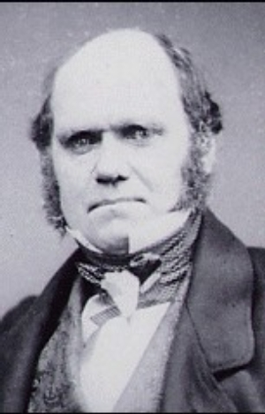
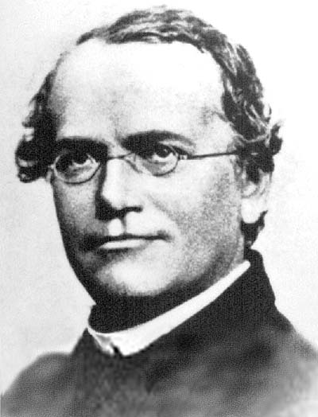
Darwin did not know how organisms passed traits to offspring
1866 - Mendel published his paper on genetics
Mendelian genetics supports Darwin’s theory → Evolution is based on genetic variation

Slide 17
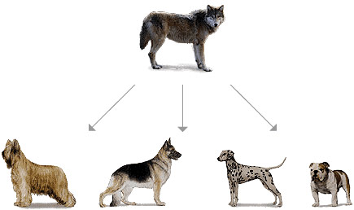
Smallest unit of evolution
Microevolution: change in the allele frequencies of a single population over generations (still uses the same mechanisms as macroevolution)

Slide 18
Minor Causes of Evolution:
#1 - Mutations
Rare, very small changes in allele frequencies
Point (one base change) vs. chromosomal (delete, duplicate, rearrange, etc)
#2 – Sexual Selection/Nonrandom mating
Affect genotypes, but not allele frequencies (crossing over)
Major Causes of Evolution:
Natural selection, genetic drift, gene flow (#3-5)

Slide 19
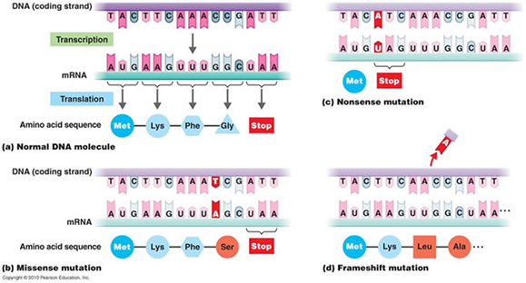
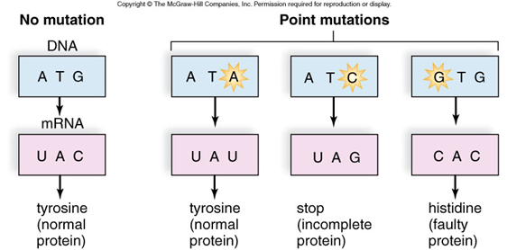
1. Mutation
Change in DNA
Mutation rates are low in animals and plants
The average is about one mutation in every 100,000 genes per generation
Mutations are more rapid in microorganisms like bacteria and viruses
Produce the variation in gene pools that contributes to differences among individuals (polymorphism – “many forms”)
Ex – blood types

Slide 20
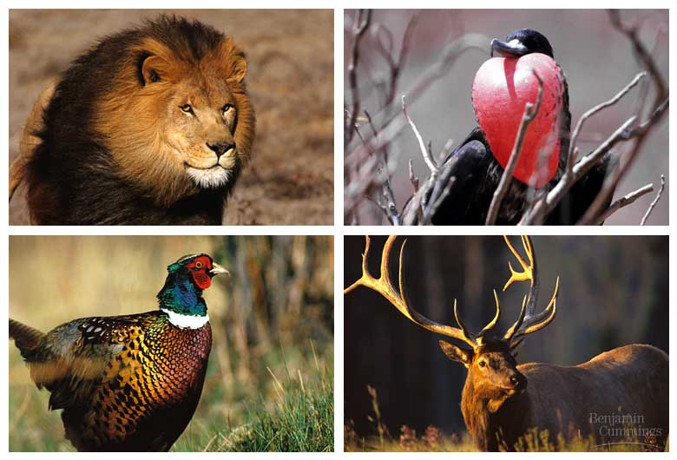
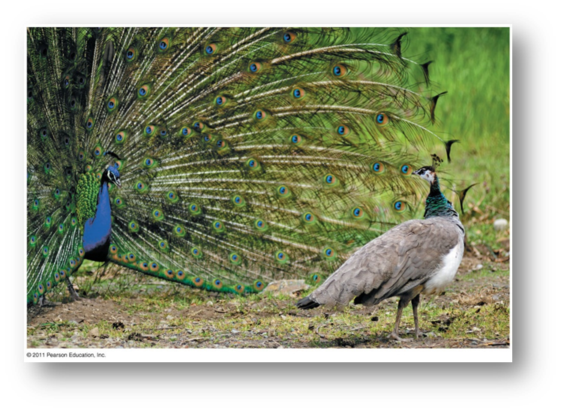
Sexual selection
Intrasexual – selection within same sex (eg. M compete with other M)
Intersexual – mate choice (eg. F choose showy M)
Sexual dimorphism: difference between 2 sexes
Size, color, ornamentation, behavior

Slide 21
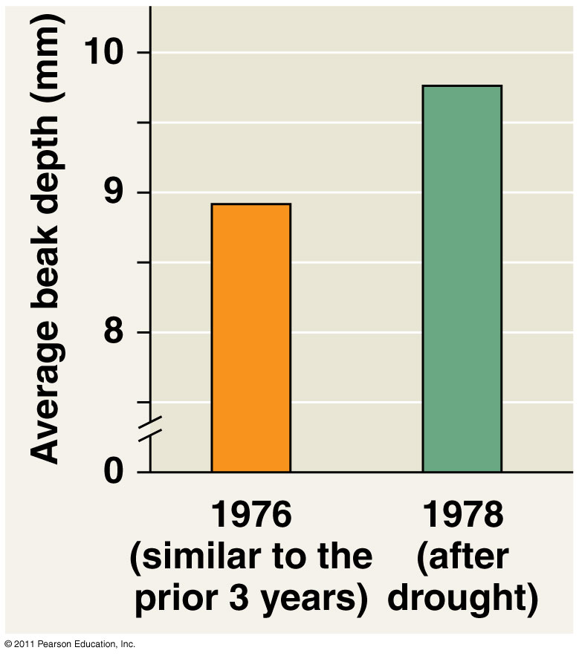
Major Causes of Evolution
#3 – Natural Selection
Individuals with variations better suited to environment pass more alleles to next generation

Slide 22
Major Causes of Evolution
#4 – Genetic Drift-describes how allele frequencies fluctuate unpredictably from one generation to the next
Small populations have greater chance of fluctuations in allele frequencies from one generation to another
Genetic drift tends to reduce genetic variation through losses of alleles
Examples:
Founder Effect
Bottleneck Effect

Slide 23
Genetic Drift

Slide 24
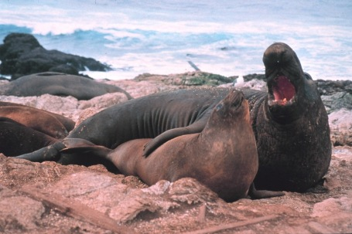
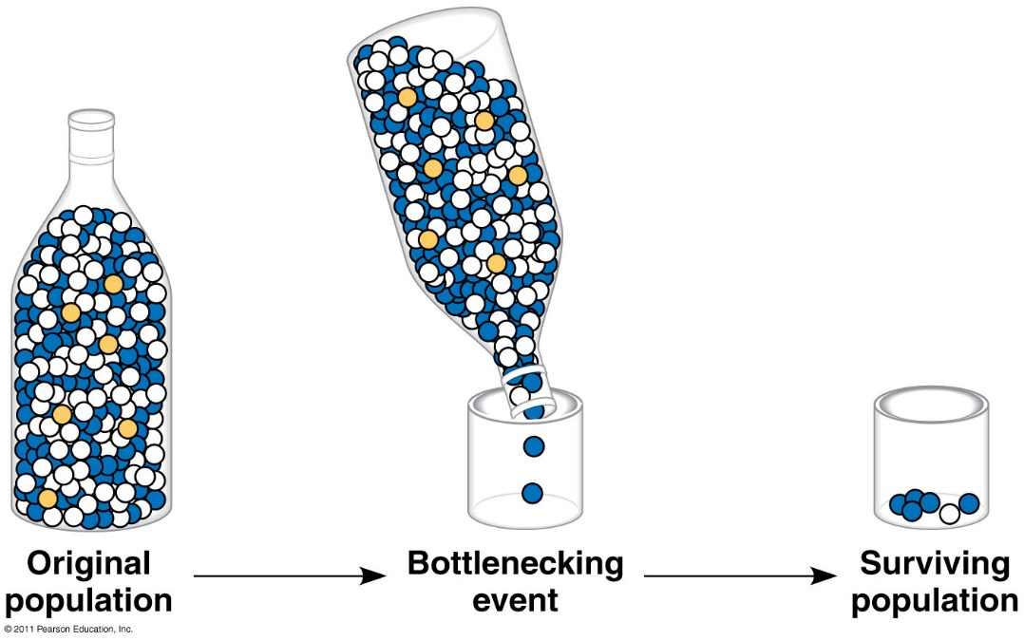
Bottleneck Effect
Sudden change in environment (fire, drought, etc)drastically reduces population size
Ex -cheetahs are sufficiently closely related to one another that transplanted skin grafts do not provoke immune responses
Northern elephant seals hunted nearly to extinction in California

Slide 25
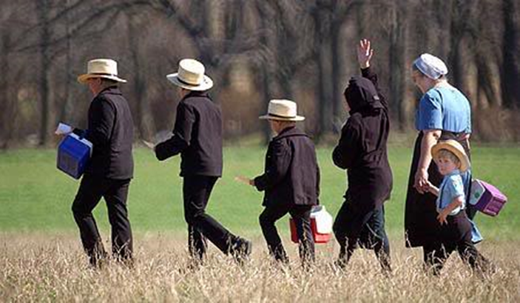
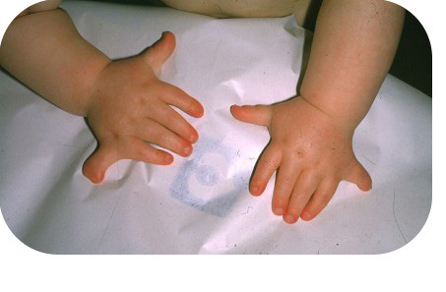
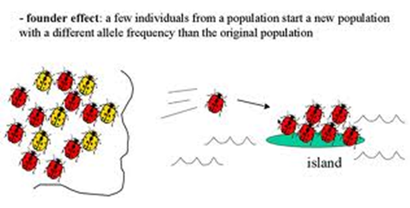
Founder Effect
Polydactyly in Amish population
A few individuals isolated from larger population
This small population size means that the colony may have:
reduced genetic variation from the original population.
a non-random sample of the genes in the original population.
Certain alleles under/over represented

Slide 26
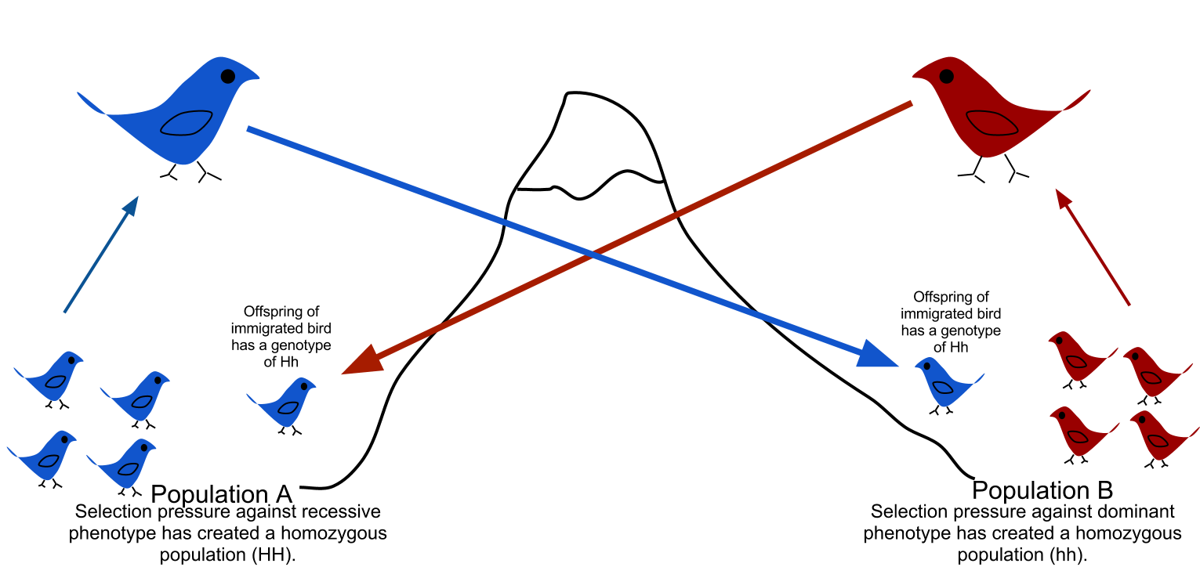
Major Causes of Evolution
#5 – Gene Flow (Immigration and Emigration)
Movement of fertile individuals between populations
Gain/lose alleles
Reduce genetic differences between populations over time

Slide 27
How does natural selection bring about adaptive evolution?

Slide 28
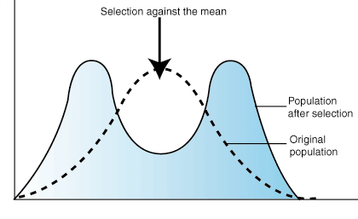
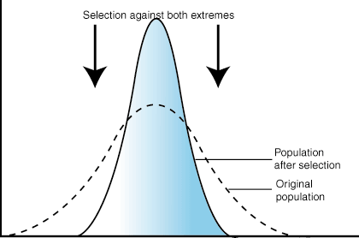
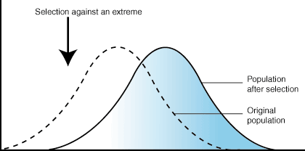
Fitness : the contribution an individual makes to the gene pool of the next generation
Natural selection can alter frequency distribution of heritable traits in 3 ways:
Directional selection
Disruptive (diversifying) selection
Stabilizing selection

Slide 29
Natural selection can alter frequency distribution of heritable traits in 3 ways:
Selection favors certain genotypes by acting on the phenotypes of certain organisms
Three modes of selection:
Directional- favors individuals at one end of the phenotypic range
Disruptive/Diversifying- favors individuals at both extremes of the phenotypic range
Stabilizing- favors intermediate variants and acts against extreme phenotypes

Slide 31
Sample Problem
Define the following examples as directional, disruptive, or stabilizing selection:
Tiger cubs usually weigh 2-3 lbs. at birth
Butterflies in 2 different colors each represent a species distasteful to birds
Brightly colored birds mate more frequently than drab birds of same species
Fossil evidence of horse size increasing over time

Slide 32
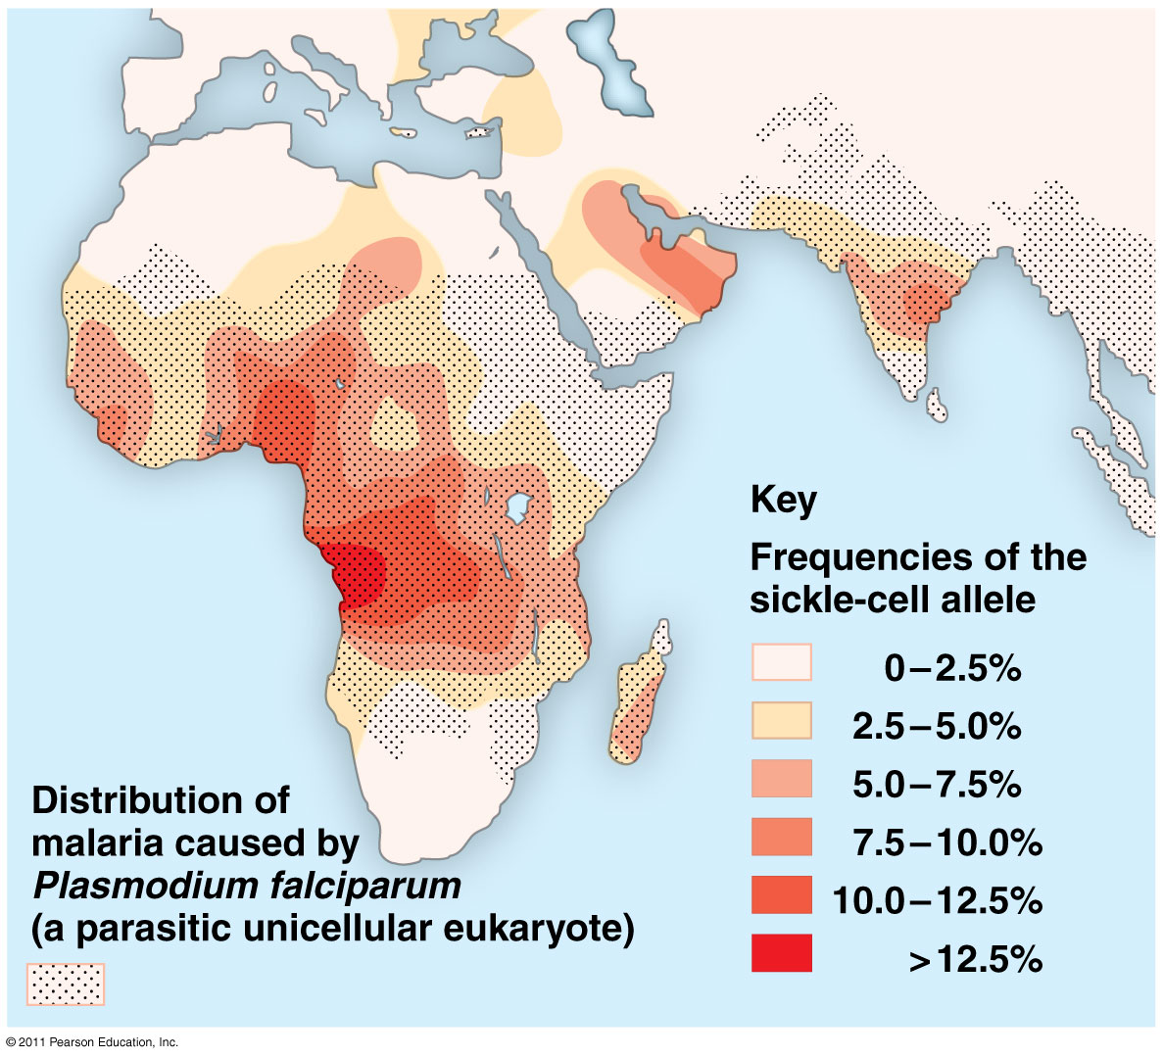
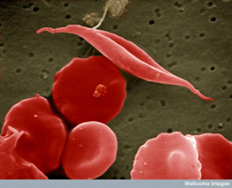
Preserving genetic variation
Diploidy: hide recessive alleles that are less favorable
Heterozygote advantage: greater fitness than homozygotes
eg. Sickle cell disease

Slide 33
Natural selection cannot fashion perfect organisms.
Selection can act only on existing variations.
Evolution is limited by historical constraints.
Adaptations are often compromises.
Chance, natural selection, and the environment interact.

Slide 34
What you must know:
How mutation and sexual reproduction each produce genetic variation.
The conditions for Hardy-Weinberg equilibrium.
How to use the Hardy-Weinburg equation to calculate allelic frequencies and to test whether a population is evolving.

Slide 35
HHMI Video: Natural Selection in Humans
Running Time: 14:03 min

