Slide 1
Ch. 23 Warm-Up
The allele fort he ability to roll one’s tongue is dominant over the allele for the lack of this ability. In a population of 1000 individuals, 360 show the recessive phenotype. How many individuals would you expect to be homozygous dominant and heterozygous for this trait?
Use directional, stabilizing or disruptive selection to answer the following:
The mice in the Arizona desert have either dark or light fur.
Birds produce 4-5 eggs per clutch
Average human baby weighs 7 lbs.
Darwin's finches and beak size during drought

Slide 2
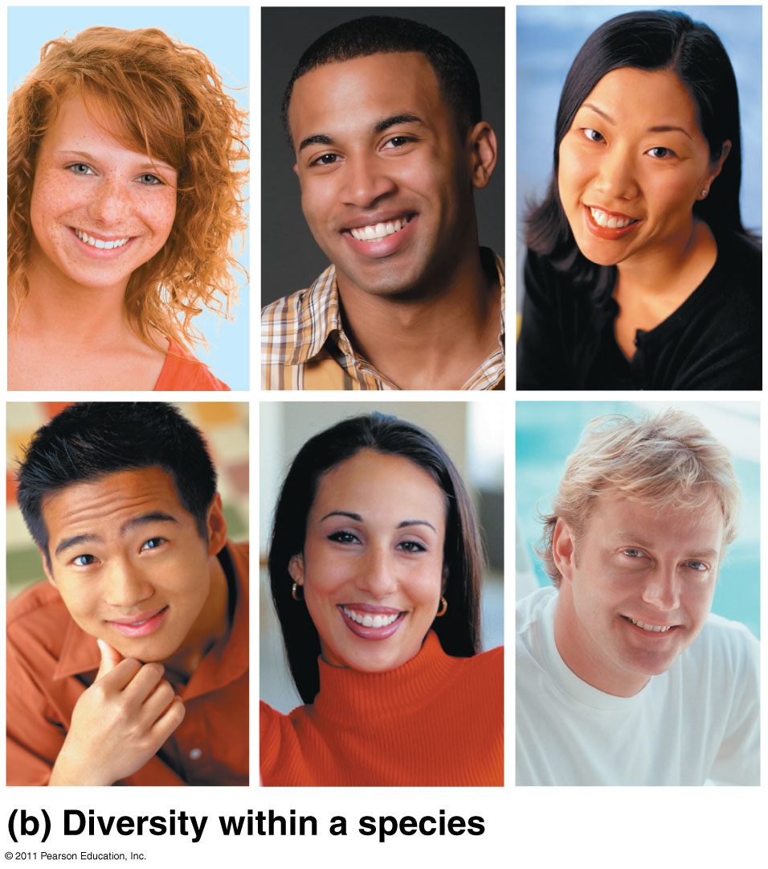
Chapter 24
The Origin of Species

Slide 3
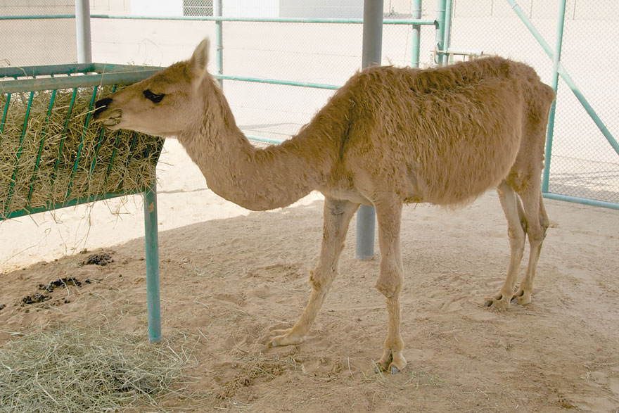
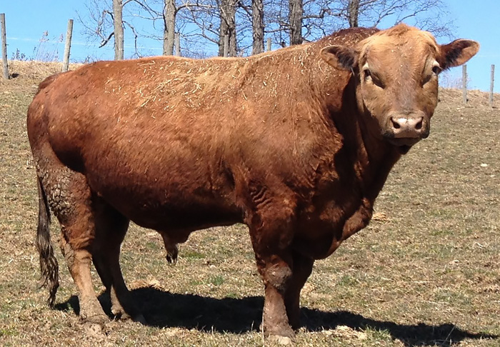
Defines a species as a population or group of populations whose members have the potential to interbreed in nature and produce viable, fertile offspring

Slide 4
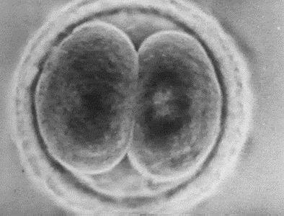
Reproductive Isolation
Reproductive isolation is the existence of biological factors (barriers) that impede two species from producing viable, fertile hybrids
A zygote is the initial cell formed when two gamete cells are joined

Slide 5
Prezygotic Barriers:
Impede mating/fertilization
Types:
Habitat isolation
Temporal isolation (active times)
Behavioral isolation
Mechanical isolation
Gametic isolation
Postzygotic Barriers:
Prevent hybrid zygote from developing into viable adult
Types:
Reduced hybrid viability
Reduced hybrid fertility
Hybrid breakdown

Slide 6
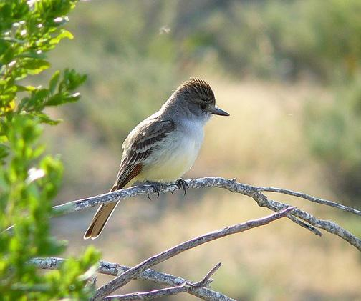
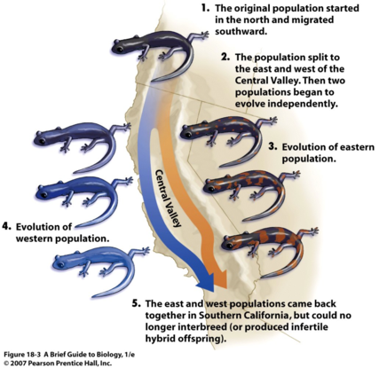
Prezygotic barriers cont:
1. Habitat isolation: Two species encounter each other rarely, or not at all, because they occupy different habitats, even though not isolated by physical barriers
Flycatchers (birds) are found in different habitats in the same area. One species prefers open woods and farmland; one frequents beech trees; one is found in alders, one in conifer woods, and one in willowy thickets.

Slide 7
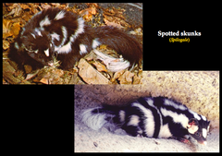
2. Temporal isolation: Species that breed at different times of the day, different seasons, or different years cannot mix their gametes

Slide 8
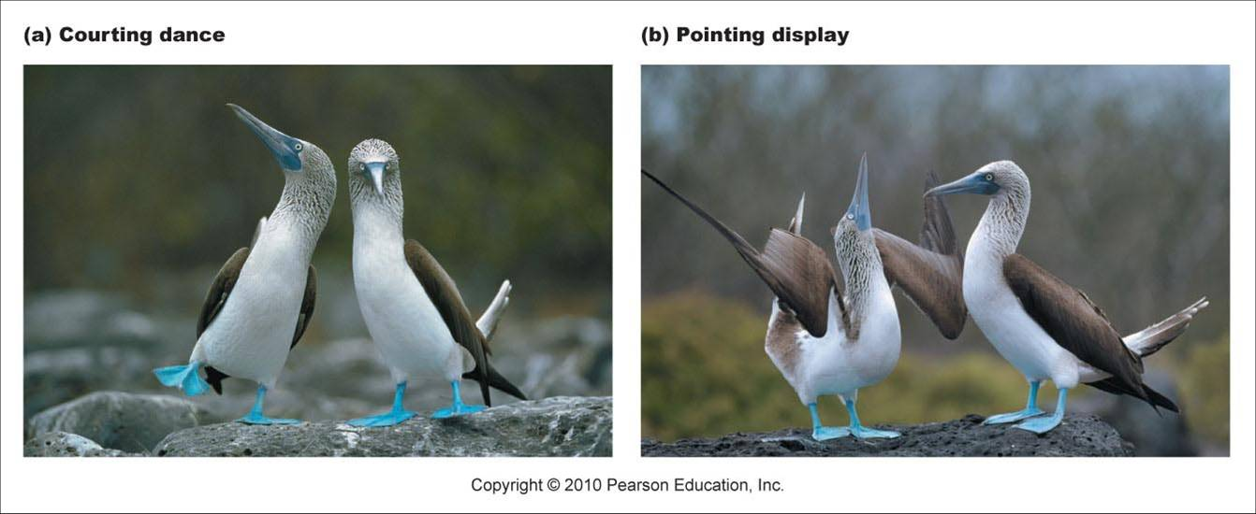
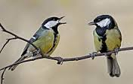
Prezygotic barriers cont.
3. Behavioral isolation: Courtship rituals and other behaviors unique to a species are effective barriers
Courtship rituals are only understood by species that share the same communication system

Slide 9
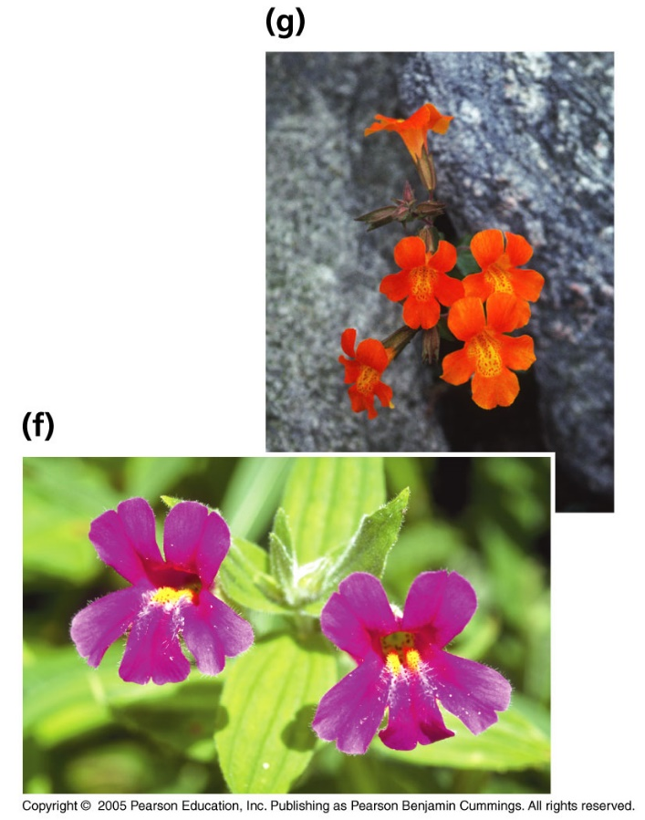
Prezygotic barriers cont.
4. Mechanical isolation: Morphological differences can prevent successful mating
the genital organs of different species are incompatible
The flowers of black sage and white sage are structurally different and are pollinated by different species of insects. In this example, each insect species pollinates flowers of only one of the sage species. Therefore, interbreeding does not occur.

Slide 10
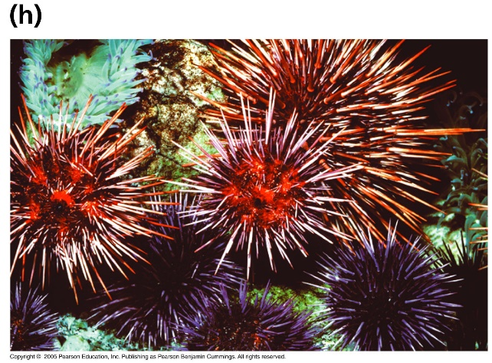
Prezygotic barriers cont.
5. Gametic isolation: the egg and sperm of different species are incompatible.
Gametic isolation is particularly important in aquatic environments because many aquatic animals release their gametes into the water, where fertilization takes place.

Slide 11
Postzygotic barriers prevent the hybrid zygote from developing into a viable, fertile adult:
Reduced hybrid viability
Reduced hybrid fertility
Hybrid breakdown

Slide 12
Postzygotic barriers
1. Reduced hybrid viability: Genes of the different parent species may interact and impair the hybrid’s development (lowered potential to survive compared to parents)

Slide 13
Postzygotic barriers
2. Reduced hybrid fertility: when two different species mate with one another and produce NONFERTILE offspring.
The reason for this is that the 2 species have different chromosome numbers, so when the offspring go to perform meiosis, their chromosomes cannot segregate in a manner that allows them to be fertile.
The classic example is when a horse is mated to a donkey, producing a mule. Both the horse and the donkey are obviously fertile, but the MULE is not, because it has a different chromosome number.

Slide 14
Postzygotic barriers
3. Hybrid breakdown: Some first-generation hybrids are fertile, but when they mate with another species or with either parent species, offspring of the next generation are feeble or sterile
an interspecies hybrid is viable and fertile, but subsequent generations harbour detrimental genetic abnormalities.

Slide 15
HHMI Video Clip: Reproductive Isolation and Speciation
Running Time: 2:38 min

Slide 16
How do new species form?
We can’t just breed two new species together….

Slide 17
Speciation = origin of species Two main modes of speciation:
Allopatric Speciation “other” “homeland”
Geographically isolated populations
Caused by geologic events or processes Evolves by natural selection & genetic drift
Eg. Squirrels on N/S rims of Grand Canyon
Sympatric Speciation “together” “homeland”
Overlapping populations within home range
Gene flow between subpopulations blocked by: polyploidy sexual selection habitat differentiation
Eg. polyploidy in crops (oats, cotton, potatoes, wheat)

Slide 18
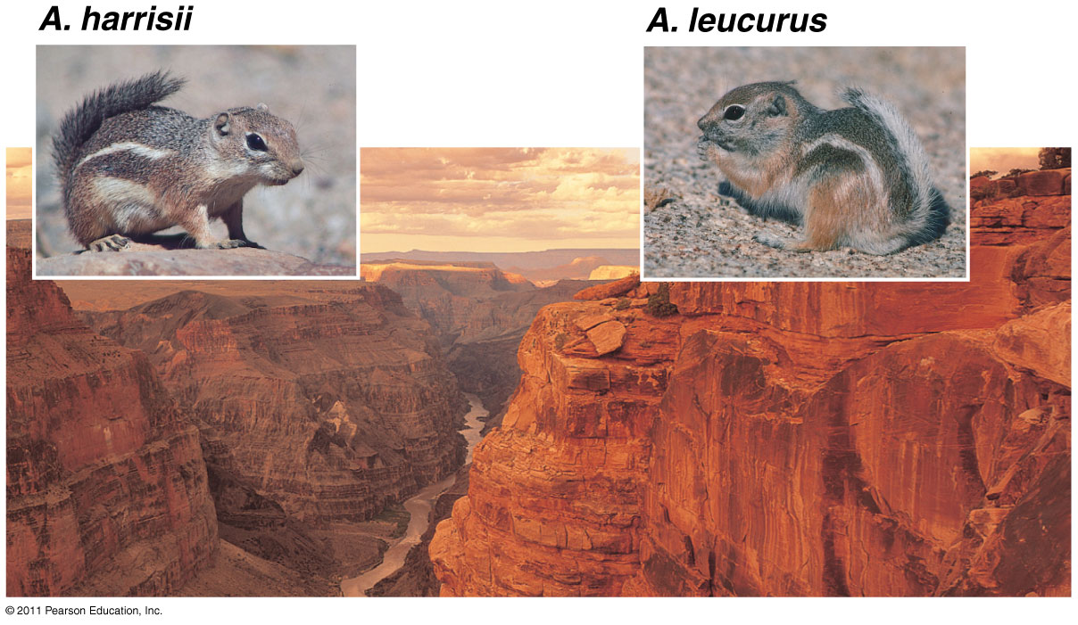
Allopatric speciation of antelope squirrels on opposite rims of the Grand Canyon

Slide 19
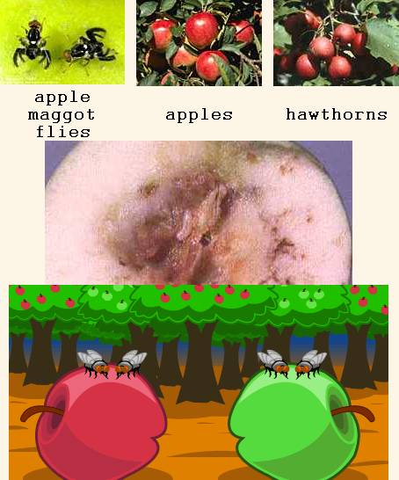
Sympatric (“Same Country”) Speciation
In sympatric speciation, no physical barrier dividing the population
Usually caused by mutations or a change in behavior
Ex – hawthorn fly

Slide 20
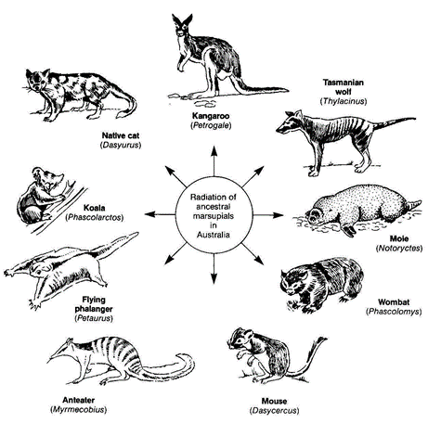
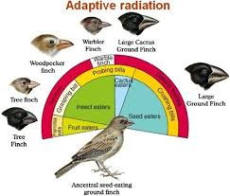
Many new species arise from a single common ancestor
Occurs when:
A few organisms make way to new, distant areas (allopatric speciation)
Environmental change → extinctions → new niches for survivors
Founding Parents

Slide 21
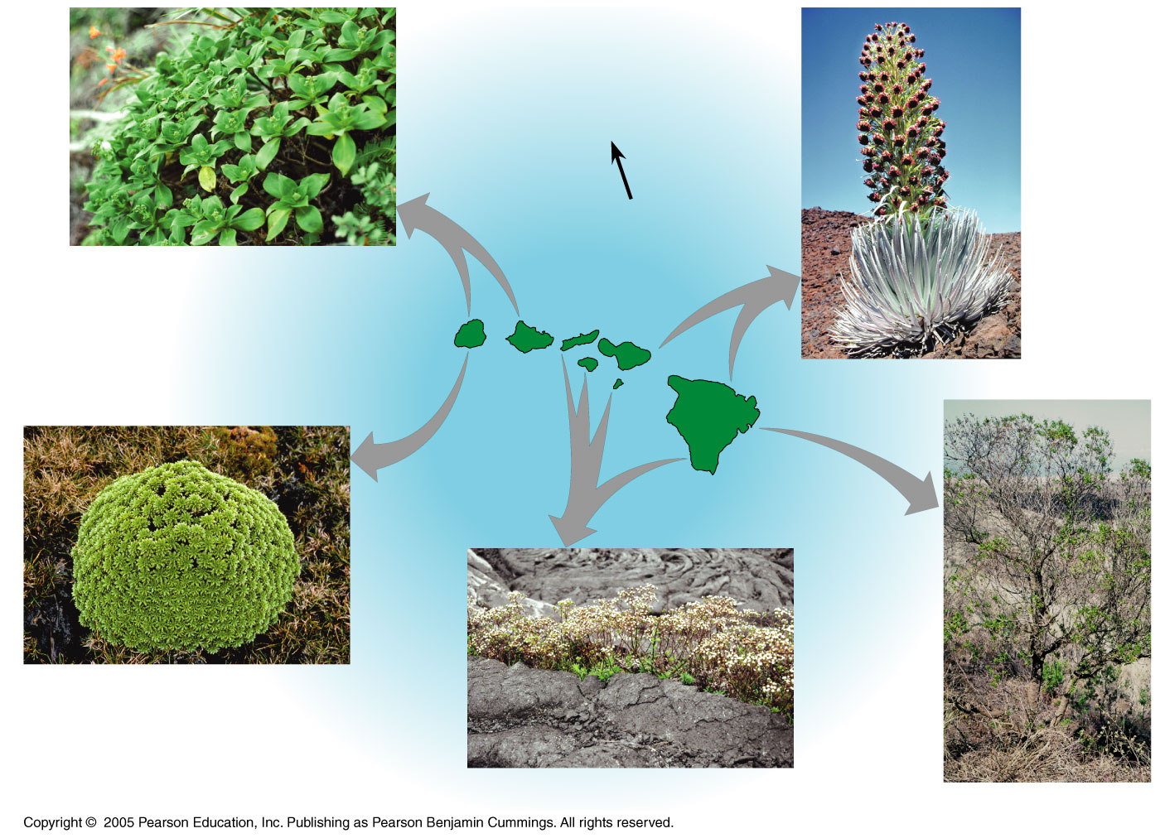
Adaptive Radiation: Hawaiian plants descended from ancestral tarweed from North America 5 million years ago
N
Dubautia laxa
1.3
million
years
KAUAI
5.1
million
years
MOLOKAI
MAUI
OAHU
3.7
million
years
LANAI
Argyroxiphium sandwicense
HAWAII
0.4
million
years
Dubautia waialealae
Dubautia scabra
Dubautia linearis

Slide 22
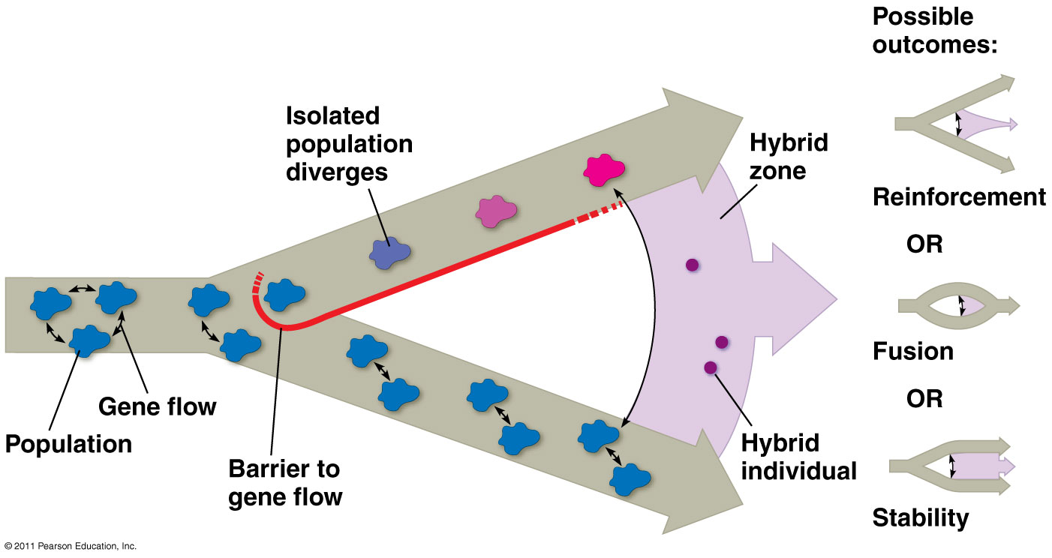
Hybrid Zones
Incomplete reproductive barriers
Possible outcomes: reinforcement, fusion, stability

Slide 23
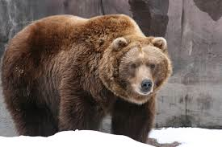
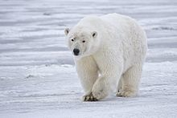
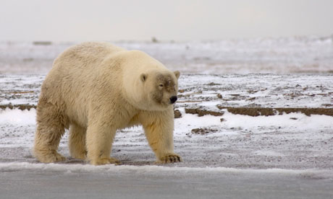
Grizzly
Polar
“Grolar” or “Pizzly”

Slide 24
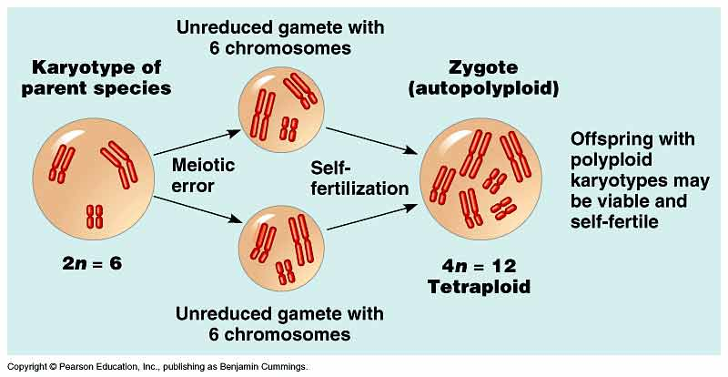
Polyploidy – sympatric speciation
Mutation
Polyploidy is presence of extra sets of chromosomes
It has caused the evolution of some plant species (speciation in sympatric plant populations)
Usually creates unviable offspring in animals
Gene flow is reduced between polyploidy and normal individuals (genetic isolation).
Occurs in Meiosis

Slide 25
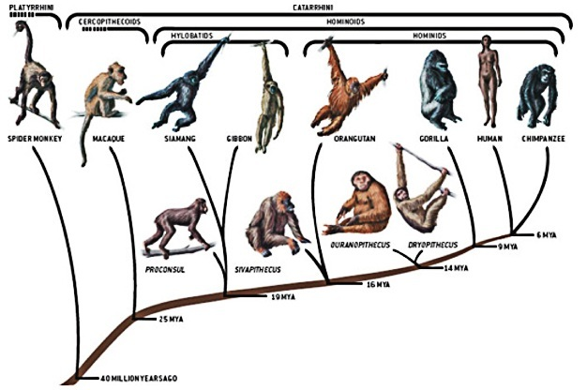
Macroevolutionary changes can accumulate through many speciation events
Macroevolutionary change is cumulative change during thousands of small speciation episodes

Slide 26
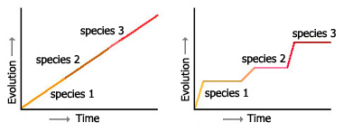
Tempo of Evolution
Gradualism
Common ancestor
Slow, constant change
Punctuated Equilibium
Eldridge & Gould
Long period of stasis punctuated by short bursts of significant change

Slide 27
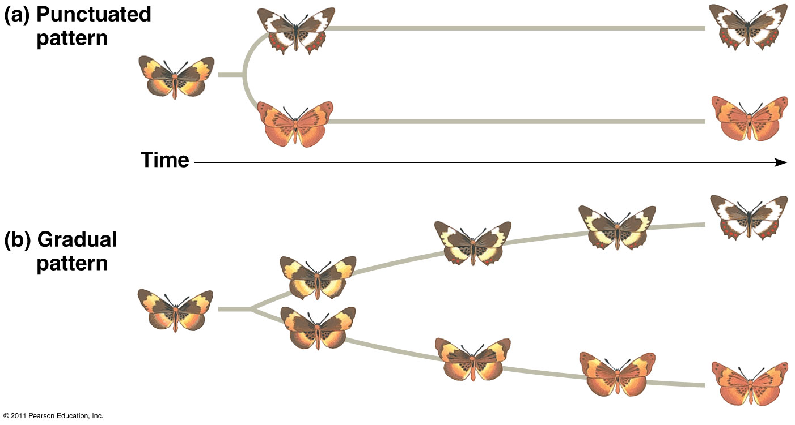

Slide 28
HHMI Short Film: Lizards in an Evolutionary Tree
Topic: Adaptive Radiation
Running Time: 17:50 min

Slide 29
Big Idea 1
Ch. 25 - Phylogeny

Slide 30
Overview: Investigating the Tree of Life
Phylogeny is the evolutionary history of a species or group of related species
The goal of phylogenetics is to create a phylogentic tree, which shows who is related to who
Speciation needs to occur to create a phylogenetic tree

Slide 31
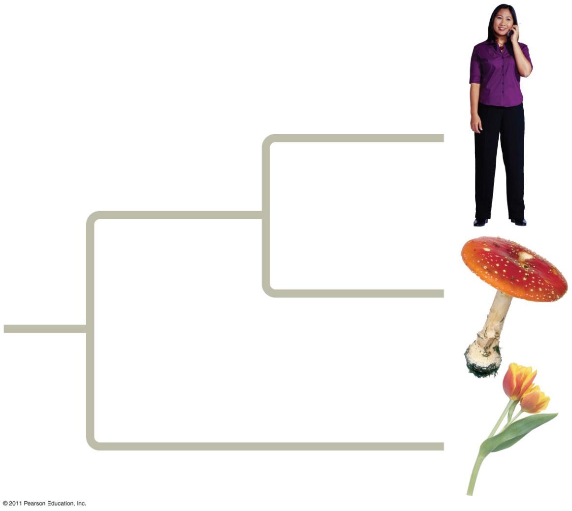
Tools used to determine evolutionary relationships:
Fossils
Morphology (homologous structures)
Molecular evidence (DNA, amino acids)
Who is more closely related?
Animals and fungi are more closely related than either is to plants.

Slide 32
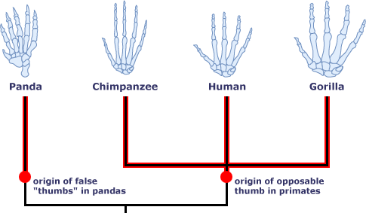
Sorting Homology from Analogy
When determining phylogeny, scientists need to distinguish whether a similarity is the result of homology or analogy
Homology is similarity due to shared ancestry
Analogy is similarity due to convergent evolution (Convergent evolution occurs when similar environmental pressures and natural selection produce similar (analogous) adaptations in organisms from different evolutionary lineages)
Ex – opossums have opposable thumbs like primates, even though they aren’t related

Slide 33
Hierarchical Classification
Linnaeus (father of modern taxonomy) introduced a system for grouping species in increasingly broad categories
*the more levels shared, the more organisms will have in common and the more closely related they will be

Slide 34
The Universal Tree of Life
The tree of life is divided into three great clades called domains: Bacteria, Archaea, and Eukarya
Archaea – prokaryotic (no nuclear membrane), distinct biochemistry and RNA markers from bacteria; oldest organisms on earth
Bacteria - prokaryotic cells possessing primarily diester lipids in their membranes and bacterial rRNA, no nuclear membrane
Eukarya -organisms that contain a membrane bound nucleus

Slide 35
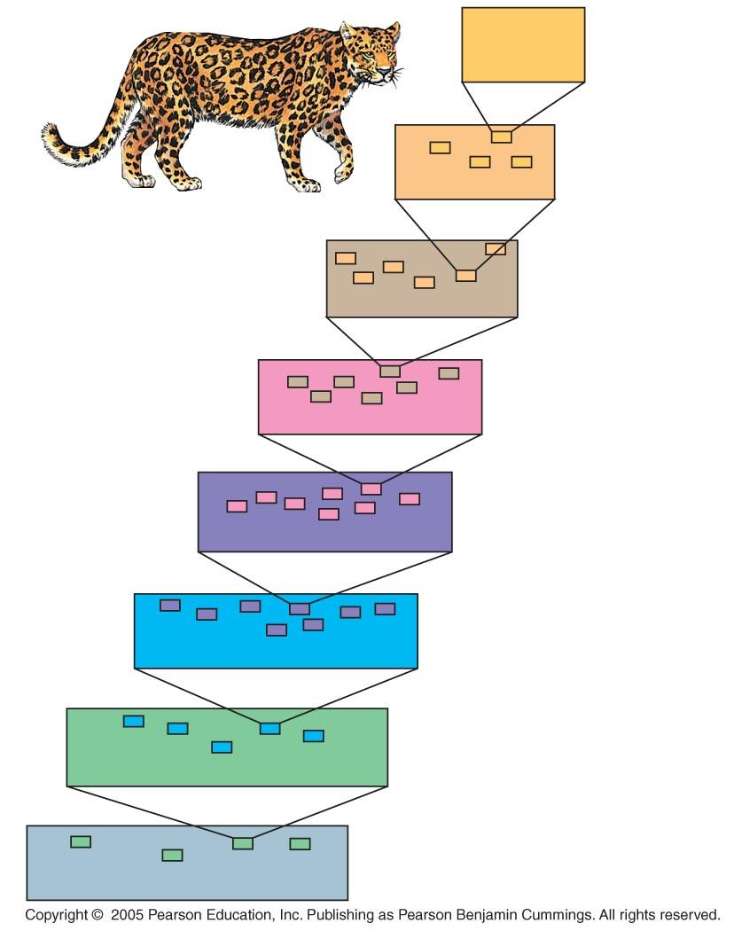
LE 25-8
Panthera
pardus
Species
Panthera
Genus
Felidae
Family
Carnivora
Order
Mammalia
Class
Chordata
Phylum
Animalia
Kingdom
Eukarya
Domain

Slide 36
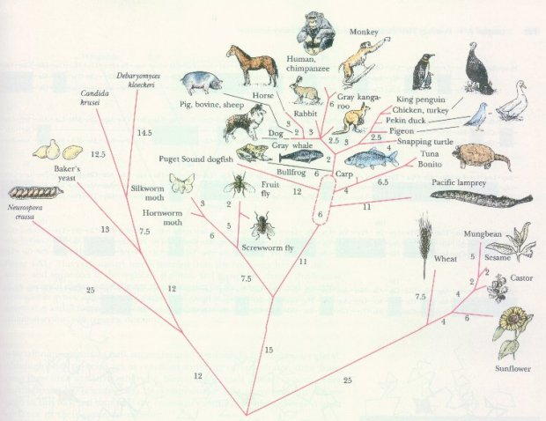
Linking Classification and Phylogeny
Scientists depict evolutionary relationships in branching phylogenetic trees
Each branch point represents the divergence of two species
“Deeper” branch points represent progressively greater amounts of divergence

Slide 37
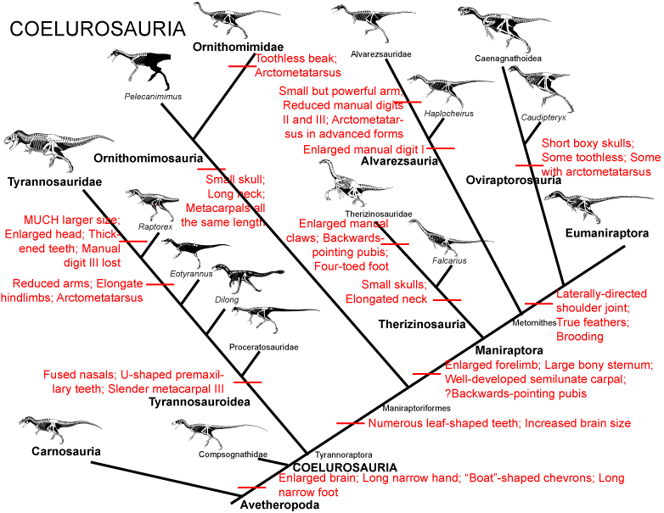
Phylogenetics informs the construction of phylogenetic trees based on shared characteristics
A cladogram depicts patterns of shared characteristics among taxa
Takes characteristics of certain organisms and putting together a hyposthesis of how you think they may be related
A clade is a group of species that includes an ancestral species and all its descendants
Difinitive answer of who’s related to who
Uses DNA AND shared characteristics (both derived and primitive)

Slide 38
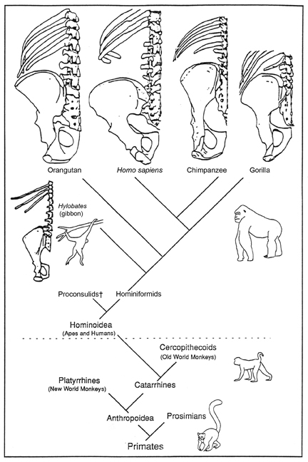
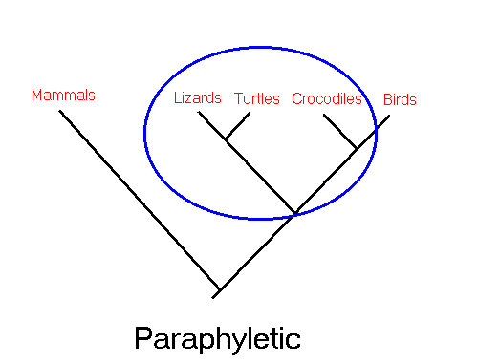
Shared Primitive and Shared Derived Characteristics
A shared derived character is an evolutionary novelty unique to a particular clade
derived is when a trait shows up that was NOT present in a common ancestor.
ancestral/primitive characters WERE present in a common ancestor.
E.G. Among primates, the relatively shortened and straight spine of a gorilla is a derived trait (it was not present in the common ancestor of all primates). However, the shortened spine of a gorilla is ancestral to apes (it is present in all apes and in the common ancestor of apes).

Slide 39
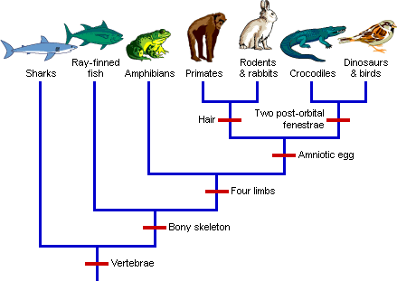
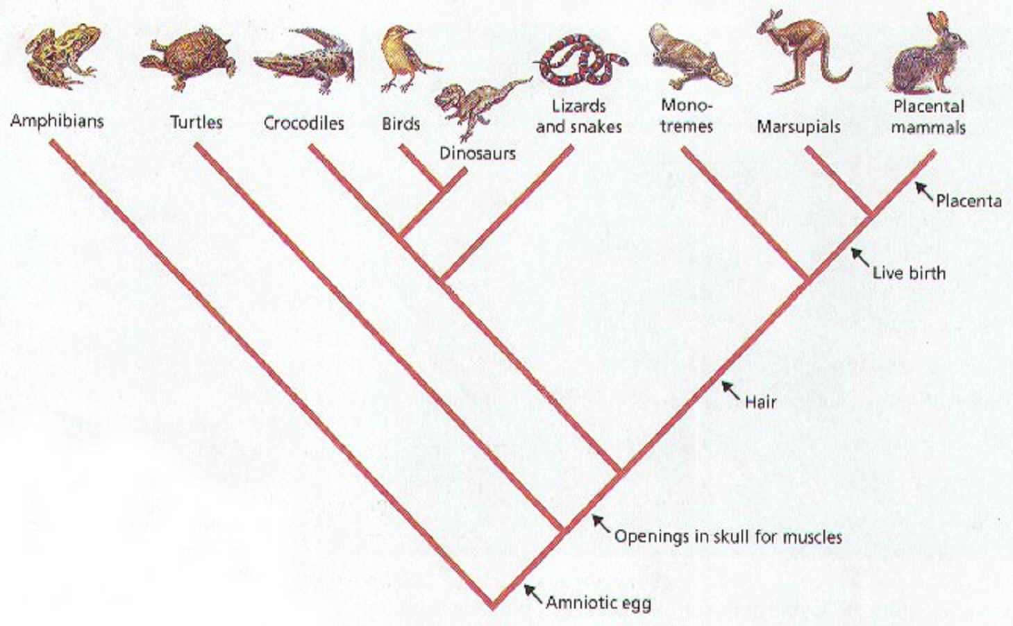
Outgroups
An outgroup is a species or group of species that has more ancestral traits than ingroups (other species on the graph)
closely related to the ingroups
“one of these things is not like the other”
Scientists compare each ingroup species with the outgroup to differentiate between shared derived and shared primitive characteristics

Slide 40
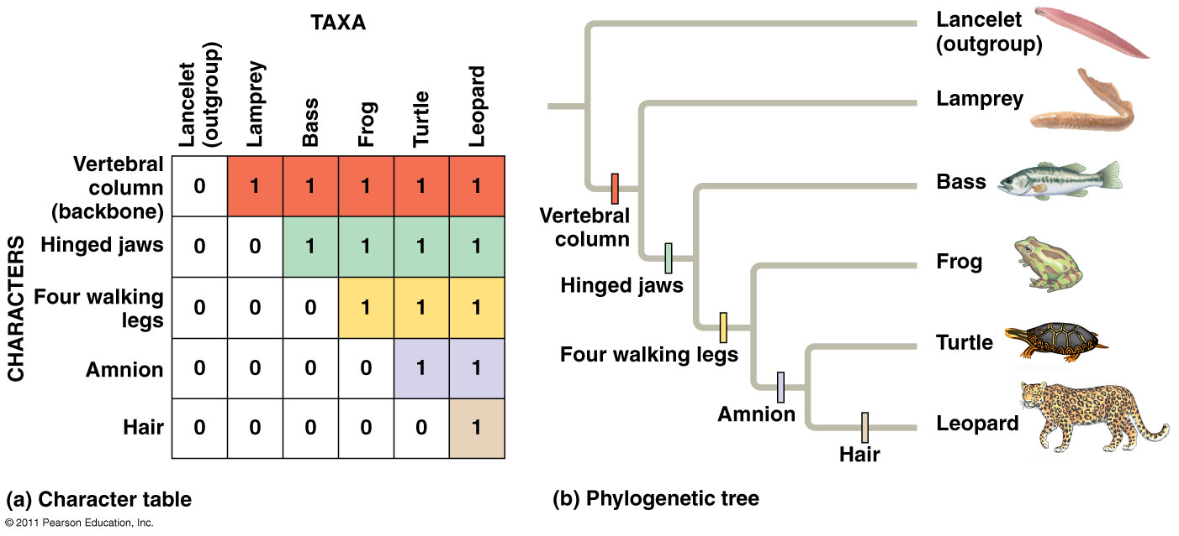
Constructing a phylogenetic tree
A 0 indicates a character is absent; a 1 indicates that a character is present.

Slide 41
Phylograms vs. cladograms
A phylogram is a phylogenetic tree that indicates the amount of evolution in addition to the branching order.
the length of a branch in a cladogram reflects the number of genetic changes that have taken place in a particular DNA or RNA sequence in that lineage and time

Slide 42
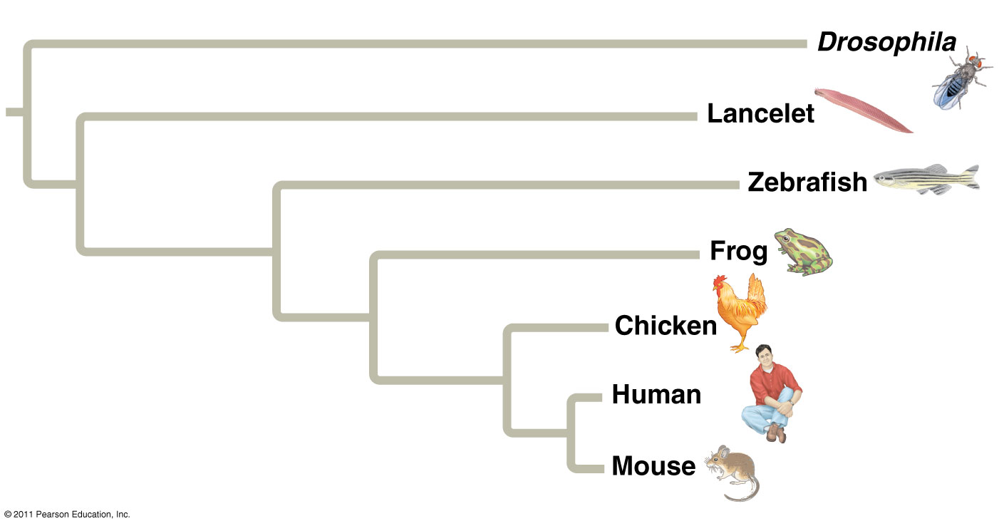
Branch lengths can represent genetic change

Slide 43
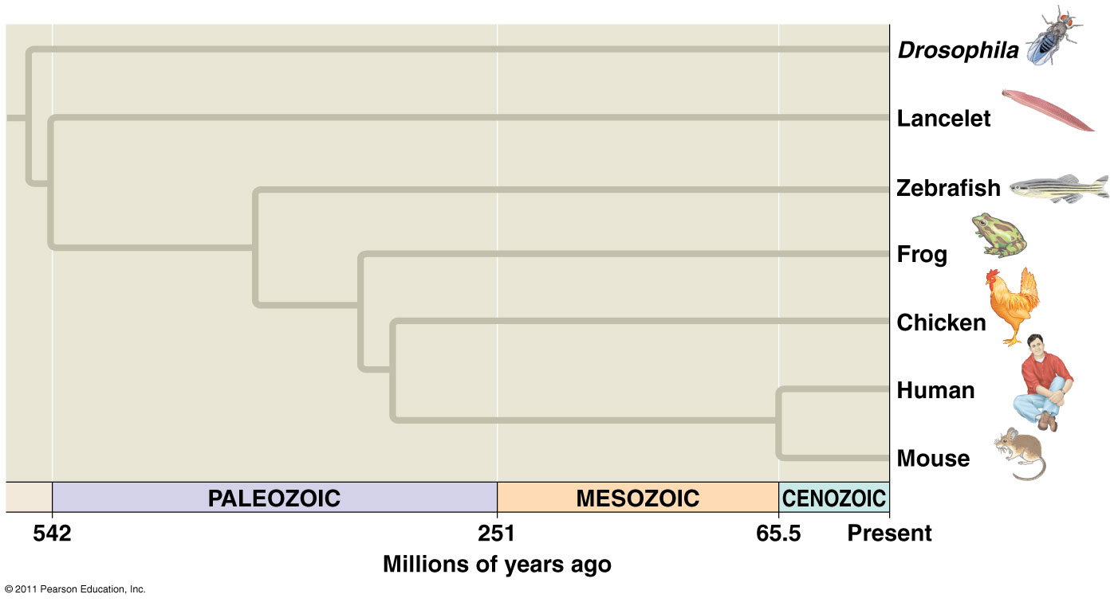
Branch lengths can indicate time

Slide 44
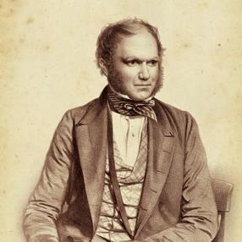
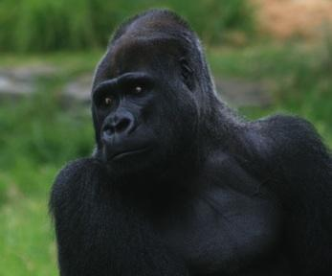
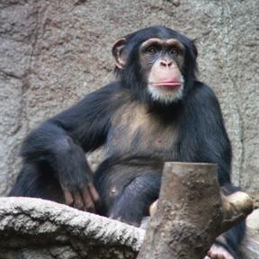
Human
Gorilla
Chimpanzee
IMAGES FROM: Wellcome Images / Wikimedia Commons

Slide 45
Extant species
Hypothetical ancestors
Human
Chimpanzee
Root
(common ancestor)
Branch
Gorilla
Outgroup

Slide 46
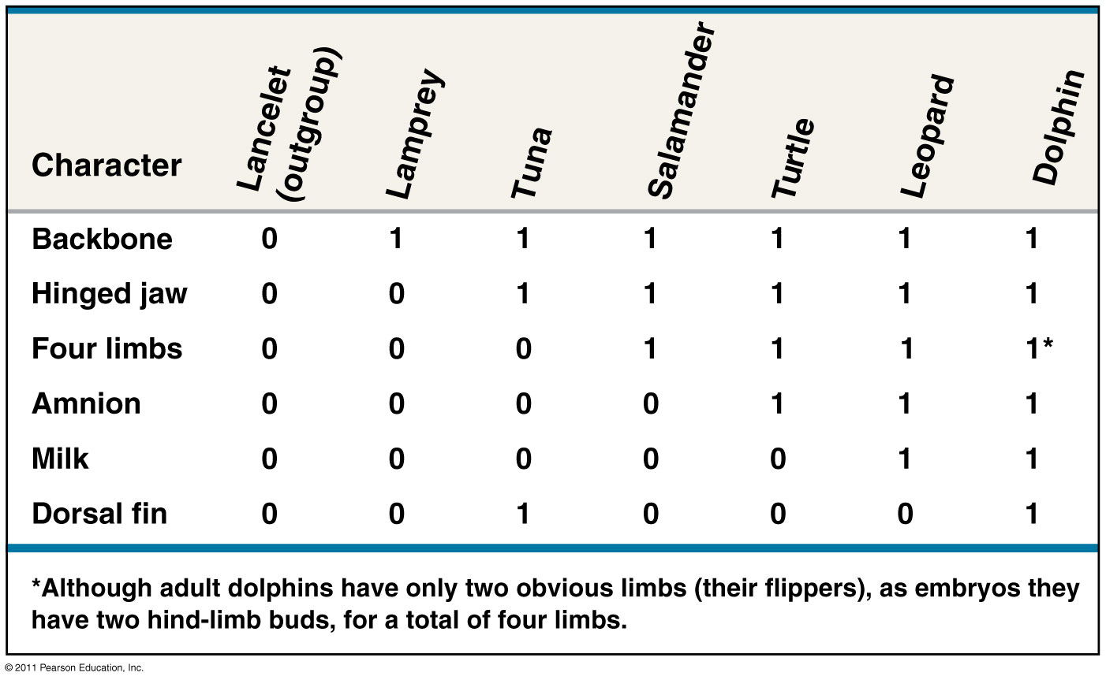
Draw a phylogenetic tree based on the data below. Draw hatch marks on the tree to indicate the origin(s) of each of the 6 characters.

Slide 47
Answer:

Slide 48
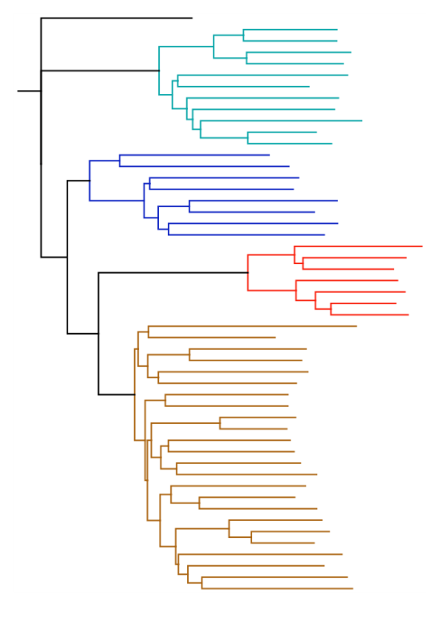
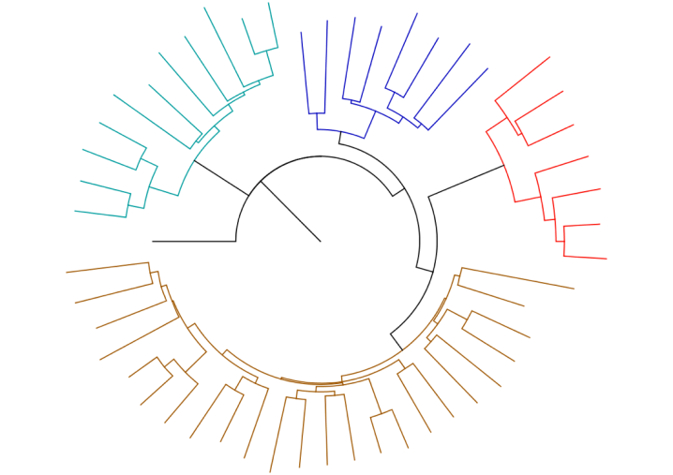
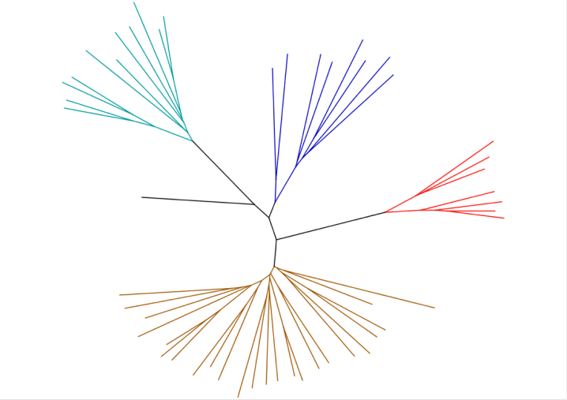
Various tree layouts
Circular (rooted) tree
Unrooted tree
Rooted tree

Slide 49
Bozeman Biology Cladograms
https://www.youtube.com/watch?v=ouZ9zEkxGWg&t=336s

Slide 50
Activity: Constructing a Cookie Phylogenetic Tree

Slide 51
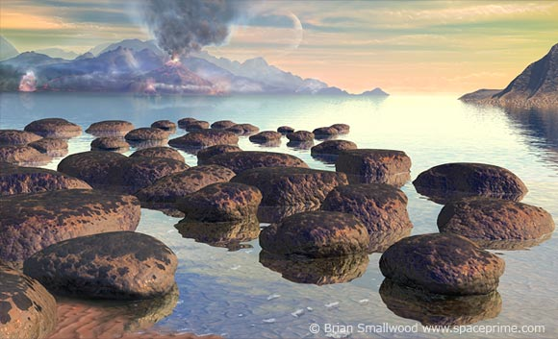
Early conditions on Earth

Slide 52
Earth = 4.6 billion years old
First life forms appeared ~3.8 billion years ago
How did life arise?
Small organic molecules were synthesized
Small molecules → macromolecules (proteins, nucleic acids)
Packaged into protocells (membrane-containing droplets)
Self-replicating molecules allow for inheritance
“RNA World”: 1st genetic material most likely RNA
First catalysts = ribozymes (RNA)

Slide 53
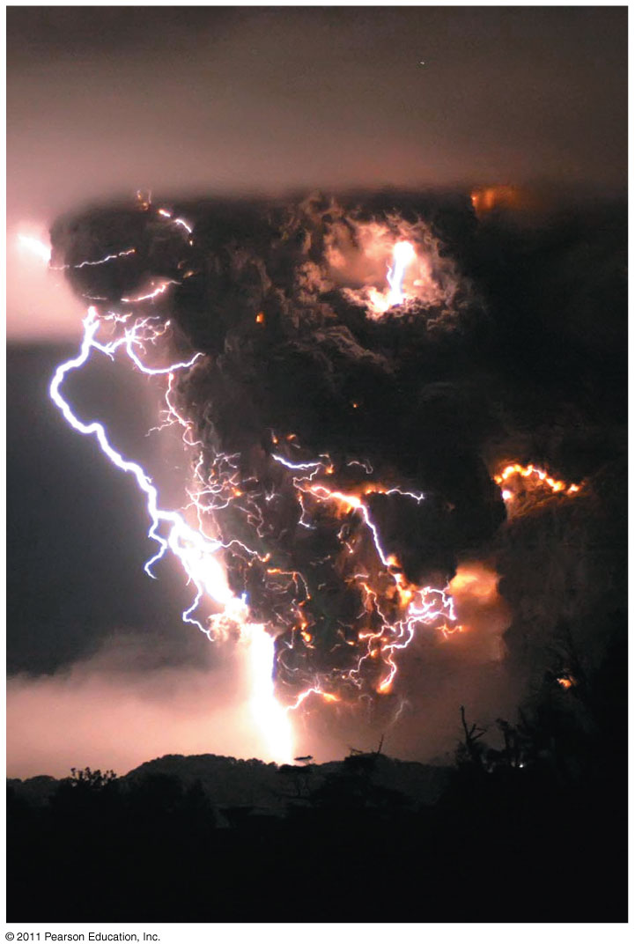
Synthesis of Organic Compounds on Early Earth
Oparin & Haldane:
Early atmosphere = H₂O vapor, N₂, CO₂, H₂, H₂S methane, ammonia
Energy = lightning & UV radiation
Conditions favored synthesis of organic compounds - a “primitive soup”

Slide 54
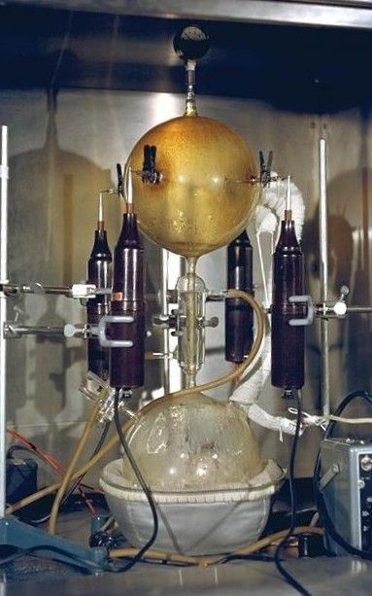
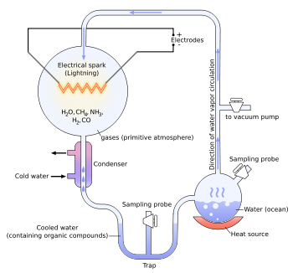
Miller & Urey:
Tested Oparin-Haldane hypothesis
Simulated conditions in lab
Produced amino acids

Slide 55
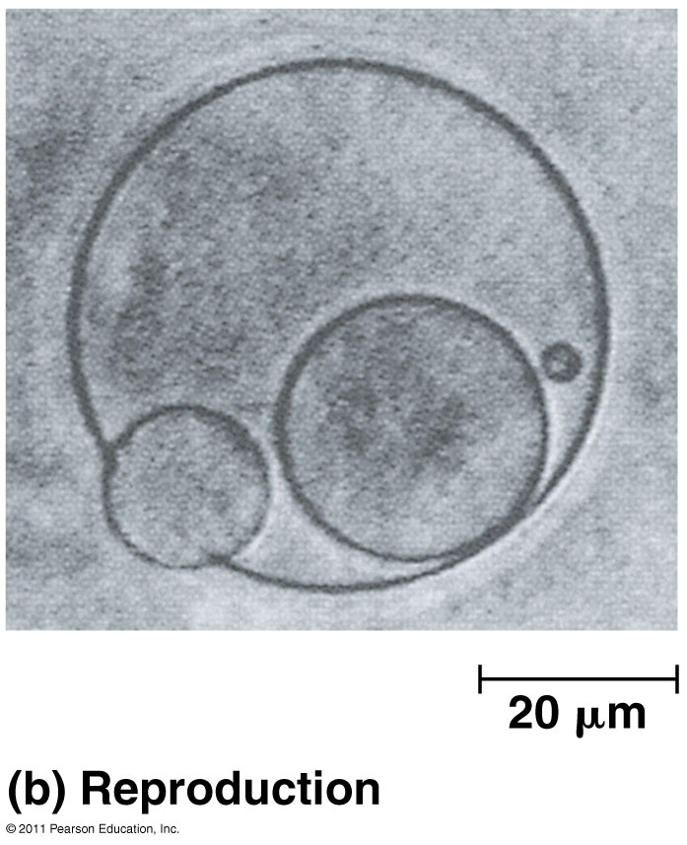
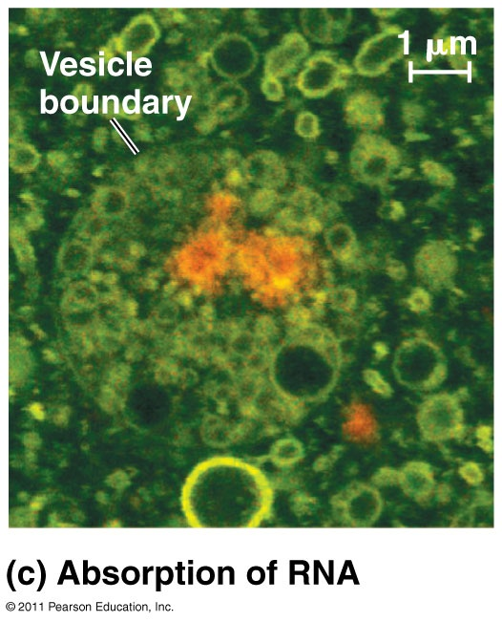
Protocells & Self-Replicating RNA

Slide 56
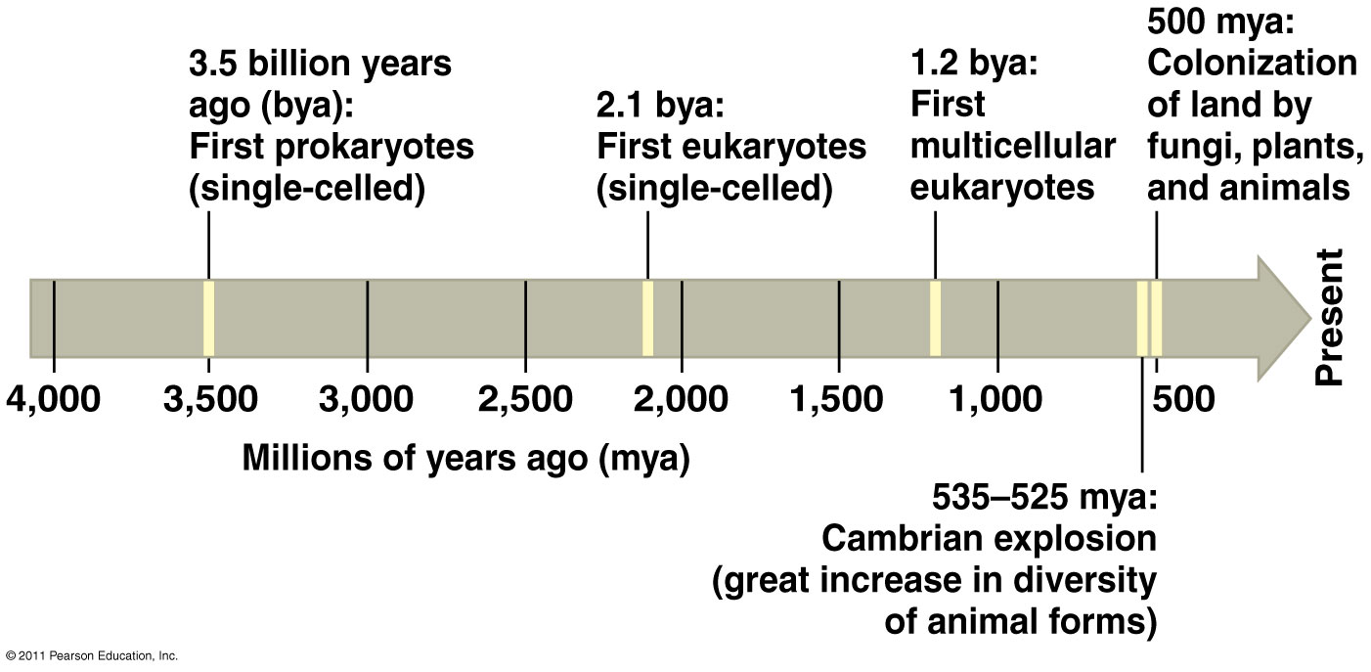
Key Events in Life’s History
O₂ accumulates in atmosphere
(2.7 bya)
Humans
(200,000)

Slide 57
Endosymbiont Theory
Mitochondria & plastids (chloroplasts) formed from small prokaryotes living in larger cells
Evidence:
Replication by binary fission
Single, circular DNA (no histones)
Ribosomes to make proteins
Enzymes similar to living prokaryotes
Two membranes

Slide 58
Mass extinctions → Diversity of life
Major periods in Earth’s history end with mass extinctions and new ones begin with adaptive radiations

