Slide 1
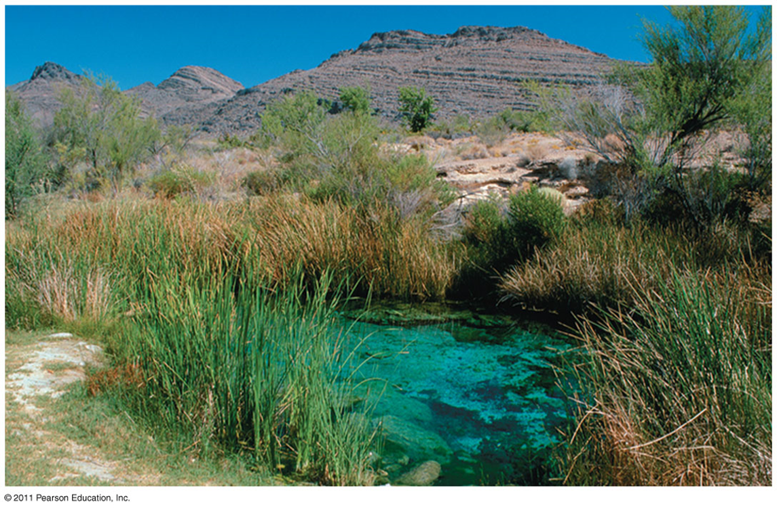
Notes – Ch. 55 & 56 (Ecology and Conservation Biology)
Big Idea 4, Essential knowledge 4.A.5

Slide 2
You Must Know:
How energy flows through the ecosystem (food chains and food webs)
The difference between gross primary productivity and net primary productivity.
The carbon and nitrogen biogeochemical cycles.
The value of biodiversity, and the major human threats to it.
How human activity is changing the earth

Slide 3
Chapter 55: Ecosystems

Slide 4
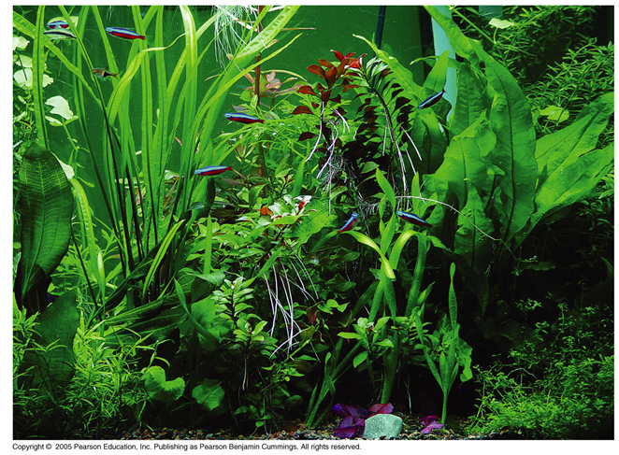
Ecosystems
Ecosystem = sum of all the organisms living within its boundaries (biotic community) + abiotic factors with which they interact
Ecosystems range from a microcosm, such as an aquarium or your garden, to a large area such as a lake or forest
Involves two unique processes:
Energy flow
matter cycling
Energy flows through ecosystems while matter cycles within them

Slide 5
Energy Flow in an Ecosystem
Energy cannot be recycled → must be constantly supplied to an ecosystem (mostly by SUN)
The autotrophs (“self feeders”) are the primary producers, and are usually photosynthetic (plants or algae).
They use light energy to synthesize sugars and other organic compounds.
Heterotrophs (“other feeders”) – can’t make own food

Slide 6
Energy Flow - Trophic Levels
Organisms in a community are related to each other through feeding relationships
Each step up in the transfer of energy is known as a trophic level
All energy ultimately comes from the SUN

Slide 7
Trophic Levels
Producers
Convert solar (or chemical) energy into organic compounds
Primary consumers
Eat producers
Secondary consumers
Eat primary consumers
Tertiary consumers
Eat secondary consumers
Detritivores –
decomposers
Energy and nutrients pass from primary producers (autotrophs) to primary consumers (herbivores) and then to secondary consumers (carnivores)

Slide 8
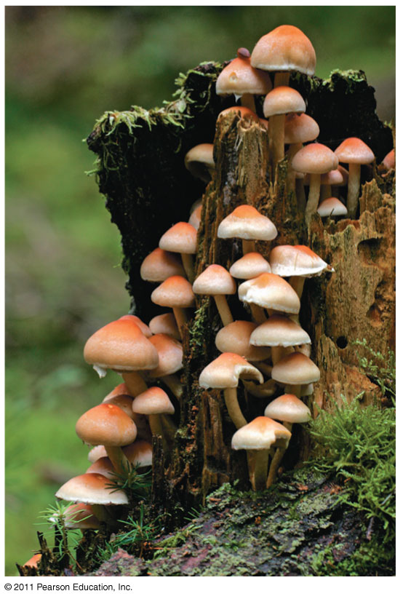
Main decomposers:
fungi & prokaryotes

Slide 9
Primary Production
Primary production = amt. of light energy that is converted to chemical energy
Gross primary production (GPP): total primary production in an ecosystem
Net primary production (NPP) = gross primary production minus the energy used by the primary producers for respiration (R):
NPP = GPP – R
NPP = storage of chemical energy available to consumers in an ecosystem

Slide 10
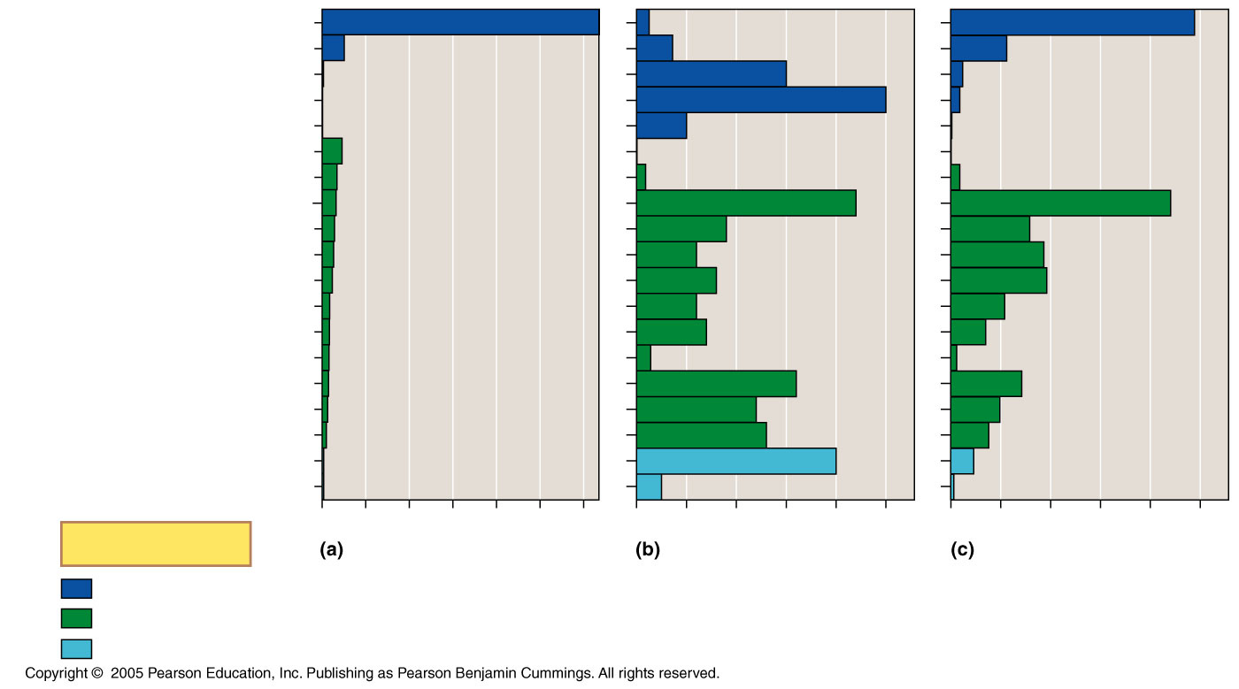
Net primary production of different ecosystems
Open ocean
Continental shelf
65.0
125
24.4
5.2
360
5.6
Estuary
Algal beds and reefs
0.3
0.1
0.1
1,500
1.2
2,500
0.9
Upwelling zones
Extreme desert, rock, sand, ice
500
0.1
4.7
3.0
0.04
Desert and semidesert scrub
Tropical rain forest
3.5
90
0.9
3.3
2,200
22
Savanna
Cultivated land
2.9
900
7.9
2.7
600
9.1
Boreal forest (taiga)
Temperate grassland
2.4
800
9.6
1.8
600
5.4
Woodland and shrubland
Tundra
1.7
700
3.5
1.6
140
0.6
Tropical seasonal forest
1.5
1,600
7.1
Temperate deciduous forest
Temperate evergreen forest
1.3
1,200
4.9
1.0
1,300
3.8
Swamp and marsh
Lake and stream
0.4
0.4
2,000
2.3
250
0.3
0
10
20
30
40
50
60
0
500
1,000
1,500
2,000
2,500
0
5
10
15
20
25
Key
Percentage of Earth’s
surface area
Average net primary
production (g/m²/yr)
Percentage of Earth’s net
primary production
Marine
Terrestrial
Freshwater (on continents)

Slide 11
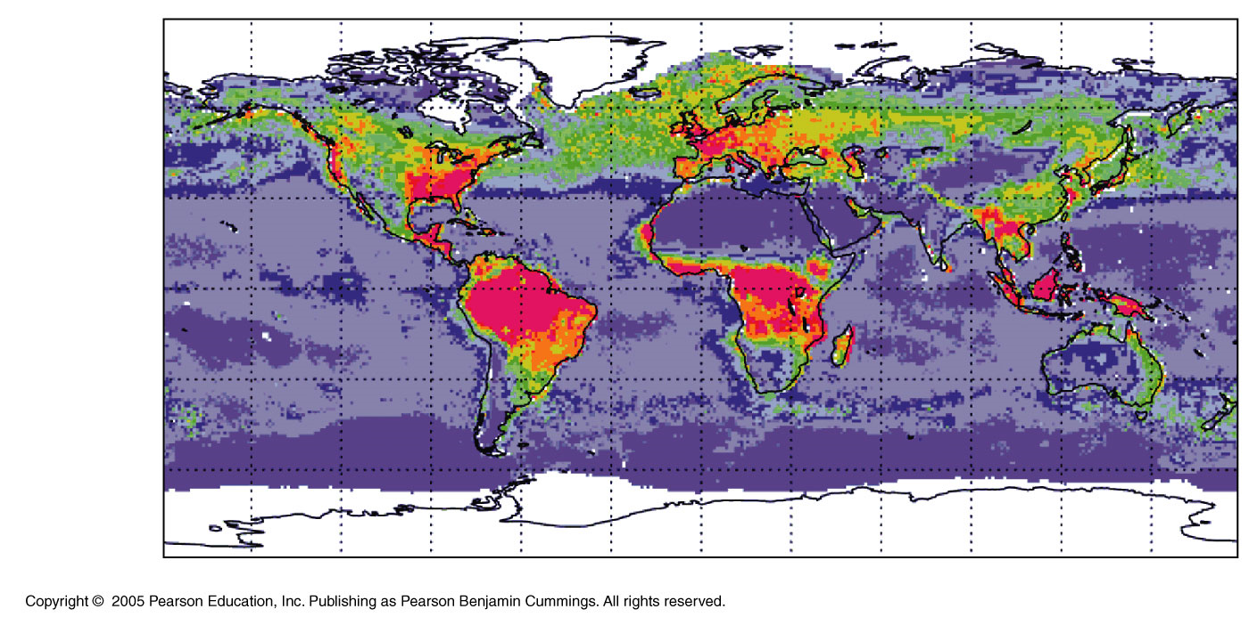
Overall, terrestrial ecosystems contribute about two-thirds of global NPP
Marine ecosystems contribute about one-third

Slide 12
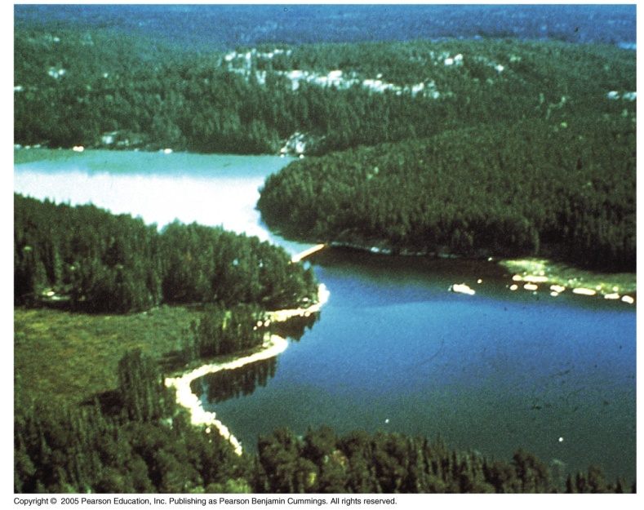
Primary production affected by:
Light availability (↑ depth, ↓ photosynthesis)
Nutrient availability (N, P in marine env.)
Key factors controlling primary production:
Temperature & moisture
A nutrient-rich lake that supports algae growth is eutrophic.

Slide 13
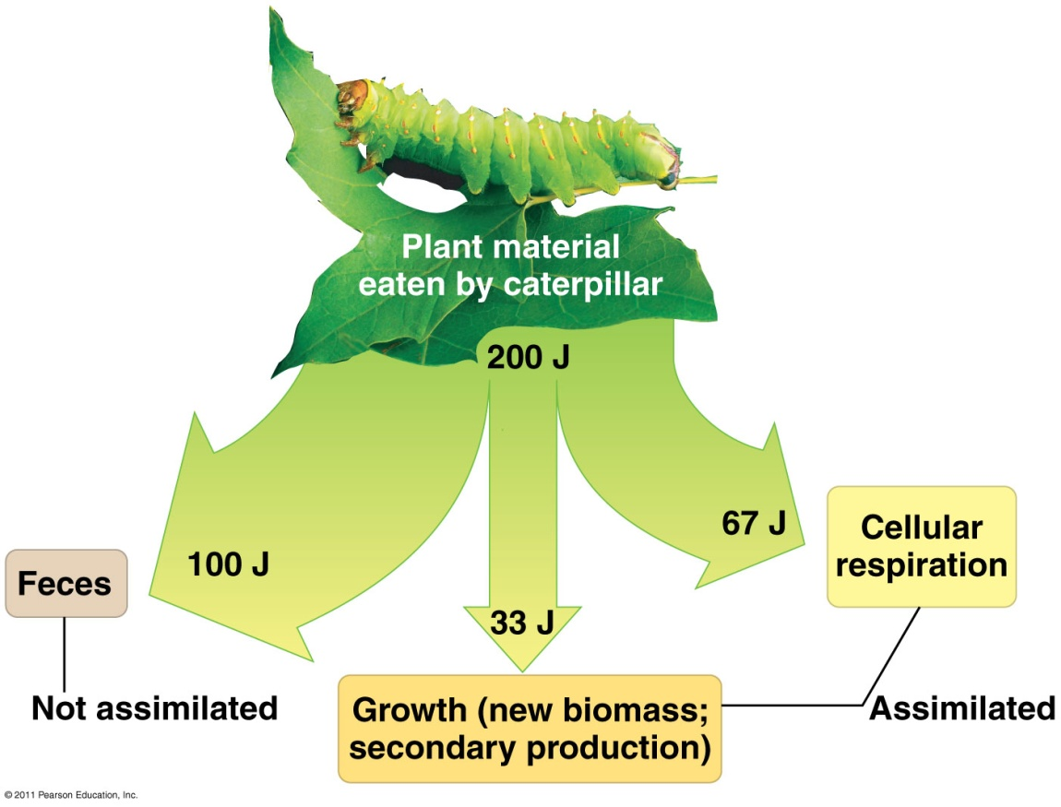
Energy transfer between trophic levels is typically only 10% efficient
Production efficiency: only fraction of E stored in food
Energy used in respiration is lost as heat
Energy flows (not cycle!) within ecosystems

Slide 14
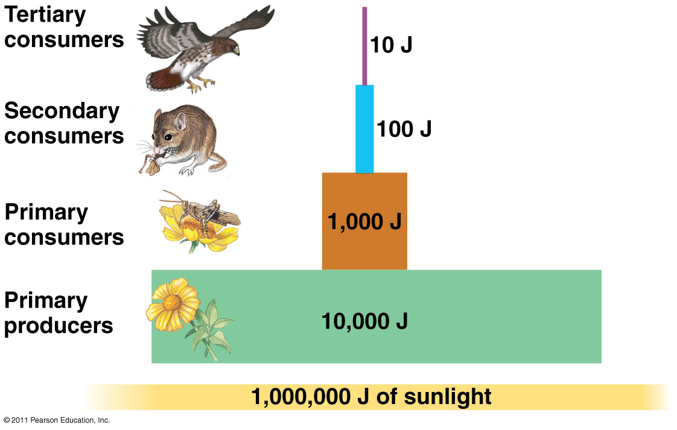
10% transfer of energy from one level to next

Slide 15
Energy transfer between trophic levels
Secondary production- the amount of chemical energy in food converted to new biomass
An organism’s production efficiency is the fraction of energy stored in food that is not used for respiration
When a caterpillar feeds on a leaf, only about one-sixth of the leaf’s energy is used for secondary production

Slide 16
Food chains
A food chain is a linear sequence of links starting from a species that are called producers in the web and ends at a species that is called decomposers.
A food chain also shows how the organisms are related with each other by the food they eat.
A straight-line sequence of who eats whom
Simple food chains are rare in nature

Slide 17
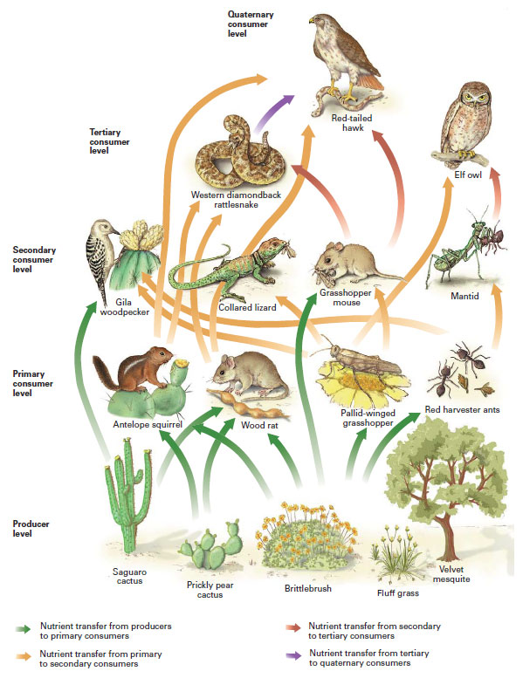
Food Webs
A food web is a series of connected food chains with complex trophic interactions

Slide 18
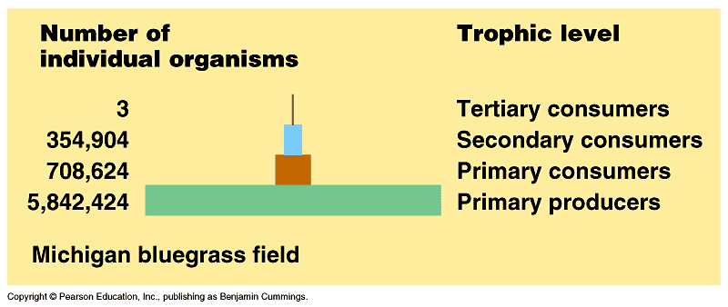
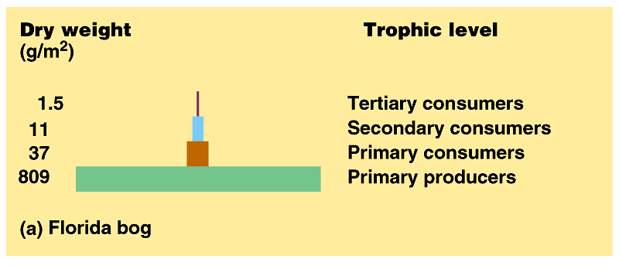
Ecological pyramids give insight to food chains
A pyramid of net production represents the loss of energy with each transfer in a food chain
Loss of energy limits # of top-level carnivores
Most food webs only have 4 or 5 trophic levels
Numbers, energy, & biomass decreases as one moves up the food chain
Pyramid of Numbers
Pyramid of Biomass

Slide 19
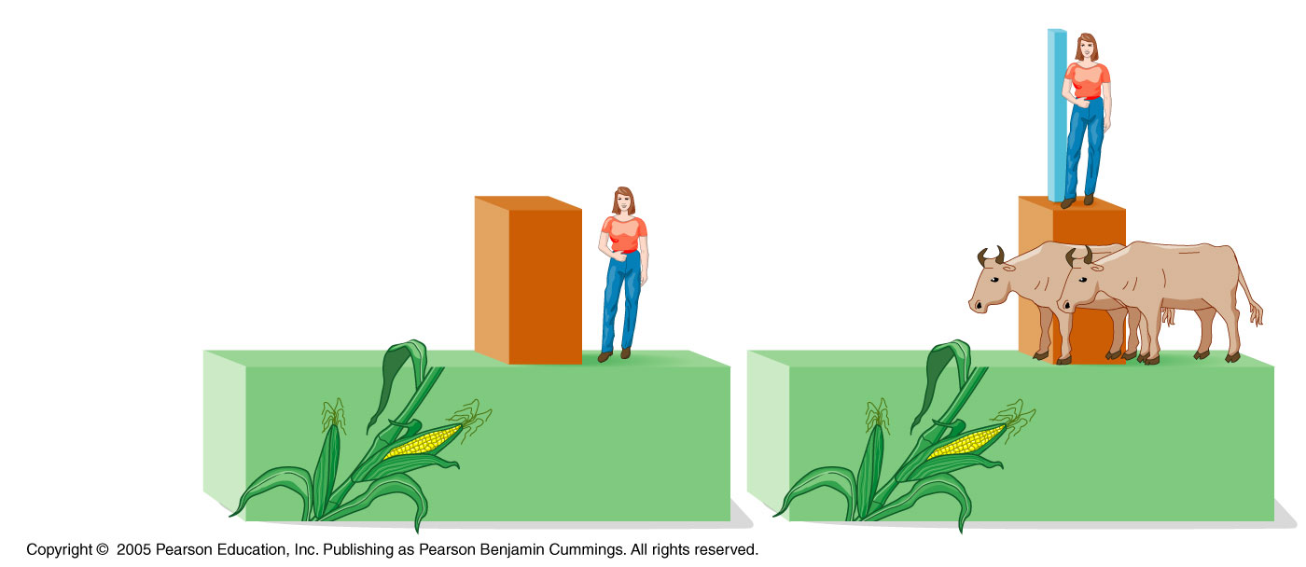
The dynamics of energy through ecosystems have important implications for the human population
Trophic level
Secondary
consumers
Primary
consumers
Primary
producers

Slide 20
Eating meat is a relatively inefficient way of tapping photosynthetic production
Worldwide agriculture could feed many more people if humans ate only plant material

Slide 21
Matter Cycles in Ecosystem
Life depends on recycling chemical elements
Biogeochemical cycles: nutrient cycles that contain both biotic and abiotic components
organic ←→ inorganic parts of an ecosystem
Nutrient Cycles: water, carbon, nitrogen, phosphorus

Slide 22
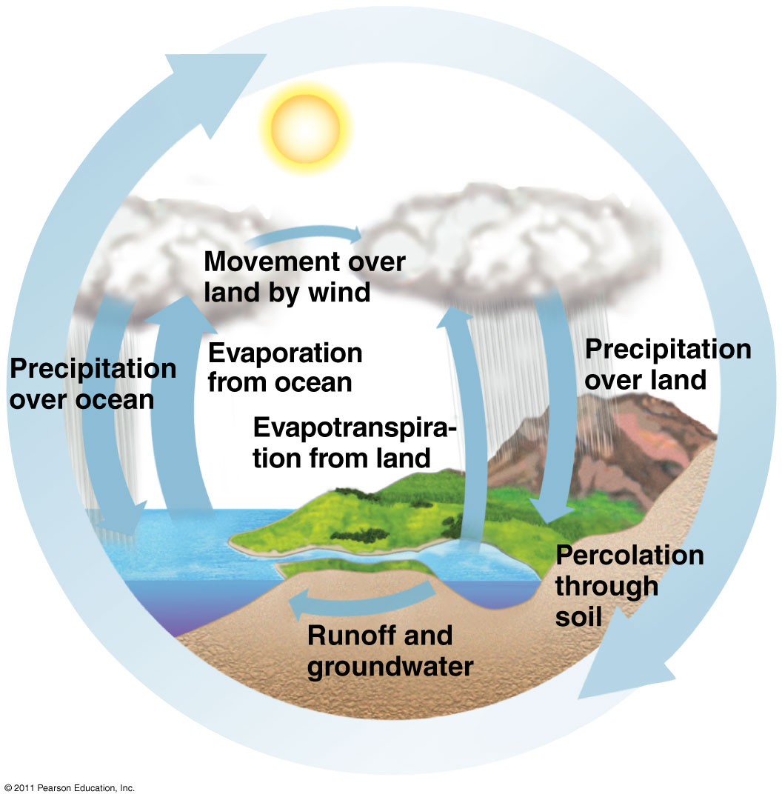
Water Cycle

Slide 23
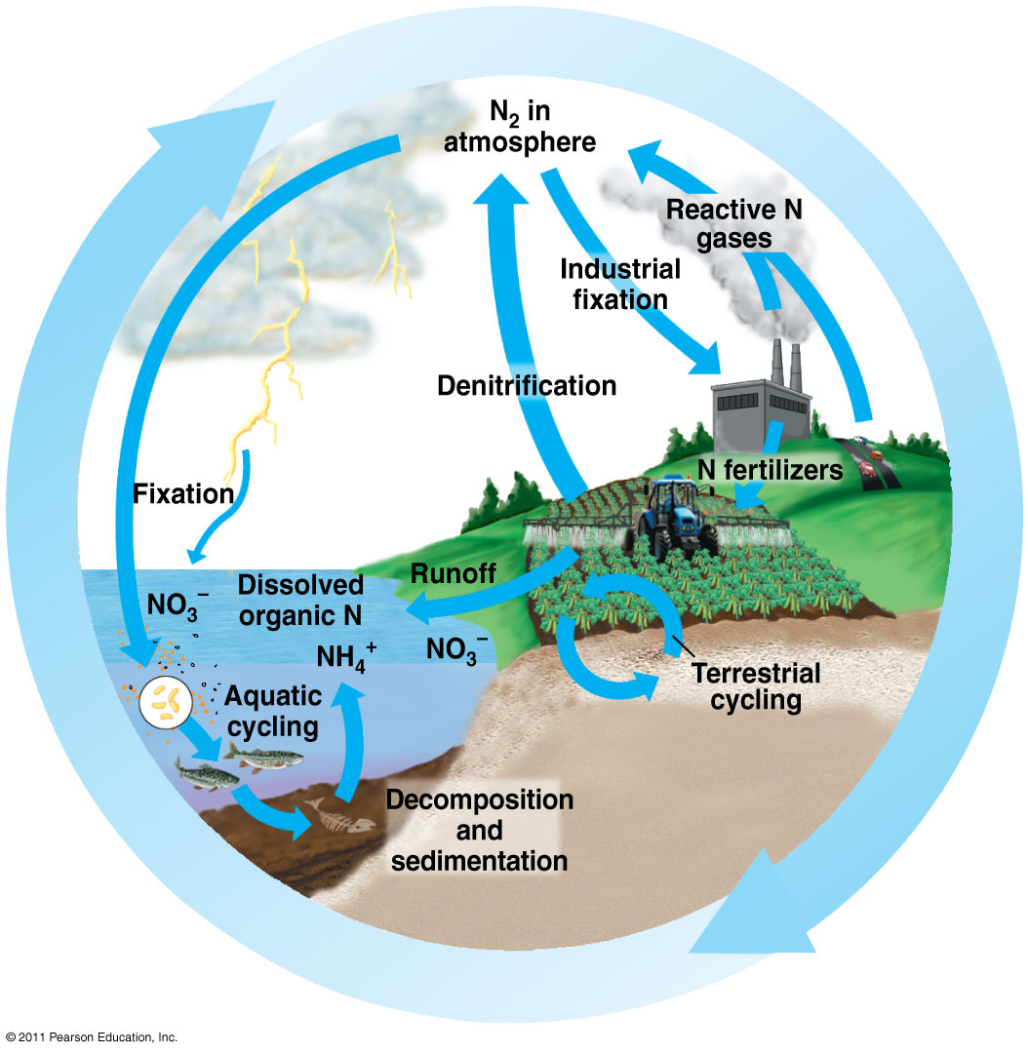
Nitrogen Cycle
Nitrogen fixation:
N₂ → plants by bacteria
Nitrification:
ammonium → nitrite → nitrate
Absorbed by plants
Denitrification:
Release N to atmosphere

Slide 24
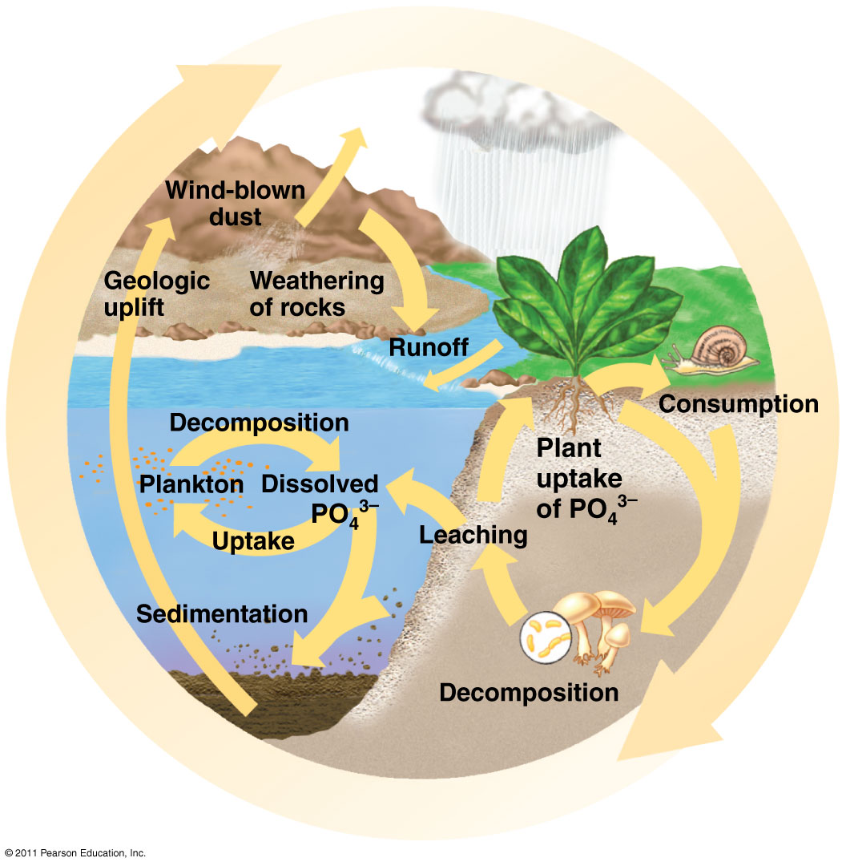
Phosphorus Cycle
Slowest cycle
P is usually solid, so not
typically found in the
atmosphere.
It’s a limiting factor in
plant growth
Can cause eutrophication

Slide 25
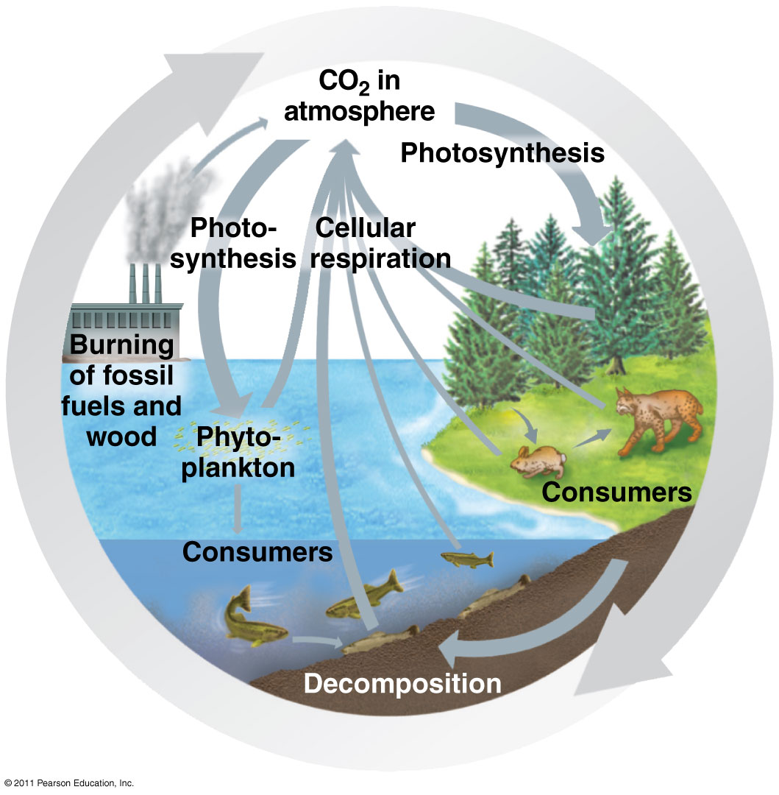
Carbon Cycle
CO₂ removed by photosynthesis, added by burning fossil fuels

Slide 26
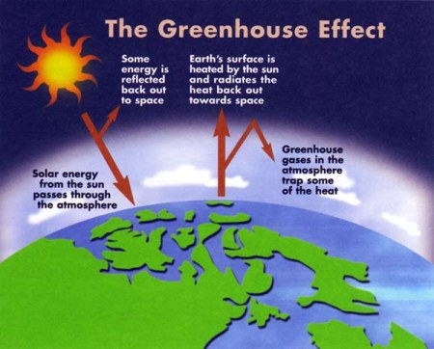
Greenhouse Effect
Greenhouse Effect: absorption of heat the Earth experiences due to certain greenhouse gases
CO₂ and water vapor absorb infrared radiation and re-reflect back toward Earth
The Earth needs this heat, but too much could be disastrous.

Slide 27
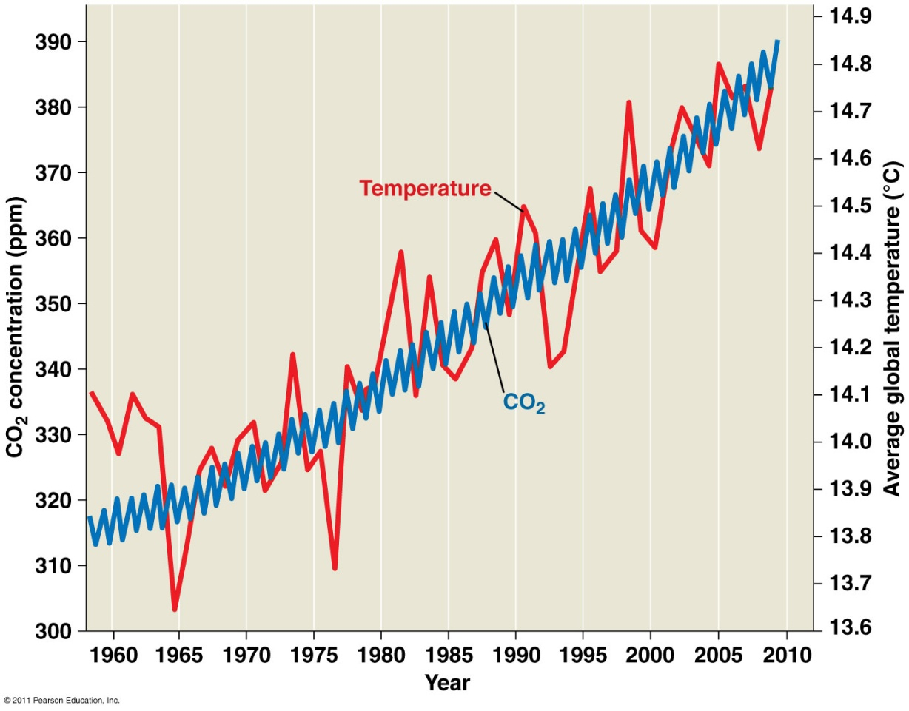
Rising atmospheric CO₂
Since the Industrial Revolution, the concentration of CO₂ in the atmosphere has increased greatly as a result of burning fossil fuels.

Slide 28
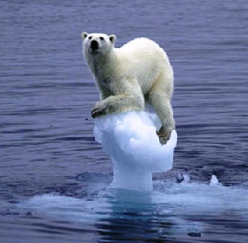
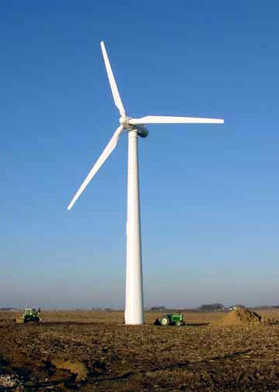
Global Climate Change (“Global Warming”)
Studies predict a doubling of CO₂ in the atmosphere will cause a 3ºC increase in the average temperature of Earth.
Rising temperatures could cause polar ice cap melting, which could flood coastal areas.
Approach: stabilize use of fossil fuels and reduce deforestation

Slide 29
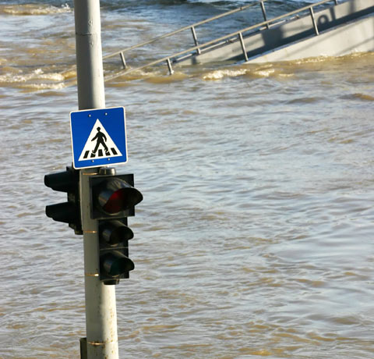
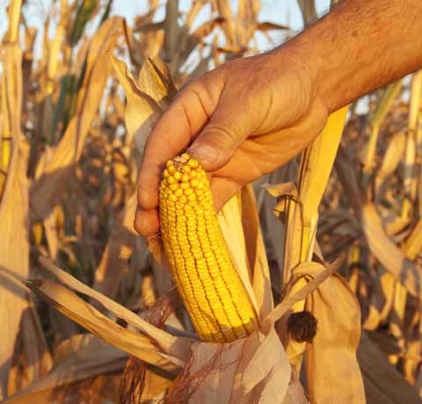
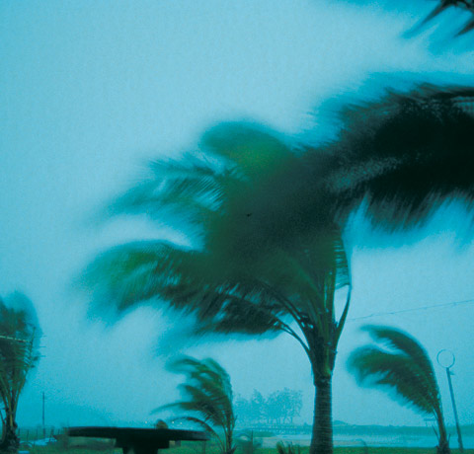
Global Climate Change
Snow and rainfall patterns shifting
Floods, drought, intense rainfall, more frequent and severe heat waves

Slide 30
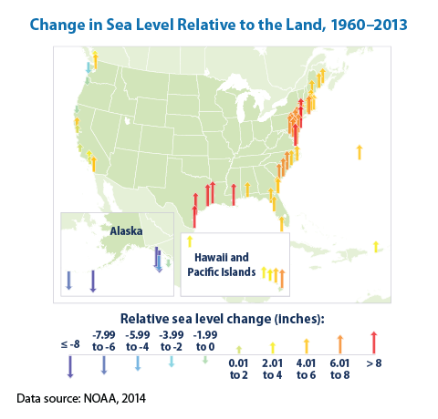

Slide 31
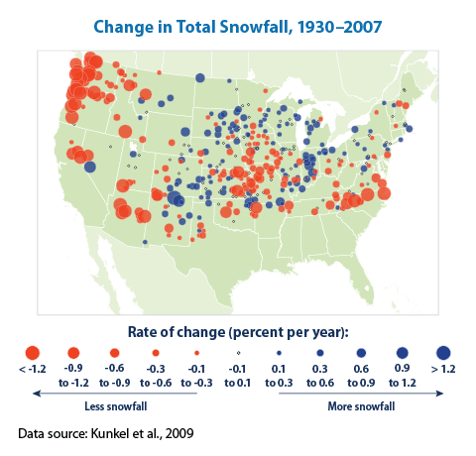

Slide 32
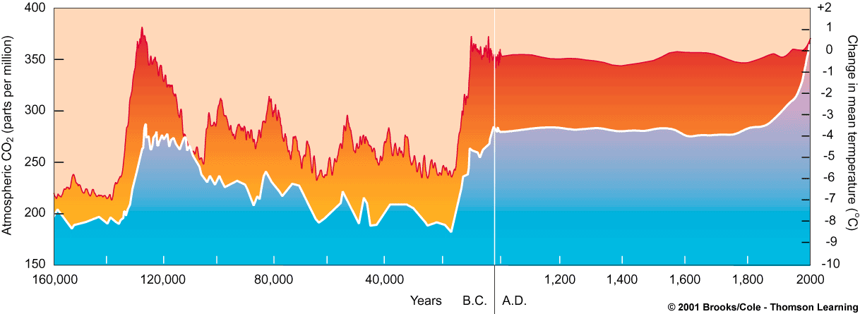
Global Warming
Long-term increase in the temperature of Earth’s lower atmosphere
Figure 48.19, Page 881

Slide 33
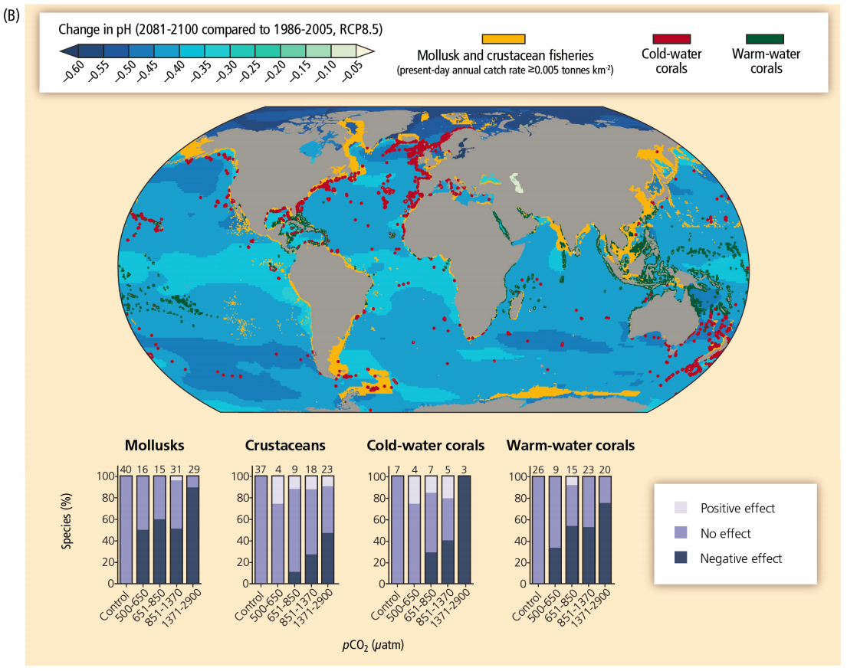

Slide 34
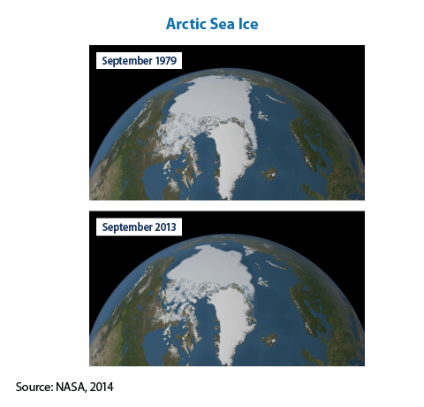
NASA Video Clip: Daily Arctic Sea Ice Changes

Slide 35
https://www.youtube.com/watch?v=McRYTC56DC4
https://www.youtube.com/watch?v=ffjIyms1BX4
https://www.youtube.com/watch?v=OWXoRSIxyIU

Slide 36
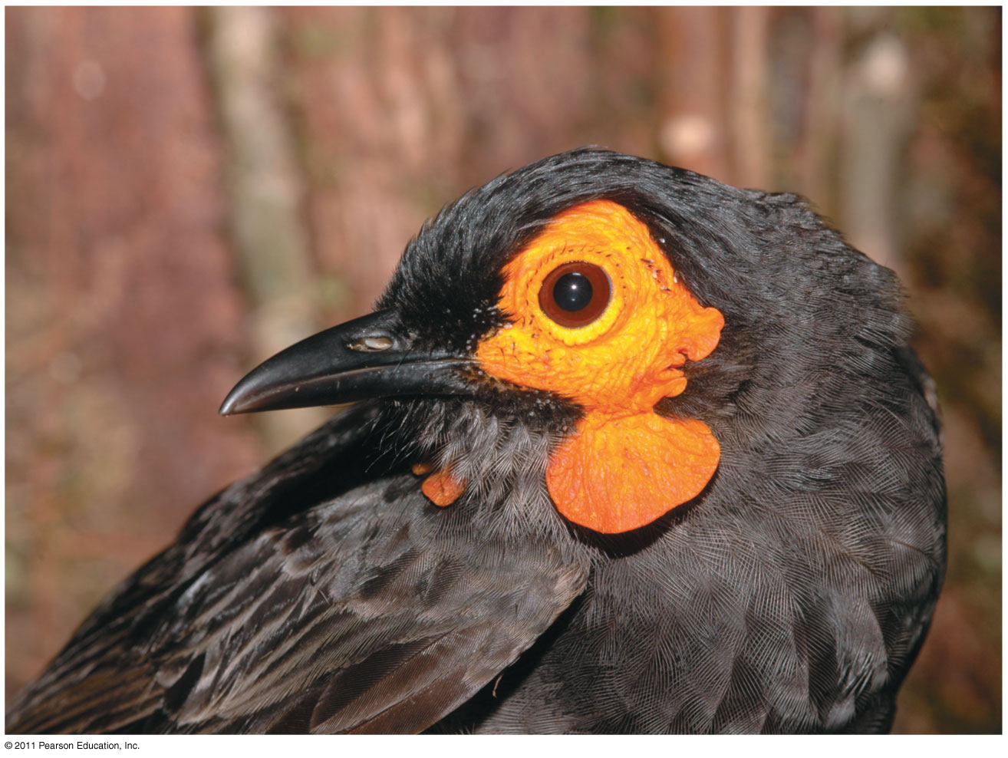
Chapter 56: Conservation Biology and Global Change

Slide 37
What you need to know:
The value of biodiversity, and the major human threats to it.
How human activity is changing the earth

Slide 38
Biodiversity
Conservation biology is a goal-oriented science that seeks to counter the biodiversity crisis, the current rapid decrease in Earth’s variety of life.
Extinction is a natural phenomenon that has been occurring since life evolved on earth.
The current rate of extinction is what underlies the biodiversity crisis.
A high rate of species extinction is being caused by humans.

Slide 39
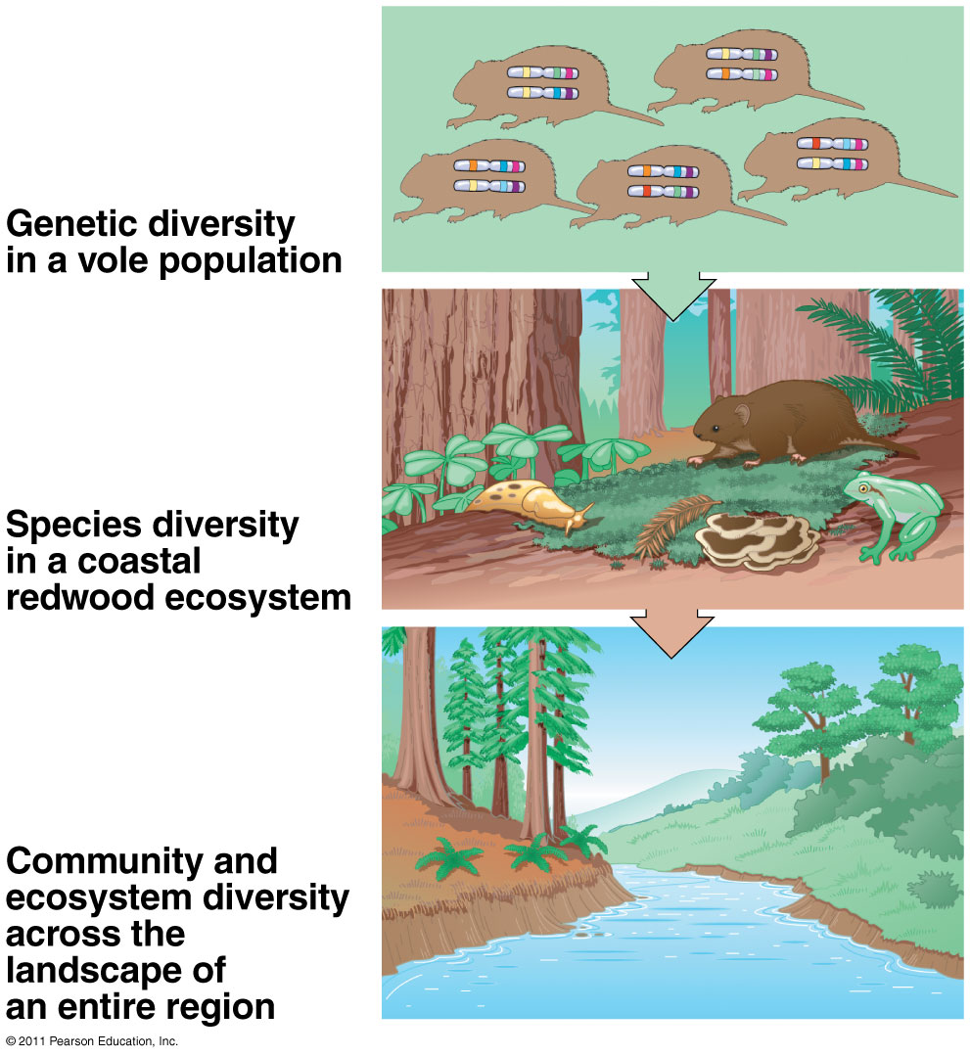
The three levels of biodiversity:
genetic diversity
species diversity
ecosystem diversity

Slide 40
The four major threats to biodiversity:
Habitat loss
Human alteration of habitat is the single greatest threat to biodiversity
Introduced species: invasive/nonnative/exotic species
Overexploitation: harvest wild plants/animals
Global change: alter climate, atmosphere, & ecological systems → reduce Earth’s capacity to sustain life

Slide 41
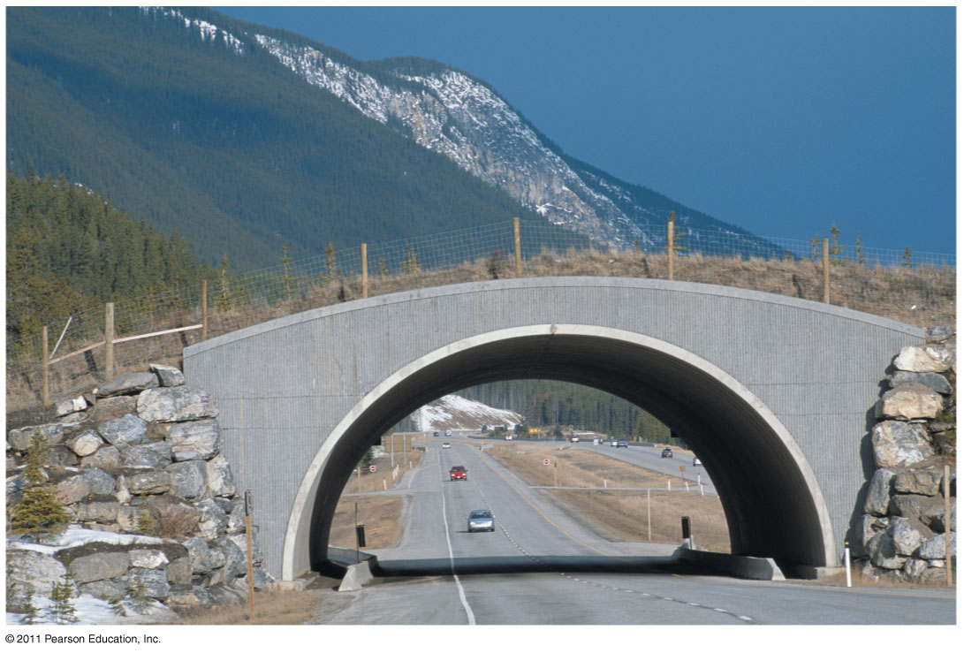
Landscape conservation
Movement corridors can promote dispersal if habitats are fragmented

Slide 42
Biodiversity Hot Spots

Slide 43
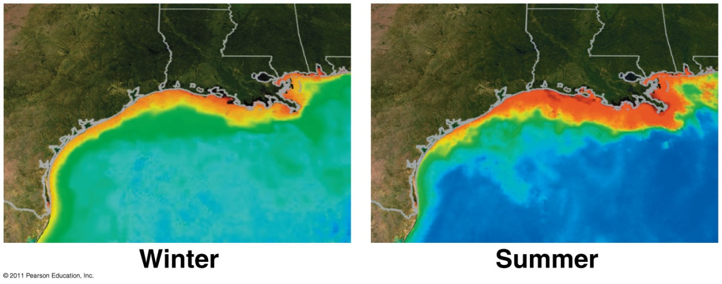
Eutrophication
Excess nitrogen from agriculture enters aquatic ecosystems
Algae and bacteria bloom/die → reduce oxygen → fish and invertebrates die
Mississippi basin dead zone (red)

Slide 44
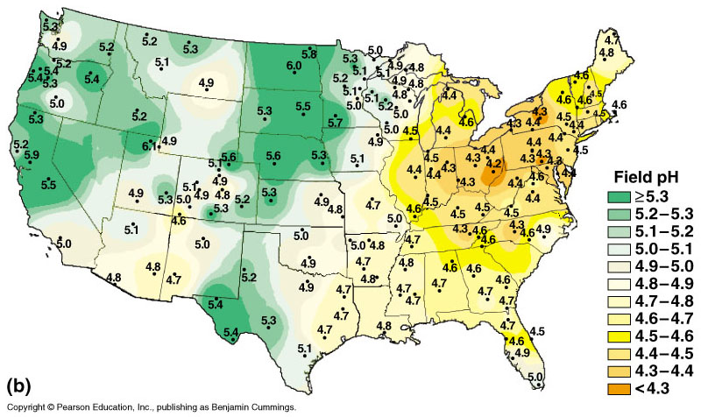
Acid Precipitation
Rain, snow, or fog with a pH less than 5.6
Caused by burning of wood & fossil fuels → release sulfur oxides and nitrogen oxides
React with water in the atmosphere to produce sulfuric and nitric acids

Slide 45
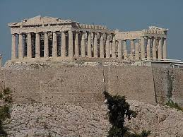
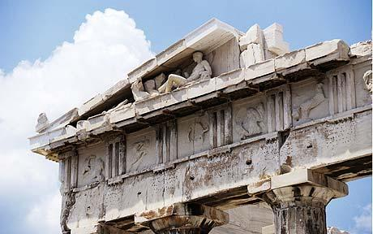
Acid Precipitation
North American and European ecosystems downwind from industrial regions have been damaged by rain and snow containing nitric and sulfuric acid
By the year 2000, acid precipitation affected the entire contiguous United States
Elgin marbles on acropolis

Slide 46
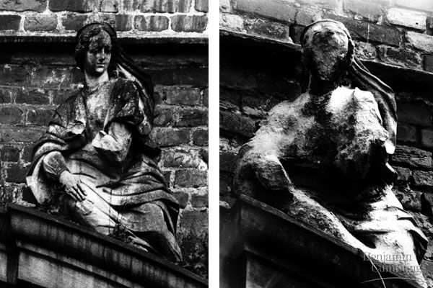
Acid rain damage to statuary, 1908 & 1968

Slide 47
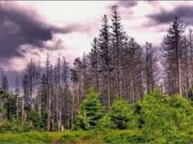
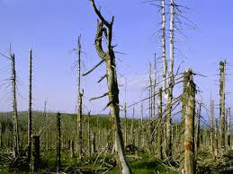
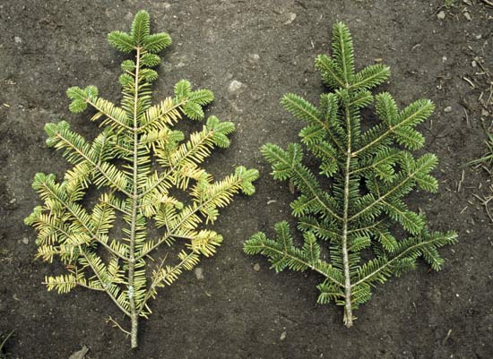
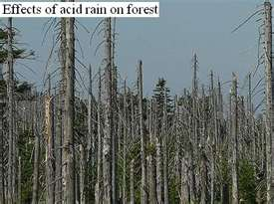
The effects of acid precipitation on a forest

Slide 48
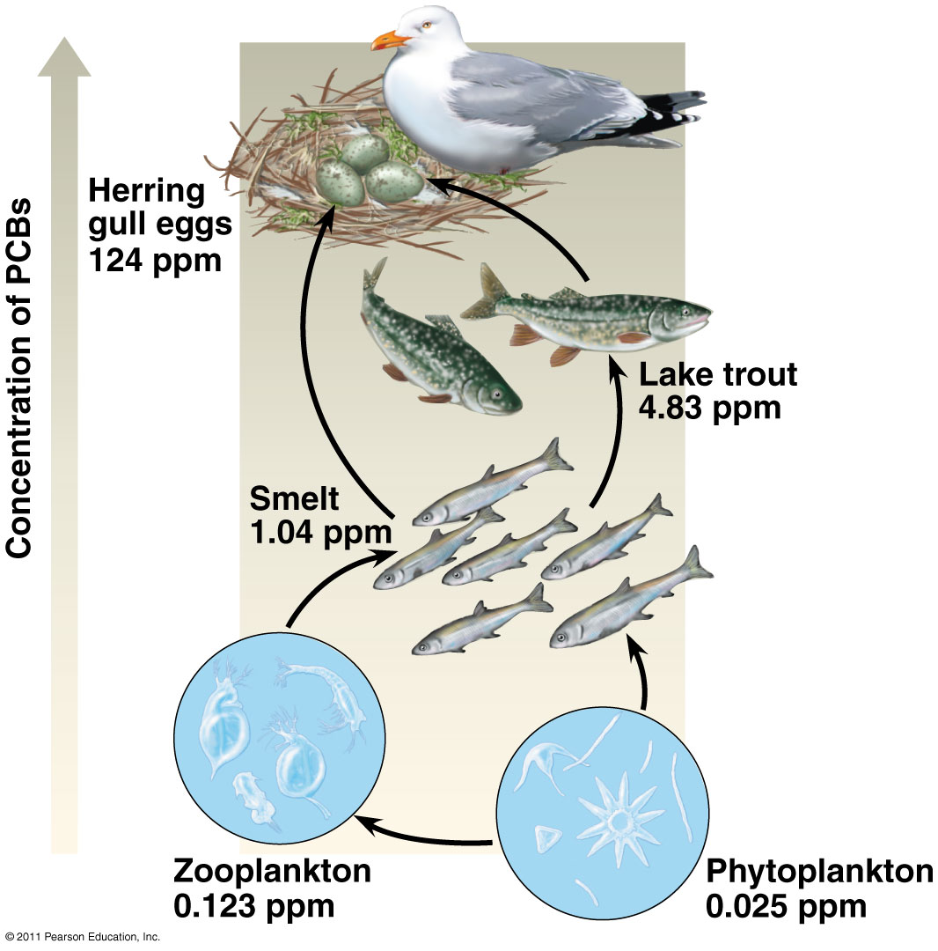
Biological Magnification
Toxins become more concentrated in successive trophic levels of a food web
Toxins can’t be broken down & magnify in concentration up the food chain
Problem: mercury in fish

Slide 49
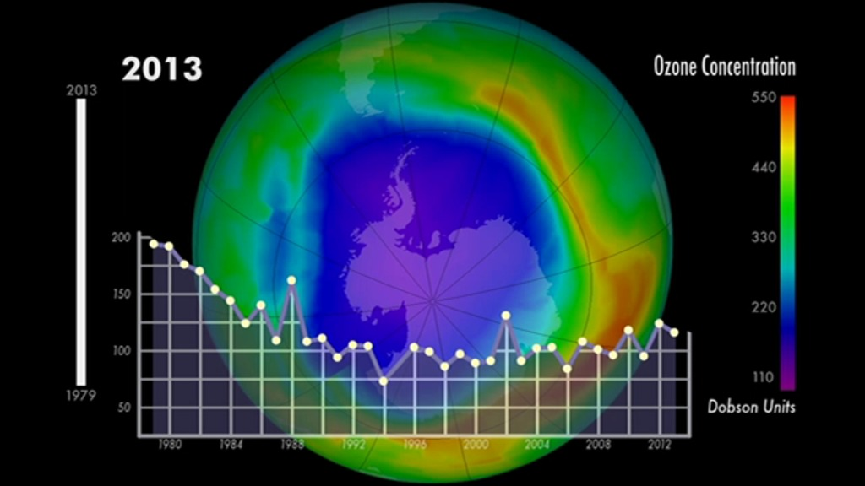
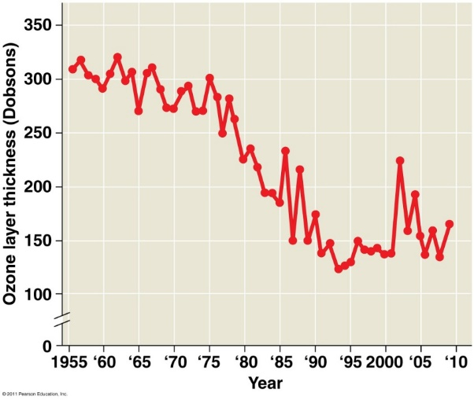
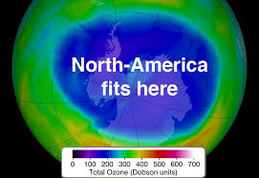
Human activities are depleting the atmospheric ozone
Life on earth is protected from the damaging affects of ultraviolet radiation (UV) by a layer of O₃, or ozone.
Chlorine-containing compounds erode the ozone layer

Slide 50
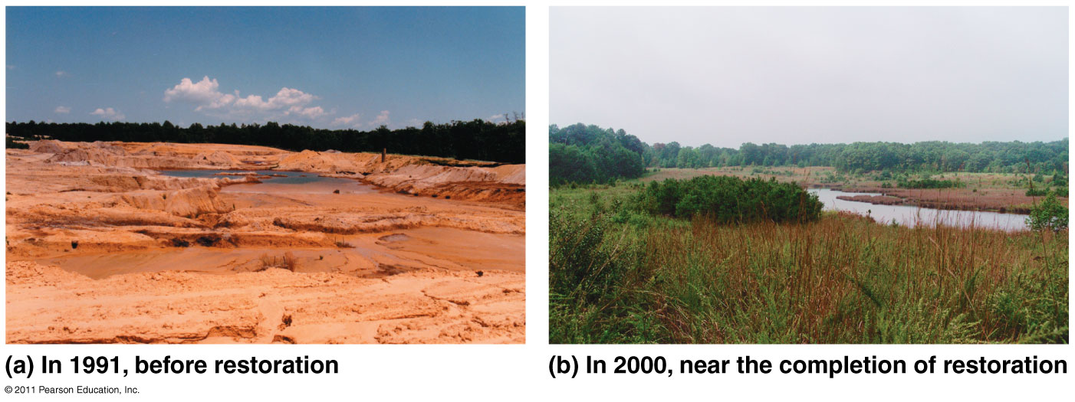
Restoration Ecology
Bioremediation: use of organisms (prokaryotes, fungi, plants) to detoxify polluted ecosystems
Bioaugmentation: introduce desirable species (eg. nitrogen-fixers) to add essential nutrients

Slide 51
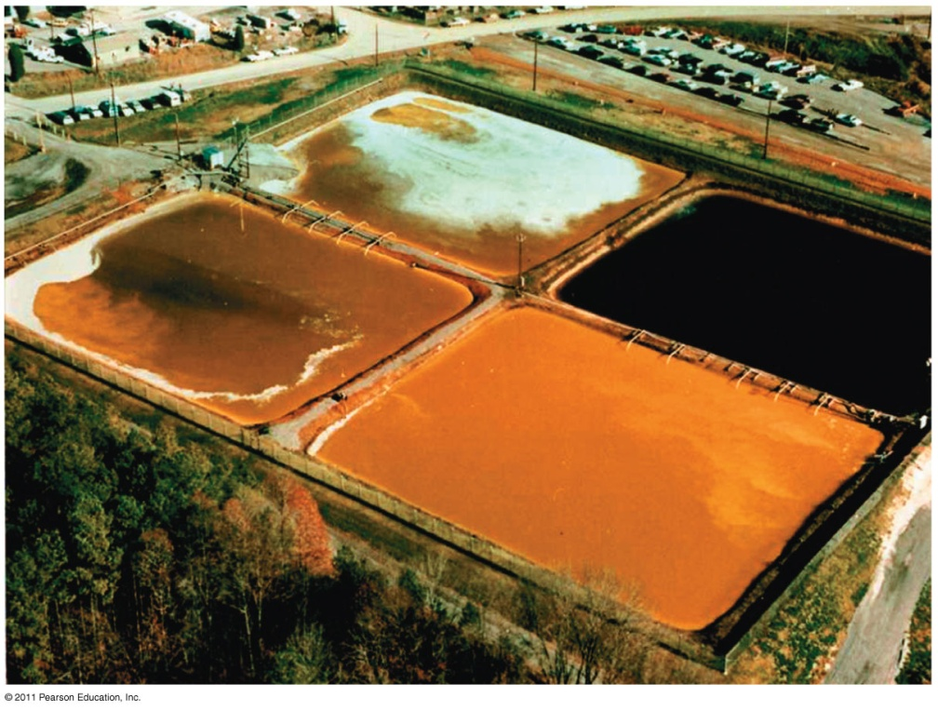
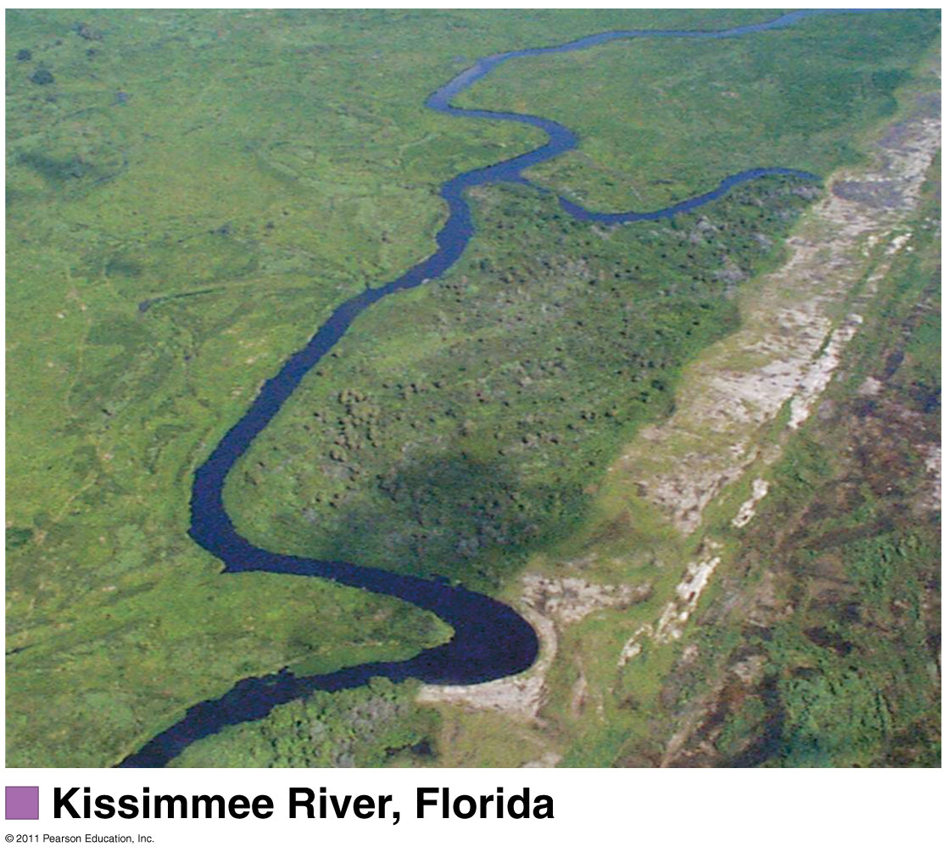
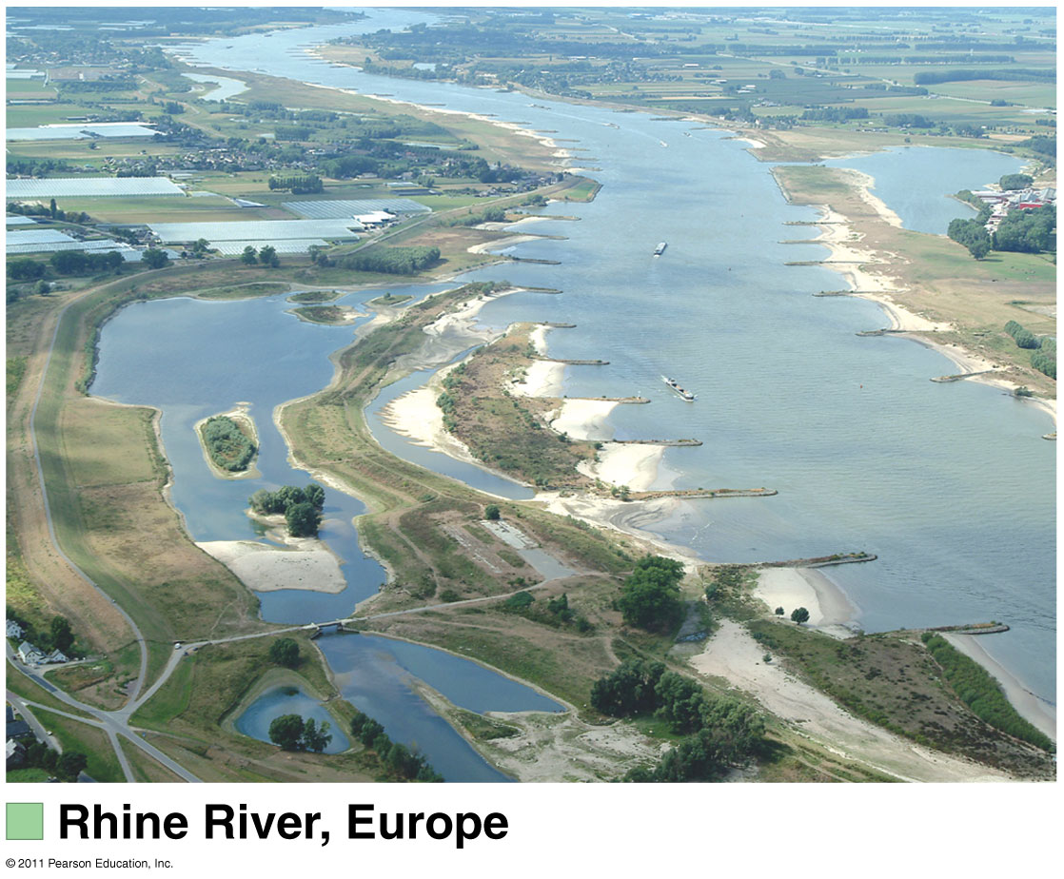
Bioremediation of groundwater contaminated with uranium
Restoration ecology projects

