Slide 1
Chi Squared Tests and degrees of freedom

Slide 2
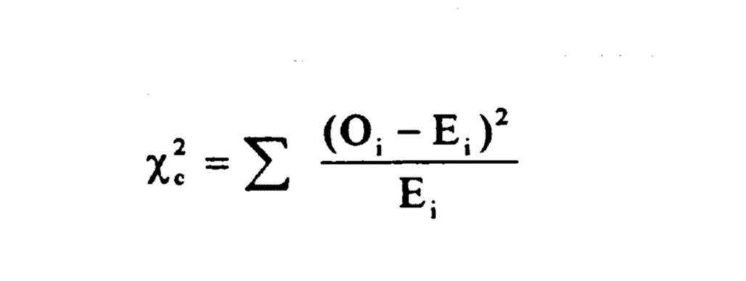
What is Chi Square?
It’s a way to see if the variation in your data is due to chance, or due to one of the variables you’re actually testing.

Slide 3
Overview
= sum
O = observed (data you actually collect)
E= what you would expect to see
*you can determine what you would expect to see before you even begin the experiment, and compare that to your observed data

Slide 4
Null hypothesis
There is no significant difference between the observed and expected frequencies (statistically)
To accept or reject it, we exceed a critical value

Slide 5
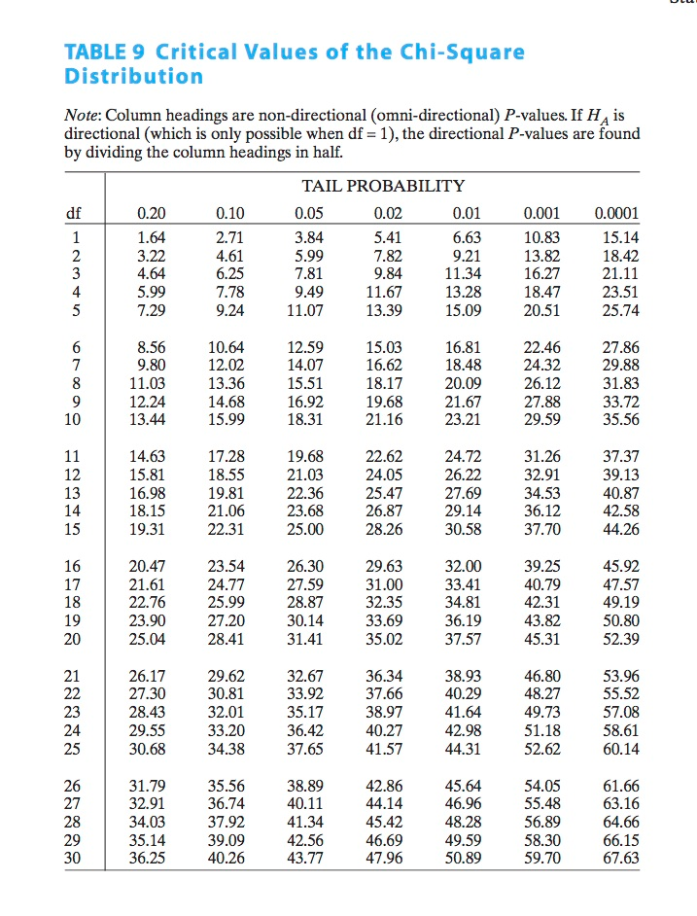
Degrees of freedom
Since we’re comparing outcomes, we need at least 2 outcomes (heads or tails of a coin)
Subtract the number of outcomes from 1

Slide 6
Critical value
Use 0.05
This is the 95% sure that you are accepting or rejecting your hypothesis (you could go higher than that)
Using the degree of freedom chart, we look at the 0.05 column to determine our degree of freedom.
If it’s higher than our critical value, we reject the null hypothesis. If it’s less, we accept the null hypothesis.

Slide 7
Bozeman Video
http://www.youtube.com/watch?v=WXPBoFDqNVk

