Slide 1
Big Idea 1
Carbon and Macromolecules
Big Idea 2.A.3 (1 and 2), 2.B.1 (b.2)
AND
Big Idea 4.A.1

Slide 2
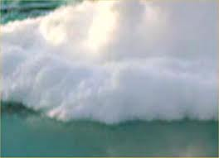
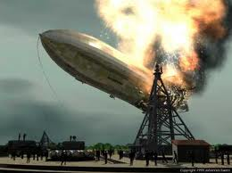
Overview: Carbon—The Backbone of Biological Molecules
96% of life is made of just 6 elements: Carbon, Hydrogen, Oxygen, Nitrogen, (plus Phosphorous and Sulfur).
(think: SPONCH)
Although cells are 70–95% water, the rest consists mostly of carbon-based compounds

Slide 3
Overview cont.
Carbon is unparalleled in its ability to form large, complex, and diverse molecules (although the major elements in life are pretty uniform from one organism to another, carbon can be used to build a huge variety of organic molecules).
Organic chemistry is the study of carbon and its compounds
Proteins, DNA, carbohydrates, and other molecules that distinguish living matter are all composed of carbon compounds

Slide 4
Molecules formed by carbon bonding
Carbon has a total of 6 electrons (which gives it 4 valence electrons in a shell that holds 8)
How many protons would the carbon have?
What is its atomic number?
Think about what that means…..
Rather than giving away or taking 4 electrons, it usually completes its valence shell by sharing.

Slide 5
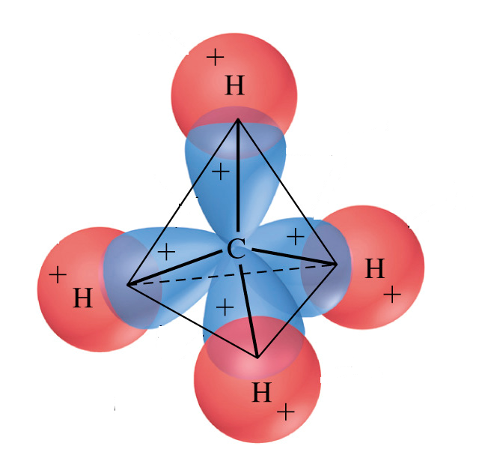
Can form FOUR stable covalent bonds at same time (=tetravalence)
Common partners = O, H, N

Slide 6
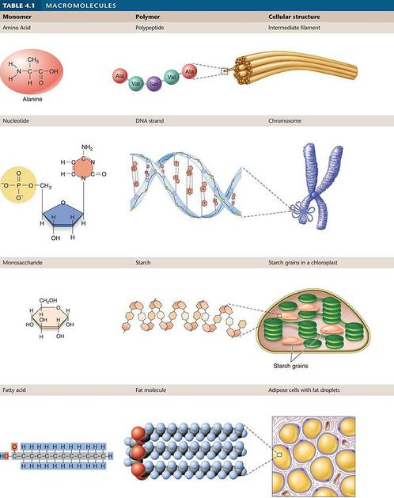
Molecular Diversity Arising from Carbon Skeleton Variation
Carbon chains form the skeletons of most organic molecules (lipids, carbohydrates, nucleic acids, proteins)
Carbon chains vary in length and shape

Slide 7
Types of Molecules cont. Hydrocarbons
Hydrocarbons are organic molecules consisting of only carbon and hydrogen
Many organic molecules, such as fats, have hydrocarbon components
Hydrocarbons can undergo reactions that release a large amount of energy

Slide 8
Carbon compounds
Skeleton may have single or double bonds
http://telstar.ote.cmu.edu/Hughes/tutorial/cellmembranes/

Slide 9
Isomers
Isomers are molecules with the same molecular formula but different structures and properties
Made of the same atoms, but they are put together in different ways, which changes their function and properties
Three types of isomers are
Structural
Geometric
Enantiomers

Slide 10
Isomers
Isomers are compounds with the same molecular formula but different structures and properties (same number of atoms, but bonded together differently):
Structural isomers have different covalent arrangements of their atoms
Geometric isomers have the same covalent arrangements but differ in spatial arrangements
Enantiomers are isomers that are mirror images of each other

Slide 11
ENANTIOMER isomers - differ in arrangement around a ASYMMETRIC carbon . . . Mirror images
AP Biology by Campbell and Reese; ©Benjamin Cummings 2005

Slide 12
Isomers cont
Enantiomers are important in the pharmaceutical industry
Two enantiomers of a drug may have different effects
Differing effects of enantiomers demonstrate that organisms are sensitive to even subtle variations in molecules
Animation: L-Dopa

Slide 14
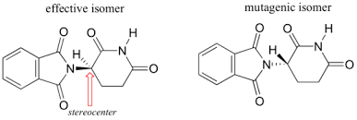
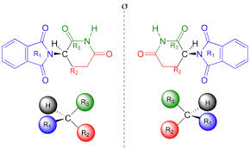
Example cont.
Researchers later realized the problem lay in the fact that thalidomide was being provided as a mixture of two different isomeric forms.
One of the isomers is an effective medication, the other caused the side effects. Both isomeric forms have the same molecular formula and the same atom-to-atom connectivity.
Where they differ is in the arrangement in three-dimensional space about one tetrahedral carbon.

Slide 15
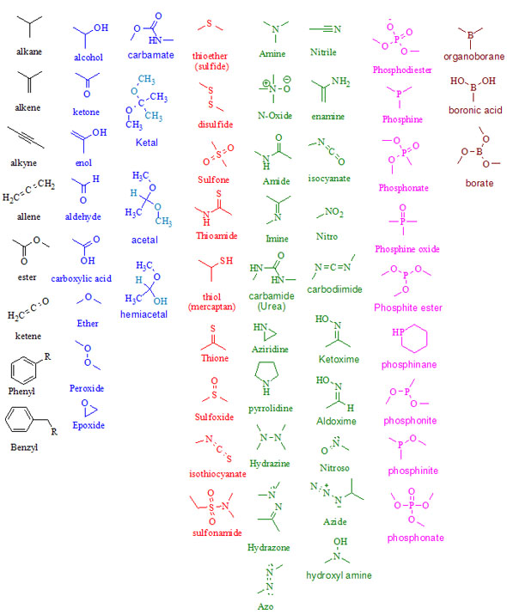
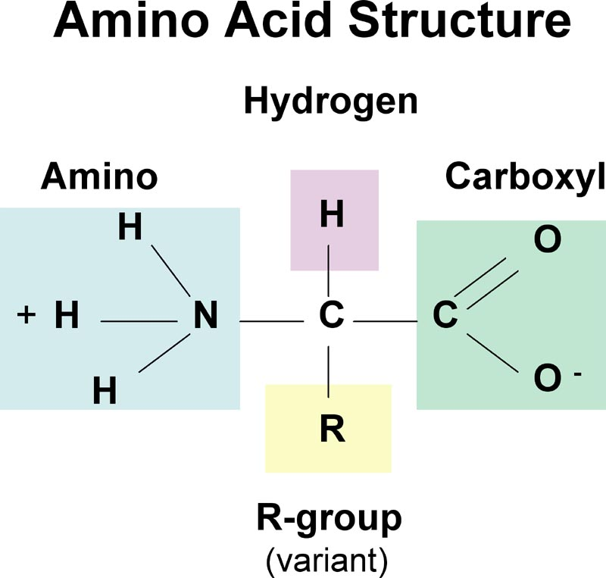
Functional groups
Organic molecules may have functional groups attached.
A functional group is a group of atoms of a particular arrangement that gives the entire molecule certain characteristics.
Functional groups are named according to the composition of the group.
Organic chemists use the letter "R" to indicate an organic molecule

Slide 16
Functional Groups Cont.
Functional groups are the parts of organic molecules that are most commonly involved in chemical reactions
The number and arrangement of functional groups give each molecule its unique properties
Example – the picture shows four fused rings (of a carbon skeleton), but they have different functional groups attached. These slight differences influence the development (both anatomical and physiological) between males and females.

Slide 17
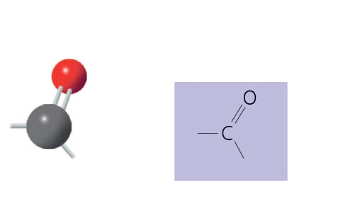
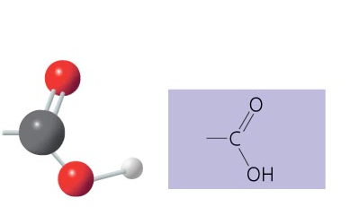
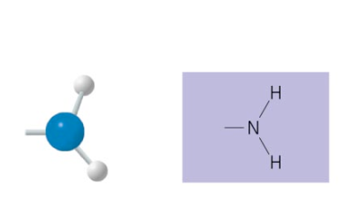
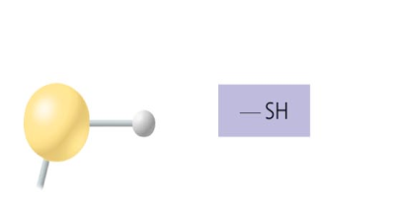
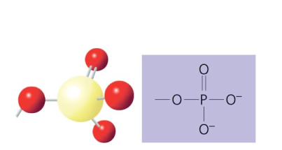
Functional Groups cont.
The six functional groups that are most important in the chemistry of life:
Hydroxyl group
Carbonyl group
Carboxyl group
Amino group
Sulfhydryl group
Phosphate group

Slide 18
Video Review
https://www.youtube.com/results?search_query=crash+course+biology+carbon

Slide 19
Stop and Review
Dice game
You and your partners will take turns; one person will roll dice and the other person/people will write everything they can remember until a 1 is rolled. Then you switch roles.

Slide 20
Ch. 5
Macromolecules

Slide 21
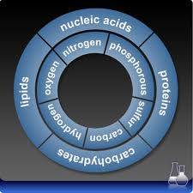
Macromolecules- Overview
Within cells, small organic molecules are joined together to form larger molecules
Macromolecules are large molecules composed of thousands of covalently connected atoms

Slide 22
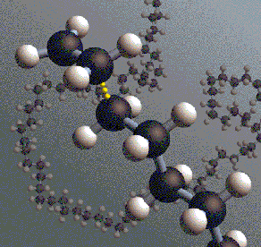
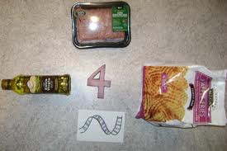
Polymers
Monomers are the repeating units that are the building blocks of a polymer
A polymer is a long molecule consisting of many similar building blocks called monomers (it’s like the cars on a train)
Greek (polys – many; meris – part)
Three of the four classes of life’s organic molecules are polymers:
Carbohydrates
Proteins
Nucleic acids
(missing lipids)
SO atoms –monomers – polymers - macromolecules

Slide 23
The Synthesis and Breakdown of Polymers
A condensation reaction is when monomers are connected by a reaction where two molecules are covalently bonded to each other through a loss of a water molecule (also called a dehydration reaction)
This forms a larger molecule
Polymers are disassembled to monomers by hydrolysis, a reaction that is essentially the reverse of the dehydration reaction (hydro – water; lysis – break)

Slide 24
Dehydration Synthesis Simplified

Slide 25
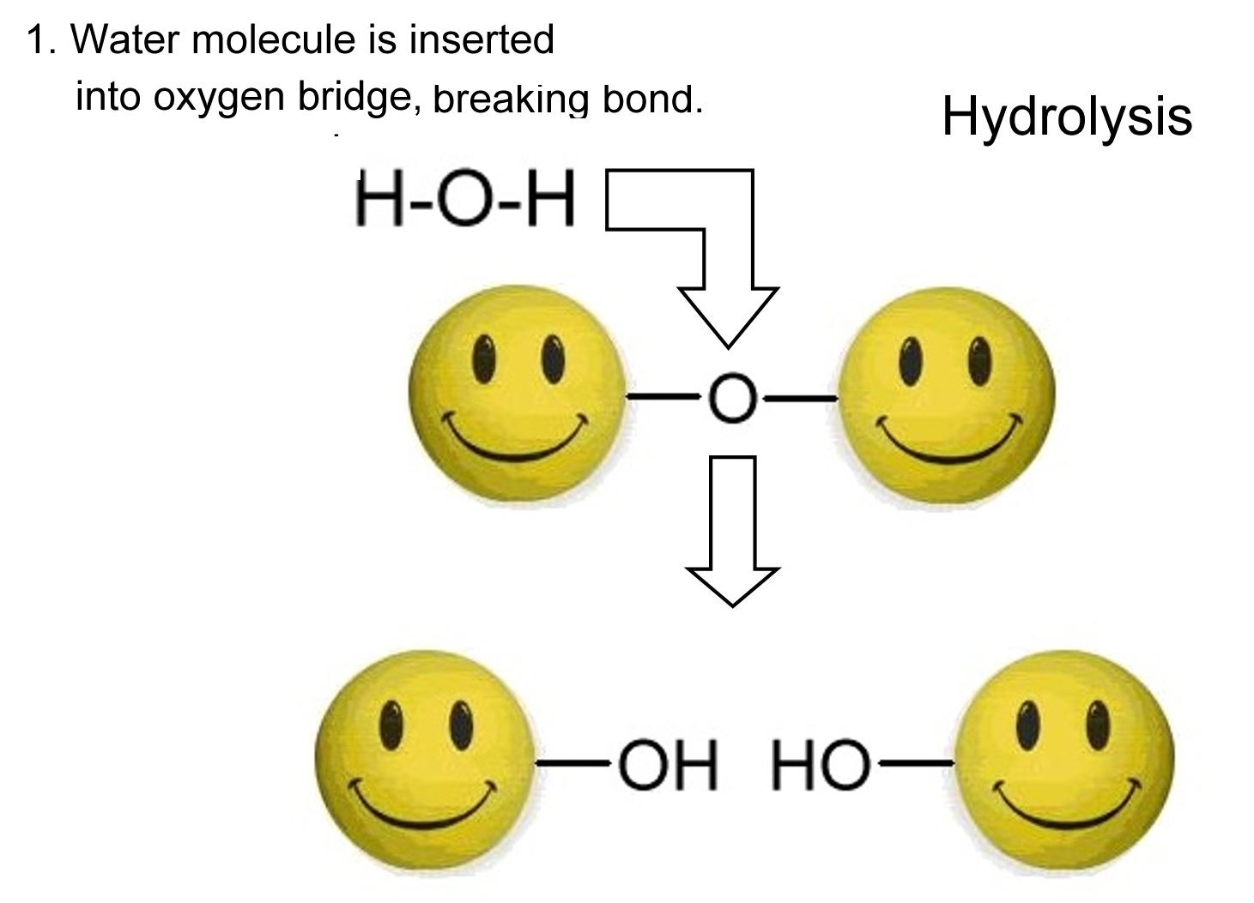
Hydrolysis Simplified

Slide 26
Endothermic vs. Exothermic Reactions
Exothermic- the word describes a process that releases energy in the form of heat.
Forming a chemical bond releases energy and therefore is an exothermic process.
Exothermic reactions usually feel hot because it is giving heat to you.
Endothermic - a process or reaction that absorbs energy in the form of heat.
Breaking a chemical bond requires energy and therefore is Endothermic.
Endothermic reactions usually feel cold because it is taking heat away from you.
What are dehydration and hydrolysis reactions?

Slide 27
Brain Break
Turn to your partner and:
explain the difference between a hydrolysis reaction and a condensation/dehydration reaction.
State if a dehydration reaction is exothermic or endothermic

Slide 28
Answer:
Dehydration is exothermic because it’s forming a bond, which releases energy

Slide 29
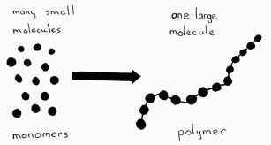
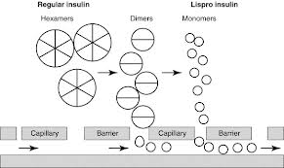
Polymers cont.
Most of our food is in the form of polymers that are too large to enter our cells.
Enzymes in our digestive tract attack the polymers which speeds up hydrolysis.
The loose monomers are then absorbed (into the blood) to be distributed to our body cells.
Those cells can use dehydration reactions to assemble the monomers into new polymers (that are different that the ones digested)
The new polymers perform specific functions for the cell.

Slide 30
Carbohydrates (monosaccharides)
Carbohydrates include sugars and the polymers of sugars
The simplest carbohydrates are monosaccharides, or single sugars
Monosaccharides have molecular formulas that are usually multiples of CH₂O (1:2:1)
Glucose is the most common monosaccharide
Carbohydrate macromolecules are polysaccharides, polymers composed of many sugar building blocks

Slide 31
Dehydration Synthesis
Monosaccharides can be linked together through the process of Dehydration Synthesis
Water is removed from 2 monocaccharides - resulting in a covalent bond between the 2 molecules
Sucrose (table sugar) is made of 2 sugars linked together and these are called Disaccharides
Require some digestion to be used by cells

Slide 32
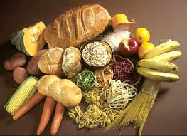
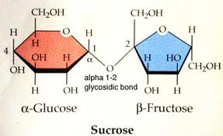
Carbohydrates cont. (Polysaccharides)
A disaccharide is formed when a dehydration reaction joins two monosaccharides
This covalent bond is called a glycosidic linkage

Slide 33
Carbohydrates cont.
Monosaccharides serve as a major fuel for cells and as raw material for building molecules
Though often drawn as a linear skeleton, in aqueous solutions they form rings

Slide 34
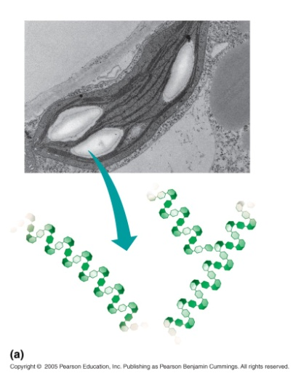
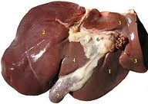
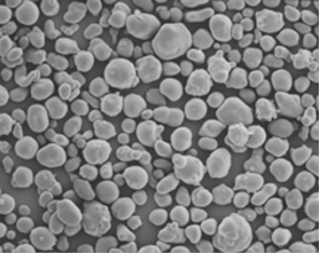
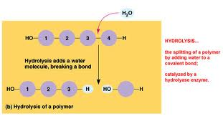
Carbohydrates (storage polysaccharides)
The structure and function of a polysaccharide are determined by its sugar monomers and the positions of glycosidic linkages
Starch is a storage polysaccharide of plants (made of glucose monomers).
Because glucose is a major source of cellular fuel, starch represents stored energy.
The sugar (glucose) can be taken from this carbohydrate “bank” by hydrolysis.
Most animals (including humans) have enzymes that can hydrolyze plant starch.
The main storage for these sugars in humans is our liver and muscle cells (we burn through these quickly and need to constantly replenish them)

Slide 35
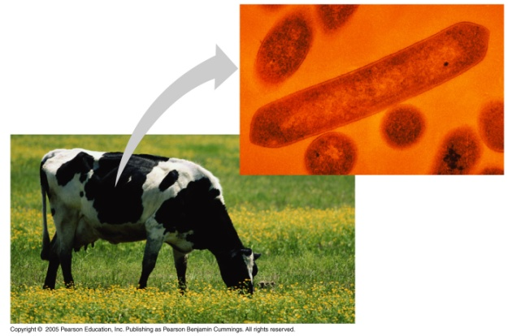
Carbohydrates (structural polysaccharides)
Cellulose is a major component of the tough wall of plant cells
Like starch, cellulose is a polymer of glucose, but the glycosidic linkages differ
Cellulose in human food passes through the digestive tract as insoluble fiber
Some microbes use enzymes to digest cellulose
Many herbivores, from cows to termites, have symbiotic relationships with these microbes

Slide 36
Carbs. Cont. (structural polys)
Chitin, another structural polysaccharide, is found in the exoskeleton of arthropods
Chitin also provides structural support for the cell walls of many fungi
Chitin can be used as surgical thread

Slide 37
Check for understanding
What are the elements that make up carbohydrates, AND in what ratio are they found?
What are the monomers (building blocks) for carbohydrates?
What are TWO functions of carbohydrates?

Slide 38
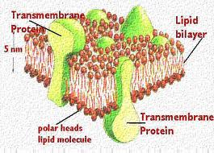
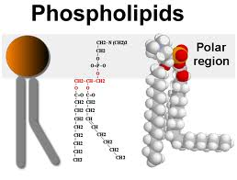
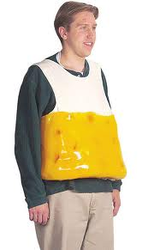
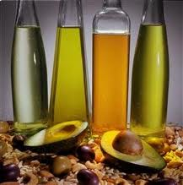
Lipids
Lipids are the one class of large biological molecules that do not form polymers
The unifying feature of lipids is having little or no affinity for water
Lipids are hydrophobic because they consist mostly of hydrocarbons, which form nonpolar covalent bonds
The most biologically important lipids are fats, phospholipids, and steroids

Slide 39
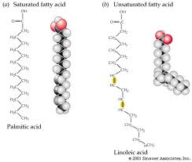
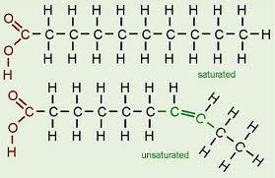
Lipids cont.
Fats separate from water because water molecules form hydrogen bonds with each other and exclude the fats
Fatty acids vary in length (number of carbons) and in the number and locations of double bonds
Saturated fatty acids have the maximum number of hydrogen atoms possible and no double bonds
Unsaturated fatty acids have one or more double bonds
The major function of fats is energy storage

Slide 40
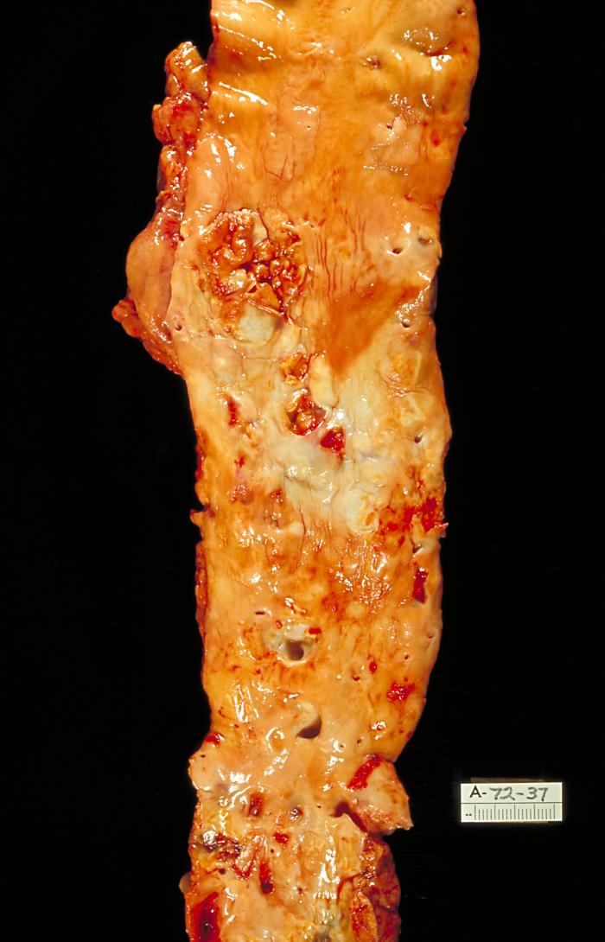
Lipids cont.
Fats made from saturated fatty acids are called saturated fats
Most animal fats are saturated
Saturated fats are solid at room temperature
A diet rich in saturated fats may contribute to cardiovascular disease through plaque deposits

Slide 41
Lipids
Fats made from unsaturated fatty acids are called unsaturated fats
Plant fats and fish fats are usually unsaturated
Plant fats and fish fats are liquid at room temperature and are called oils

Slide 42
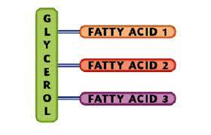
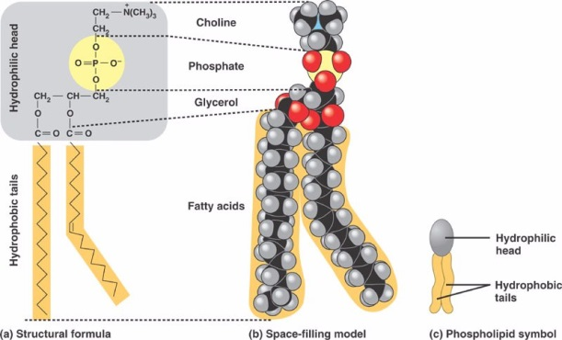
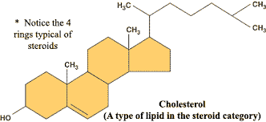
Types of Lipids
Fatty Acids + another compound
Triglycerides
Main form of energy storage in animals
Glycerol molecule plus 3 fatty acids
Phospholipids
A hydrocarbon chain with a phosphate group
Responsible for the structure of cell membrane
Steroids
Make up cholesterol and other hormones

Slide 43
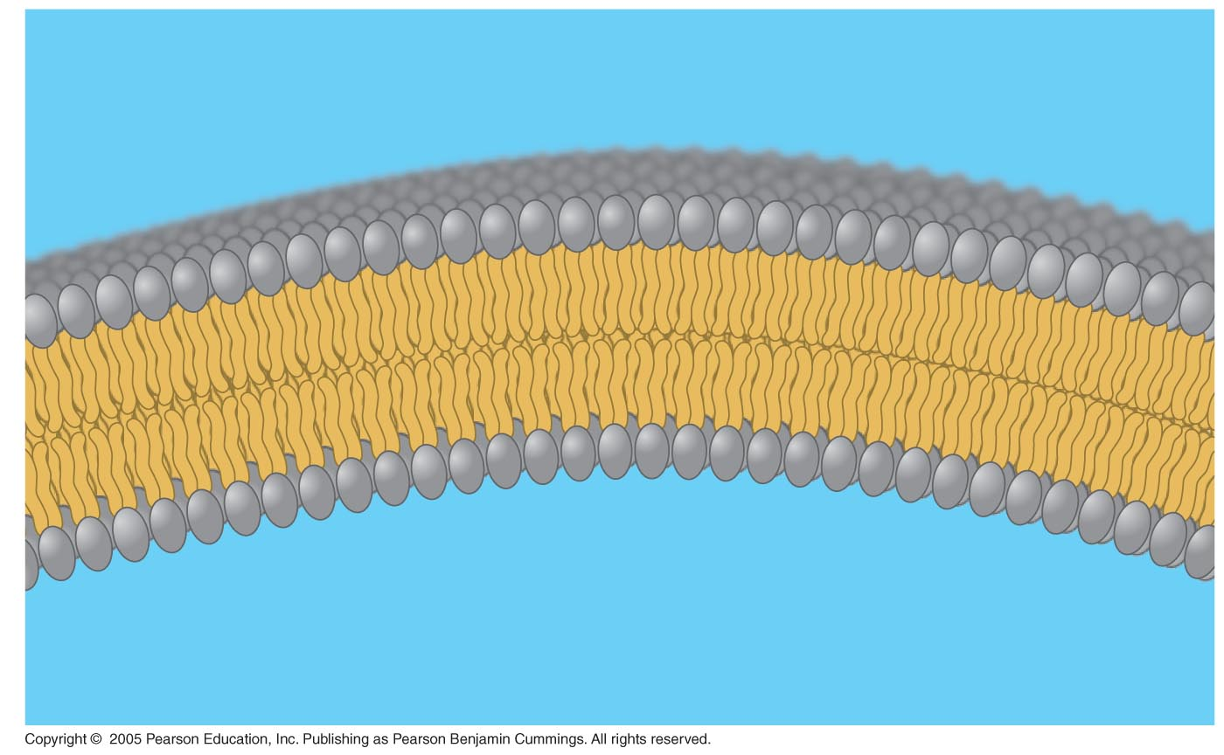
Lipids cont. (Phospholipids)
In phospholipids, the two fatty acid tails are hydrophobic, but the phosphate group (remember the functional group?) and its attachments form a hydrophilic head

Slide 44
Check for understanding
Are lipids hydrophobic or hydrophillic?
EXPLAIN WHY
What functional group is attached to lipids?

Slide 45
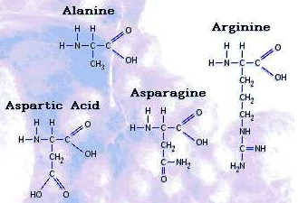
Proteins
Proteins are made of Amino Acids
There are 20 different amino acids. Each having a similar general structure - Differ only in their “R” groups (They have the same amino and carboxyl functional group)
Notice these are the only macromolecules with NITROGEN

Slide 46
Peptide Bonds
Amino acids form proteins via dehydration synthesis forming peptide bonds
Two amino acids linked together are called dipeptides
More than 2 linked together are called polypeptides - polypeptides can be thousands of amino acids long

Slide 47
Proteins
Proteins account for more than 50% of the dry mass of most cells (15% of our total body mass)
Protein functions include structural support, storage, transport, cellular communications, movement, and defense against foreign substances

Slide 48
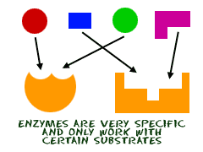
Proteins cont.
Enzymes are a type of protein that acts as a catalyst, speeding up chemical reactions
Enzymes can perform their functions repeatedly, functioning as workhorses that carry out the processes of life
Operate most efficiently under certain, ideal conditions (which are individual for each enzyme)
Factors include substrate concentration, pH, and temp.

Slide 49
Proteins cont.
The primary structure of a protein is its unique sequence of amino acids
Secondary structure, found in most proteins, consists of coils and folds in the polypeptide chain
Tertiary structure is determined by interactions among various side chains (R groups)
Quaternary structure results when a protein consists of multiple polypeptide chains

Slide 50
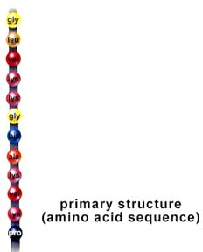
Primary Structure
Primary Structure of a protein is it’s sequence of amino acids
Primary Structure dictates all further levels of protein structure

Slide 51
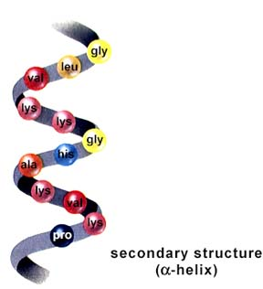
Secondary Structure
The Sequence (primary structure) causes parts of a protein molecule to fold into sheets or bend into helix shapes - this is a protein’s Secondary Structure.

Slide 52
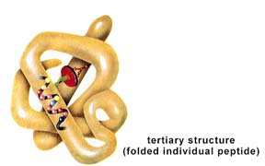
Tertiary Structure
The protein then can compact and twist on itself to form a mass called it’s Tertiary Structure

Slide 53
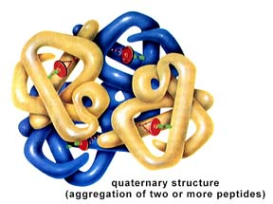
Quaternary Structure
Several Proteins then can can combine and form a protein’s Quaternary Structure
Various conformations are usually caused by the formation of hydrogen or disulfide bonds.
PH, changes or heat can disrupt these bonds, permanently denaturing the protein.

Slide 54
Proteins cont.
A slight change in primary structure can affect a protein’s conformation and ability to function
Sickle-cell disease, an inherited blood disorder, results from a single amino acid substitution in the protein hemoglobin

Slide 55
Check for understanding
What are the monomers (building blocks) for proteins?
How many are there?

Slide 56
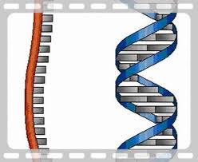
Nucleic Acids
The amino acid sequence of a polypeptide is programmed by a unit of inheritance called a gene
(genes create a message that tells the amino acids how to hook together and what to make)
Genes are made of DNA, a nucleic acid

Slide 57
Nucleic Acids cont.
There are two types of nucleic acids:
Deoxyribonucleic acid (DNA)
Ribonucleic acid (RNA)
DNA provides directions for its own replication
DNA directs synthesis of messenger RNA (mRNA) and, through mRNA, controls protein synthesis
Protein synthesis occurs in ribosomes
Synthesis of
mRNA in the nucleus
Movement of
mRNA into cytoplasm
via nuclear pore
Synthesis
of protein

Slide 58
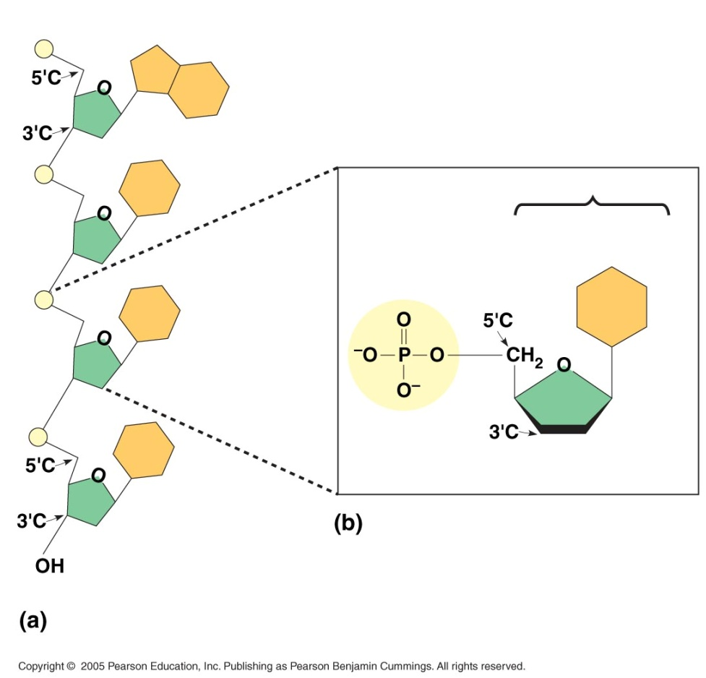
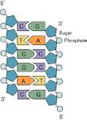
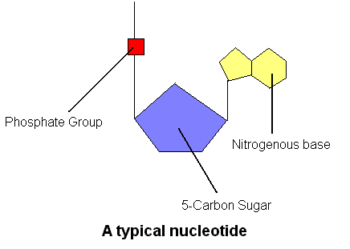
Nucleotides
DNA is formed from Nucleotides
These are made of 3 components
A 5-Carbon Sugar
A Nitrogenous base
A Phosphate group
Draw and label a nucleotide!

Slide 59
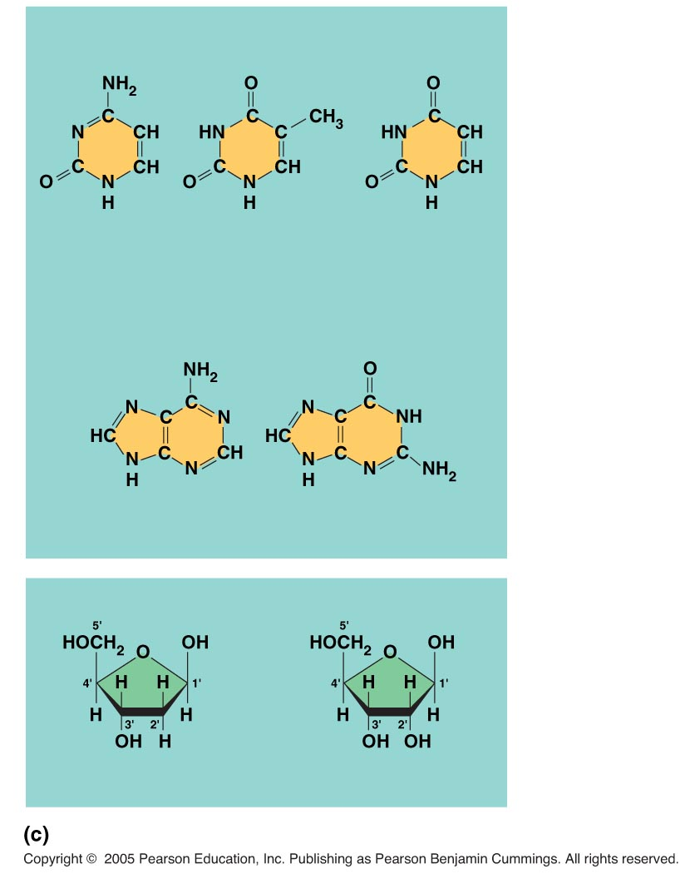
Nucleic Acids cont.
Nucleotide monomers are made up of nucleosides and phosphate groups
There are two families of nitrogenous bases:
Pyrimidines have a single six-membered ring
Purines have a six-membered ring fused to a five-membered ring
In DNA, the sugar is deoxyribose
In RNA, the sugar is ribose

Slide 60
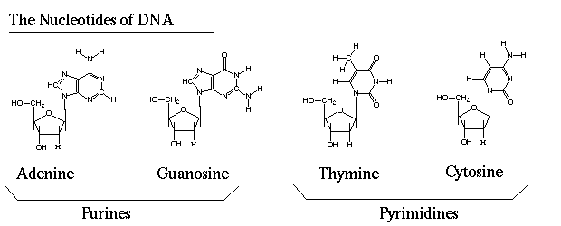
Types of Nucleotides
For DNA There are 4 different Nucleotides categorized as either Purines (double ring) or Pyramidines (single ringed). These are usually represented by a letter. These Are:
Adenine (A)
Cytosine (C)
Guanine (G)
Thymine (T)

Slide 61
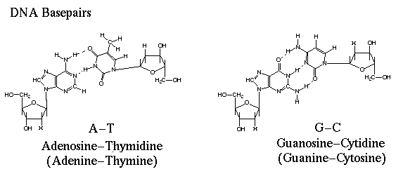
Base Pairing Rules
Each "Rung" of the DNA "staircase" is formed by the linking of 2 Nucleotides through Hydrogen Bonds.
These Hydrogen bonds form only between specific Nucleotides. This is known as Base Pairing. The rules are as follows:
Adenine (A) will ONLY bond to Thymine (T)
Cytosine (C) will ONLY bond to Guanine (G)

Slide 62
Summary of DNA Structure

Slide 63
RNA
AKA ribonucleic acid
RNA differs from DNA in several important ways.
It is much smaller
It is single-stranded
It does NOT contain Thymine, but rather a new nucleotide called Uracil which will bind to Adenine.
It uses ribose instead of deoxyribose sugar

Slide 64
Nucleic Acids cont.
The linear sequences of nucleotides in DNA molecules are passed from parents to offspring
Two closely related species are more similar in DNA than are more distantly related species
Molecular biology can be used to assess evolutionary kinship

Slide 65
Stop and Review
Draw a poster that contains all 4 macromolecues. Include their structure, function, and a brief description.

