Slide 1
Big Idea 3 Essential knowledge 3.A.2 (c)
Ch. 13 - Meiosis

Slide 2
What you must know
The difference between asexual and sexual reproduction.
The role of meiosis and fertilization in sexually reproducing organisms.
The importance of homologous chromosomes to meiosis.
How the chromosome number is reduced from diploid to haploid through the stages of meiosis.
Three important differences between mitosis and meiosis.
The importance of crossing over, independent assortment, and random fertilization to increasing genetic variability.

Slide 3
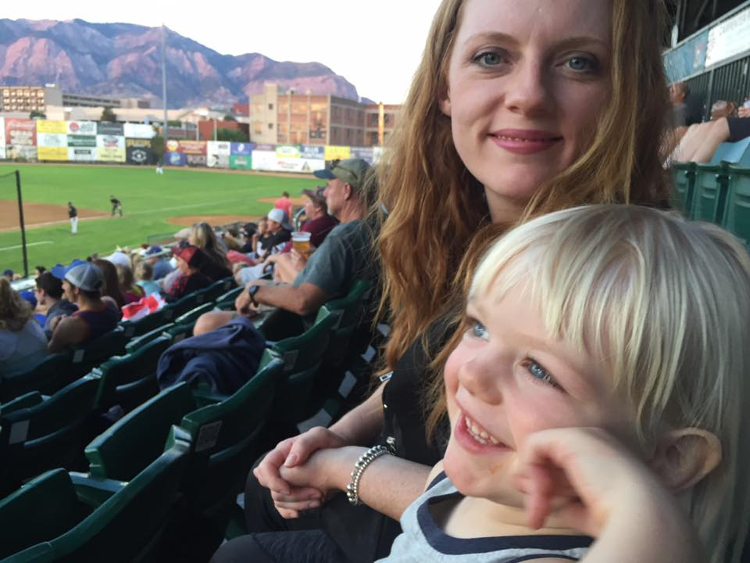
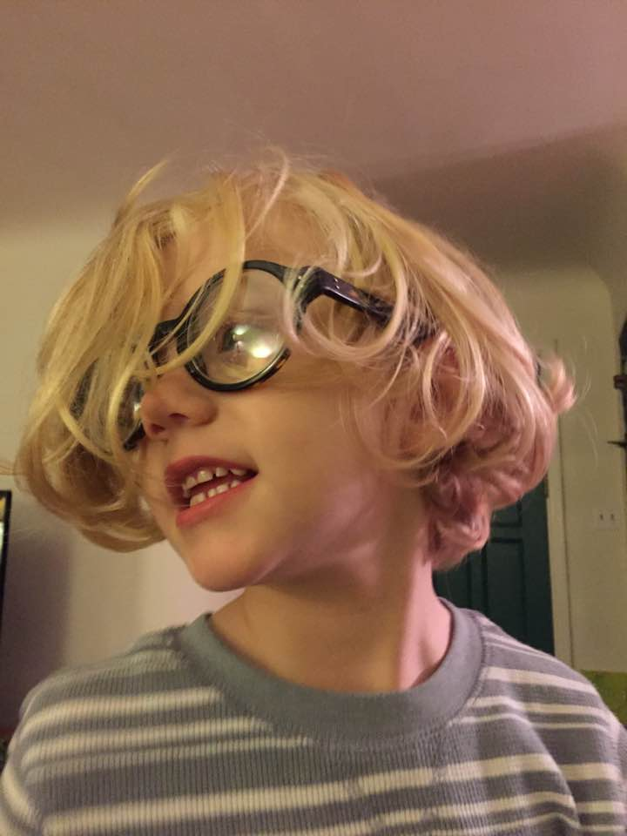
Genes: segments of DNA that code for basic units of heredity
Offspring acquire genes from parents by inheriting chromosomes
Each chromosome has hundreds or thousands of genes, each of which play a role in determining the characteristics and functions of the cell
Different forms of a gene are called ALLELES

Slide 4
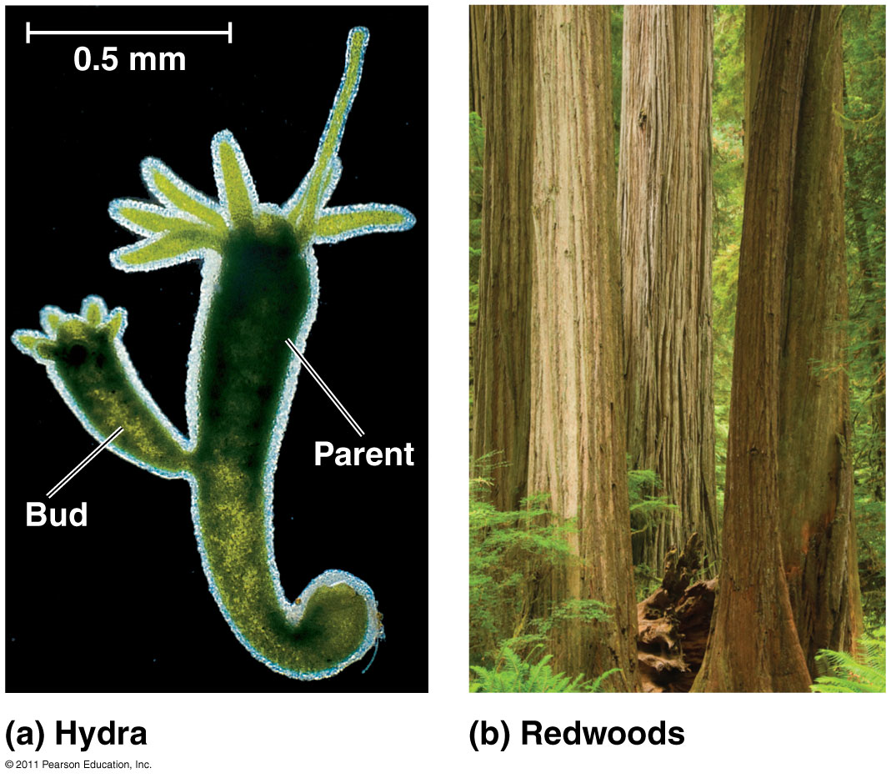
Types of Reproduction
ASEXUAL
Produces clones (genetically identical)
Single parent
Little variation in population - only through mutations
Fast and energy efficient
Eg. budding, binary fission
SEXUAL
Meiosis produces gametes (sex cells)
2 parents: male/female
Lots of variation/diversity
Slower and energy consumptive
Eg. humans, trees

Slide 5
Chromosomes
Somatic (body) cell: 2n = 46 chromosomes
Each pair of homologous chromosomes includes 1 chromosome from each parent
Autosomes: 22 pairs of chromosomes that do not determine sex
Sex chromosomes: X and Y
Females: XX
Males: XY
Gametes (n=23): 22 autosomes + 1 sex chromosome
Egg: 22 + X
Sperm: 22 + X **or** 22 + Y

Slide 6
Homologous Chromosomes in a Somatic Cell

Slide 7
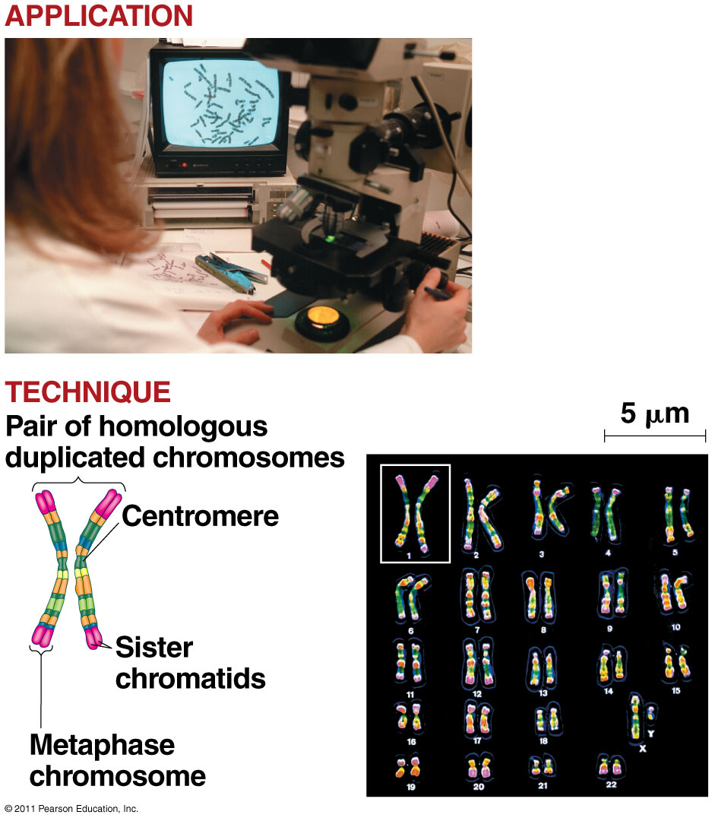
Karyotype: a picture of an organism’s complete set of chromosomes
Arranged from largest → smallest pair

Slide 8
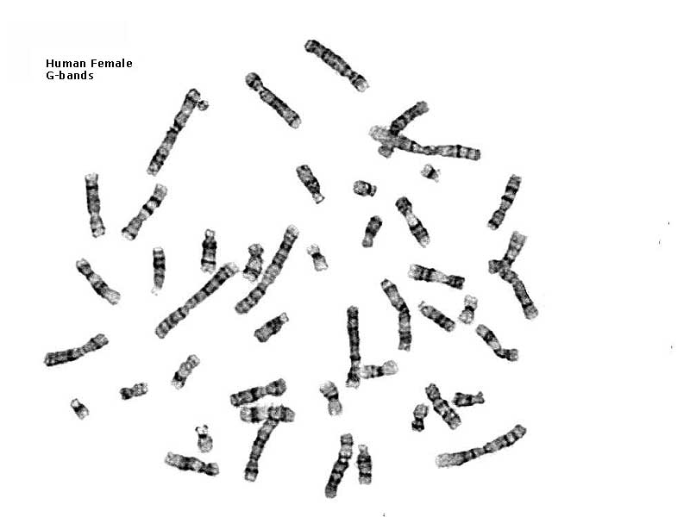
Making a karyotype – unsorted chromosomes

Slide 9
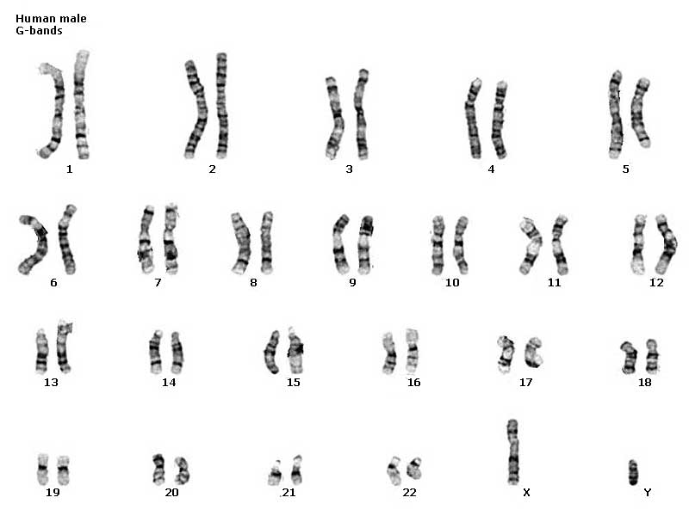
Male or female?

Slide 10
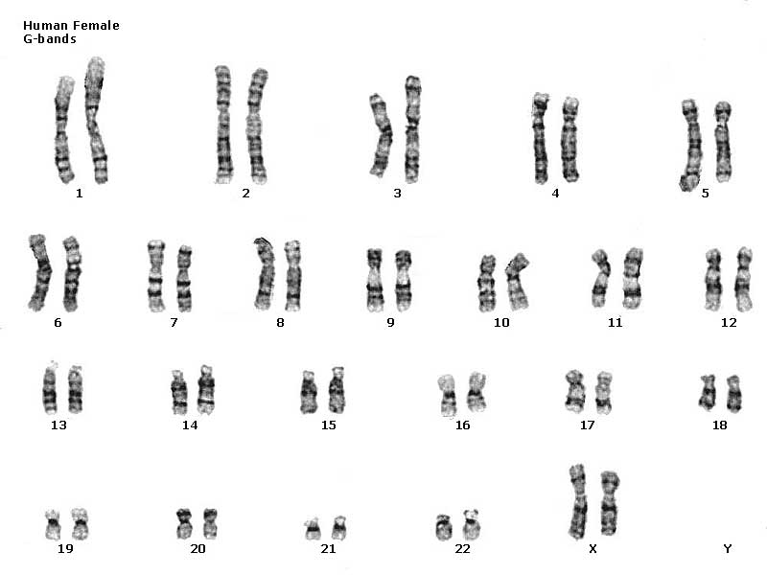
22 pairs of autosomes + 1 pair of sex chromosomes
Male or female?

Slide 11
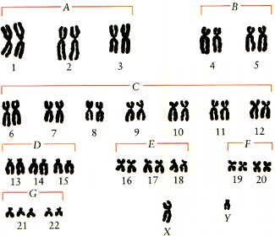
Karyotype - used to determine genetic abnormalities

Slide 12
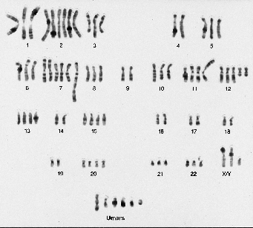
Cancer cells
Some have abnormal #’s of chromosomes
Karyotype of Metastatic Melanoma

Slide 13
Breast Cancer Cell Karyotype

Slide 14
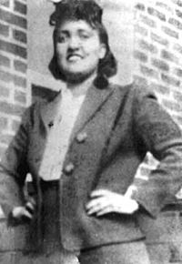
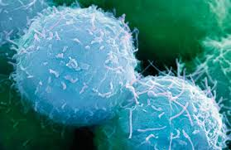
HeLa Cells
Oldest and most commonly used human cell line
Cervical cancer cells taken from Henrietta Lacks (d.1951)

Slide 15
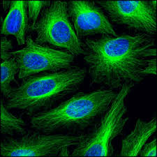
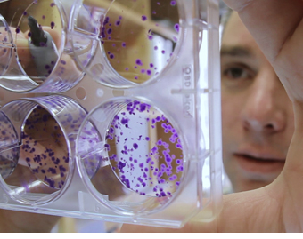
HeLa Cells
“Immortal” cells – do not die after a few divisions
Active version of telomerase
Used in research:
Develop vaccine for polio
Cancer, AIDS, virus, radiation research
Estimated that cells produced in culture exceeded # cells in Henrietta’s body

Slide 16
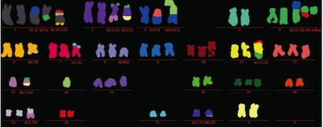
HeLa Cell Karyotype

Slide 18
HeLa Cells – Ethical Concerns
Controversy: Cells harvested without patient consent
“Discarded tissues can be commercialized” – sold for profit
Genome published in 2013 without family’s consent
“The Immortal Life of Henrietta Lacks” by Rebecca Skloot

Slide 19
https://www.youtube.com/watch?v=22lGbAVWhro

Slide 20
Life cycle: reproductive history of organism, from conception → production of own offspring
Fertilization and meiosis alternate in sexual life cycles
Meiosis: cell division that reduces # of chromosomes (2n → n), creates gametes
Fertilization: combine gametes (sperm + egg)
Fertilized egg = zygote (2n)
Zygote divides by mitosis to make multicellular diploid organism

Slide 21
Human Life Cycle

Slide 22
Varieties of Sexual Life Cycles

Slide 23
Overview
https://www.youtube.com/watch?v=mKWxeMMFTEU

Slide 24
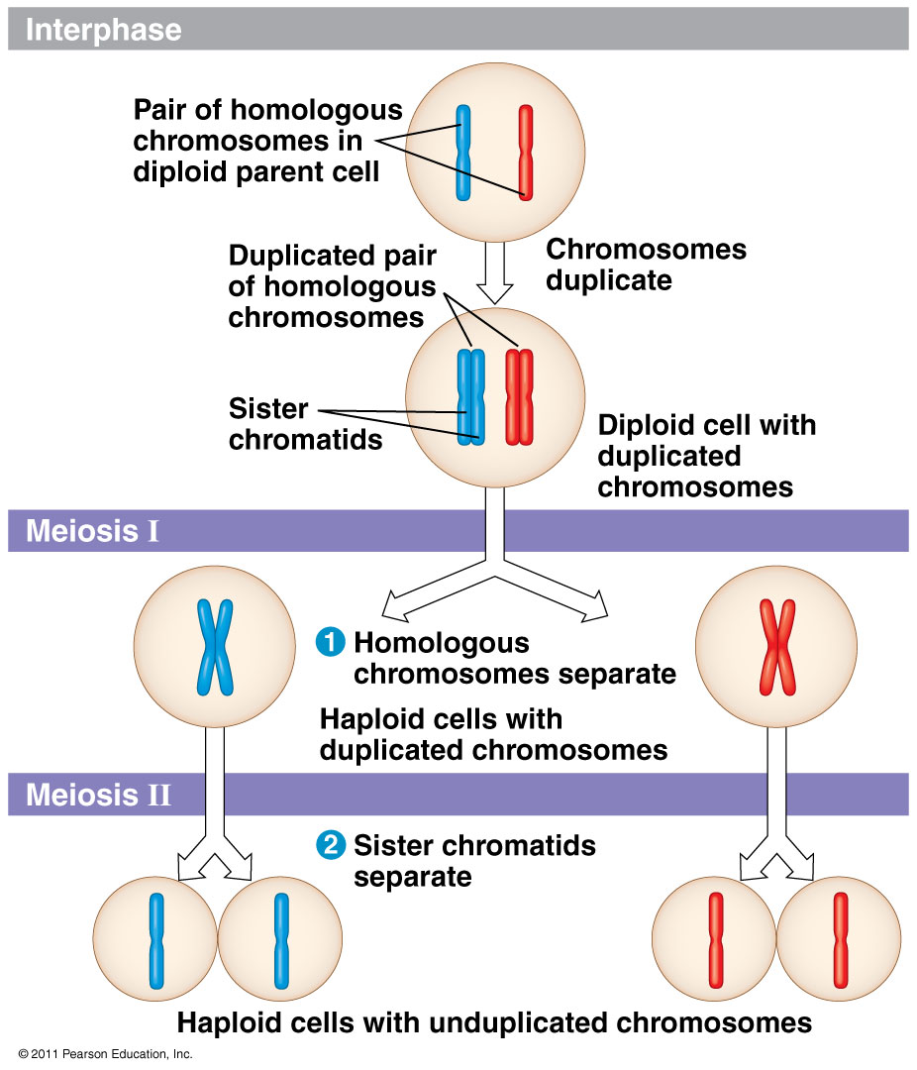
Meiosis = reduction division
Cells divide twice
Result: 4 daughter cells, each with half as many chromosomes as parent cell

Slide 25
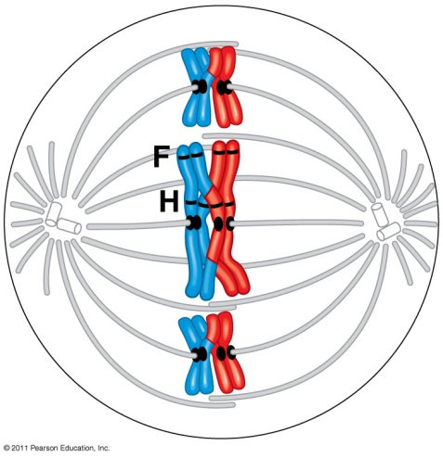
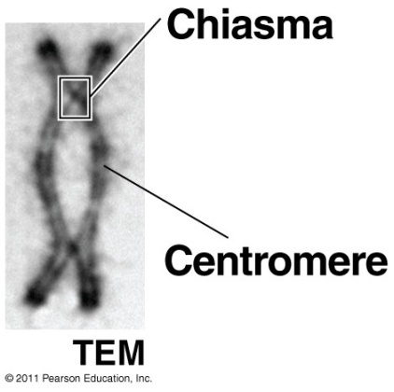
Meiosis I (1st division)
Interphase: chromosomes replicated
Prophase I:
Synapsis: homologous chromosomes pair up
Tetrad = 4 sister chromatids
Crossing over at the chiasmata
Metaphase I: Tetrads line up
Anaphase I:
Pairs of homologous chromosomes separate
(Sister chromatids still attached by centromere)
Telophase I & Cytokinesis:
Haploid set of chromosomes in each cell
Each chromosome = 2 sister chromatids
Some species: chromatin & nucleus reforms

Slide 26
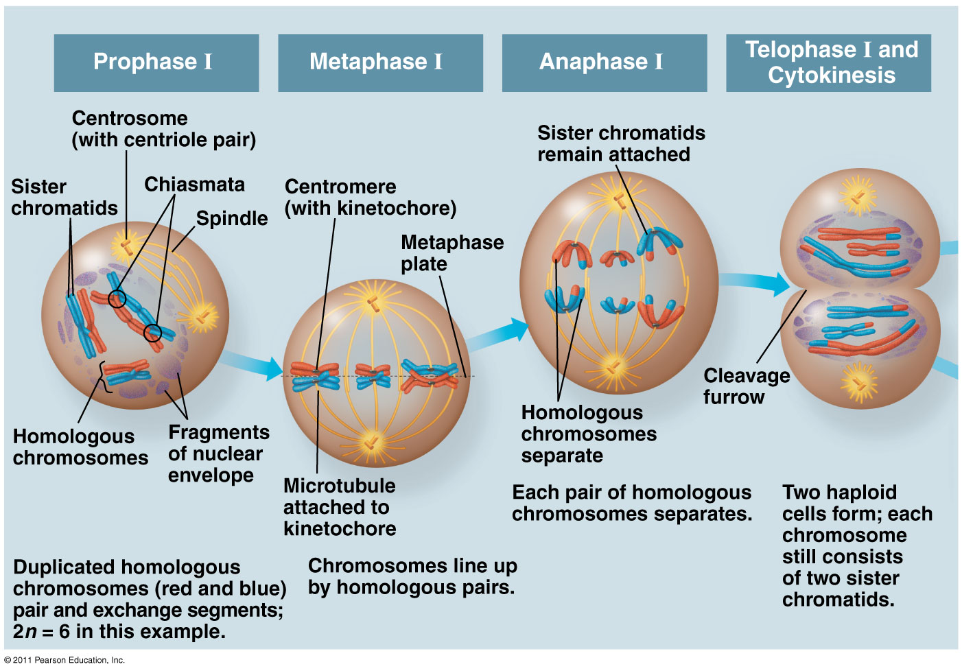

Slide 27
Meiosis II (2nd division) = create gametes
Prophase II:
No interphase
No crossing over
Spindle forms
Metaphase II:
Chromosomes line up
Anaphase II:
Sister chromatids separate
Telophase II:
4 haploid cells
Nuclei reappear
Each daughter cell genetically unique

Slide 29
Events Unique to Meiosis I (not in mitosis)
Prophase I: Synapsis and crossing over
Metaphase I: pairs of homologous chromosomes line up on metaphase plate
Anaphase I: homologous pairs separate → sister chromatids still attached at centromere

Slide 30
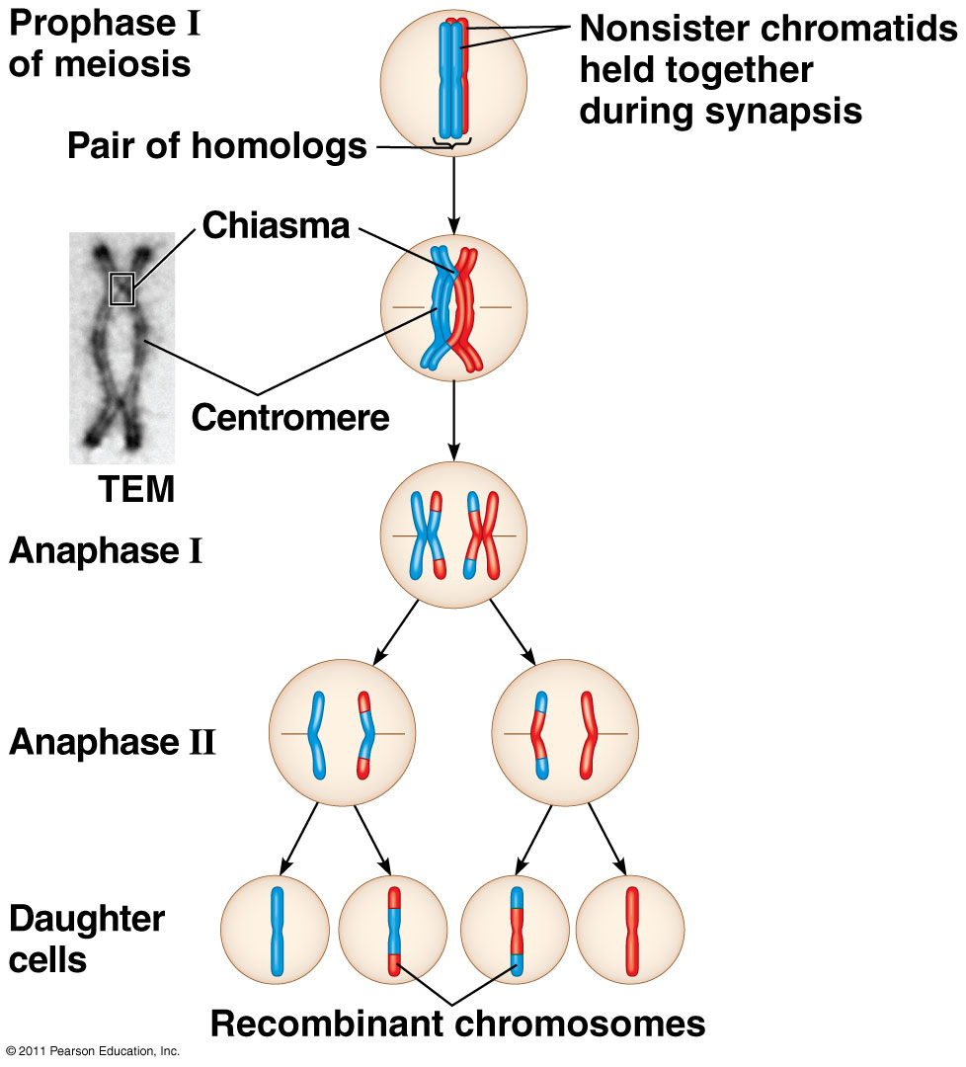
Sources of Genetic Variation:
Crossing Over
Exchange genetic material
Recombinant chromosomes

Slide 31
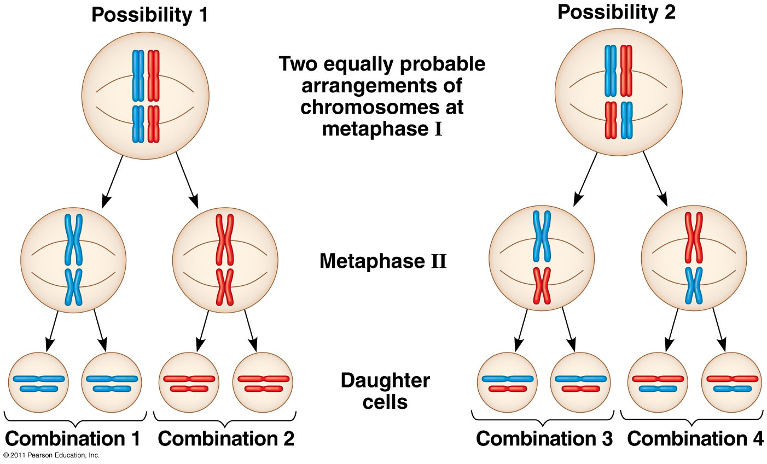
Sources of Genetic Variation:
Independent Assortment of Chromosomes
Random orientation of homologous pairs in Metaphase I

Slide 32
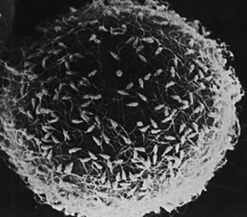
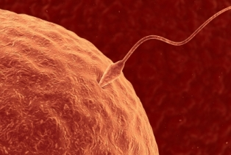
Sources of Genetic Variation:
Random Fertilization
Any sperm + Any egg
8 million X 8 million = 64 trillion combinations!

Slide 33
Mitosis Meiosis
Both are divisions of cell nucleus
Somatic cells
1 division
2 diploid daughter cells
Clones
From zygote to death
Purpose: growth and repair
No synapsis, crossing over
Gametes
2 divisions
4 haploid daughter cells
Genetically different-less than 1 in 8 million alike
Females before birth follicles are formed. Mature ova released beginning puberty
Purpose: Reproduction

Slide 34
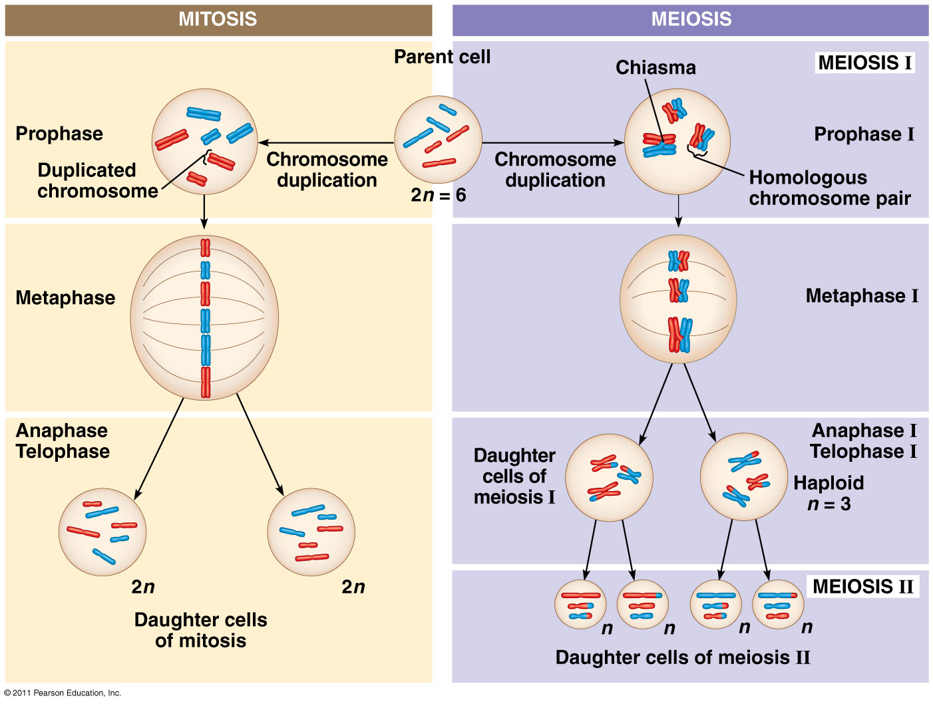

Slide 35
Review of Meiosis
https://www.youtube.com/watch?v=D1_-mQS_FZ0

Slide 36
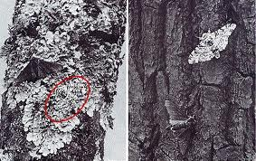
Importance of Meiosis
This process gives us our variation
Why would variation by important?

Slide 37
Mitosis vs. meiosis
https://www.youtube.com/watch?v=Ba9LXKH2ztU

Slide 38
Assignment 1
Create a Venn Diagram, and label AT LEAST 3 similarities and differences between mitosis and meiosis.

Slide 39
Mitosis Vs. Meiosis
Two divisions
Four haploid (n) cells formed.
Daughter cells are not genetically identical.
Occurs in reproductive cells (gametes)
Genetic diversity.
One Division
Two identical cells formed per cycle.
Genetically identical daughter cells.
Occurs only in body cells.
Cell growth and repair

Slide 40
Mitosis vs. Meiosis

Slide 41
Assignment
Models!

